Slide 1
Documentum training View Relationships & Batch Export Files
Michele Diederich
March 2024

Slide 2
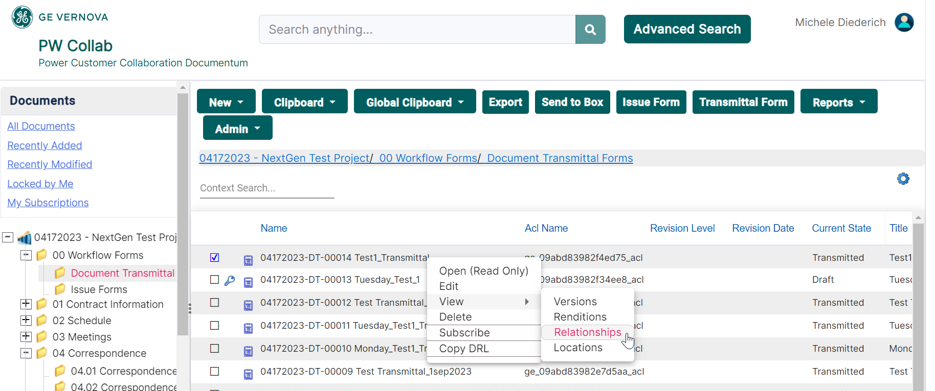
View Form Relationships
Select any Document Transmittal or Issue Form in the corresponding sub folder of the 00 Workflow Forms folder or the folder it was created in. Right click and select View > Relationships.

Slide 3
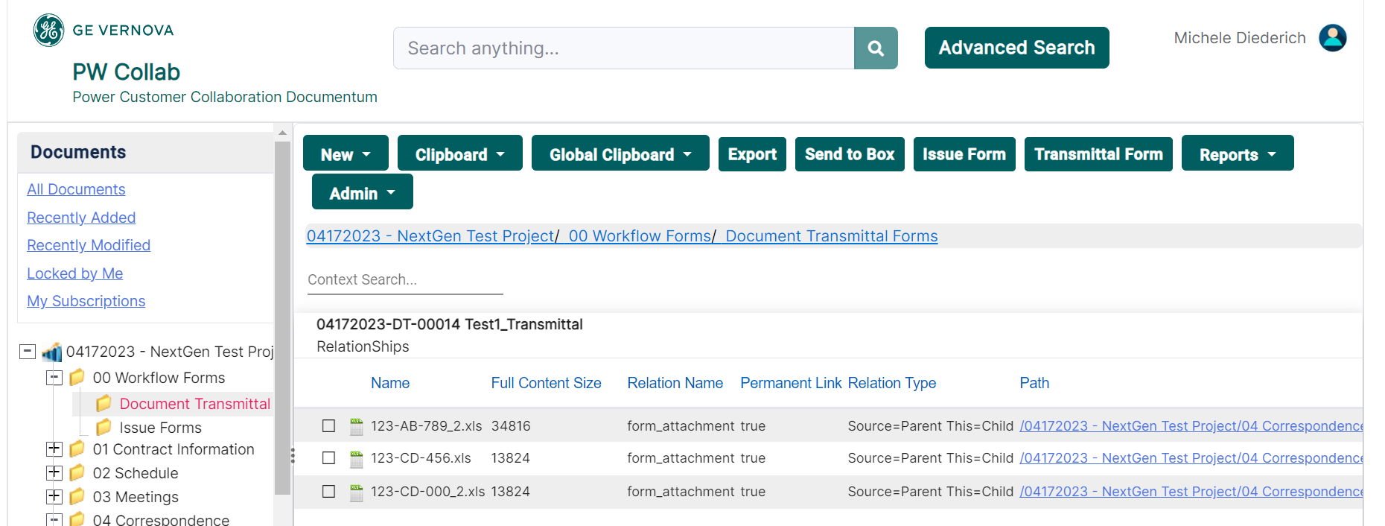
View Form Relationships
All files attached to the selected form will be listed.

Slide 4
Batch Export Files
Select all files to be Exported. Right click and select Export or select Export from the tool bar.

Slide 5
Batch Export Files
Files will be saved as a zip file in your default download location.

Slide 6
Documentum Support
If you encounter any issues with Documentum, please send an email to: ebusinesstechsupport@ps.ge.com and include the following information:
Full Name
Email Address
SSO
Project Name
Screen Shot of any Errors

