Slide 1
Documentum training Sync Files to Box
Michele Diederich
March 2024

Slide 2
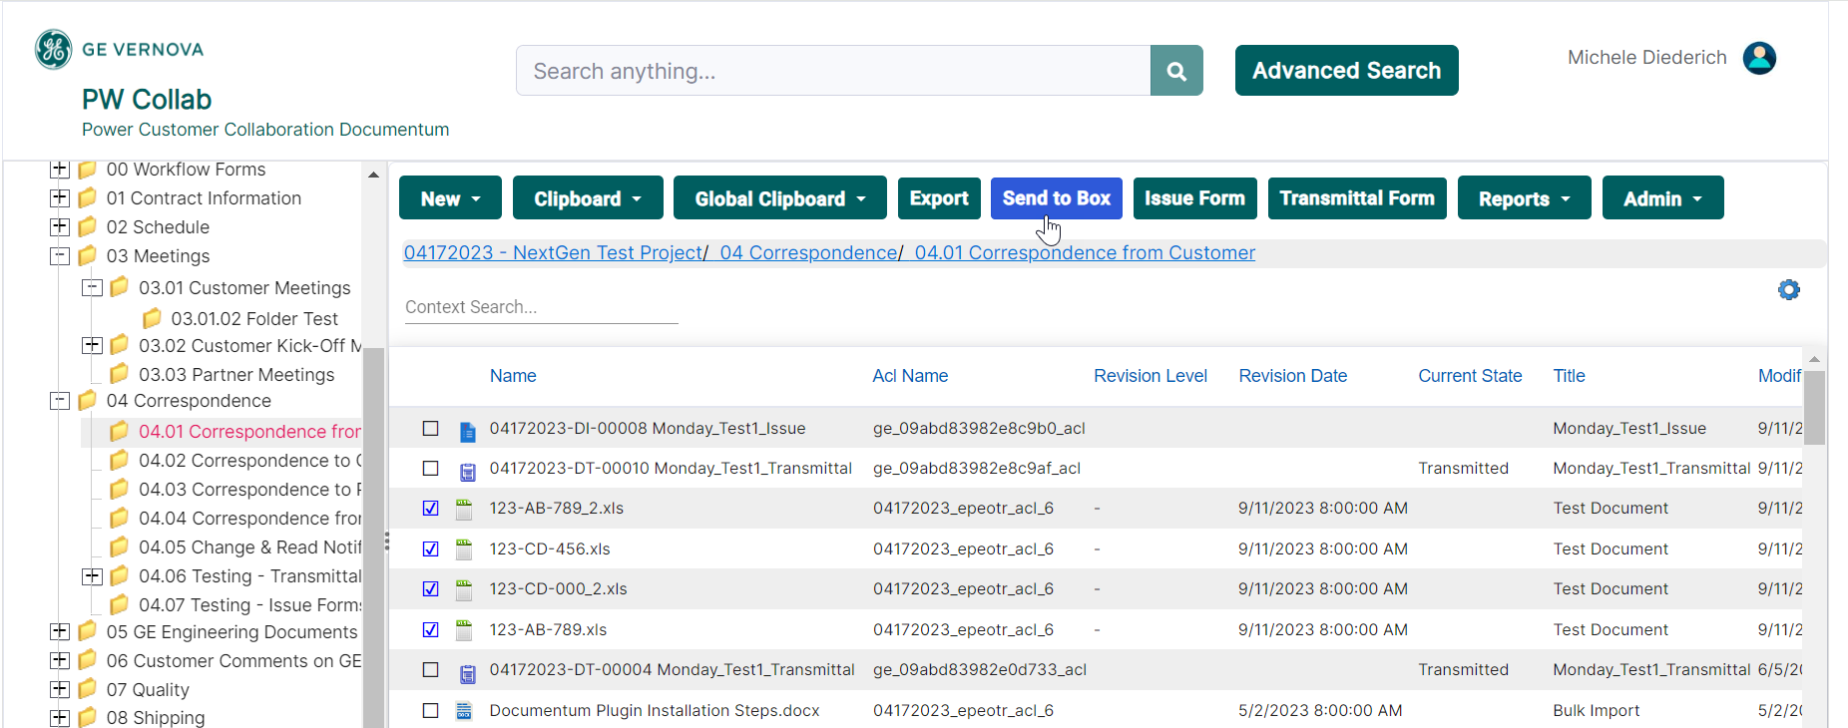
Synch Files to Box
Select the files(s) to sync, right click and select Export or one-way Synch to Box or click the Send to Box button. Only documents can be selected to sync.

Slide 3
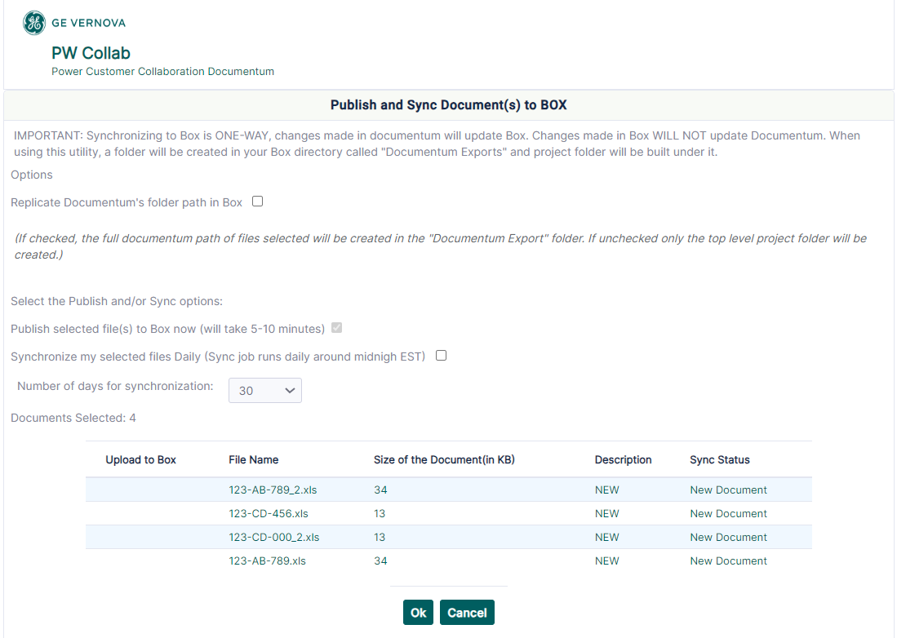
Synch Files to Box
Chose options and click OK. A confirmation email will be received within 5-10 minutes. The file will stop syncing if moved to a different folder or the original folder name is changed.

Slide 4
Documentum Support
If you encounter any issues with Documentum, please send an email to: ebusinesstechsupport@ps.ge.com and include the following information:
Full Name
Email Address
SSO
Project Name
Screen Shot of any Errors

