Slide 1
Documentum training Subscriptions
Michele Diederich
March 2024

Slide 2
Subscriptions
Subscriptions act as Favorites or Bookmarks. A user can subscribe to folders and/or documents. The Subscriptions node includes objects from all projects in the repository.
To open the Subscriptions window, click on My Subscriptions in the Navigation Tree. The subscribed folders/documents will populate in the Workspace.
Double click to open a file or navigate to a folder.
You can also perform other actions on the document with the right click functionality.

Slide 3
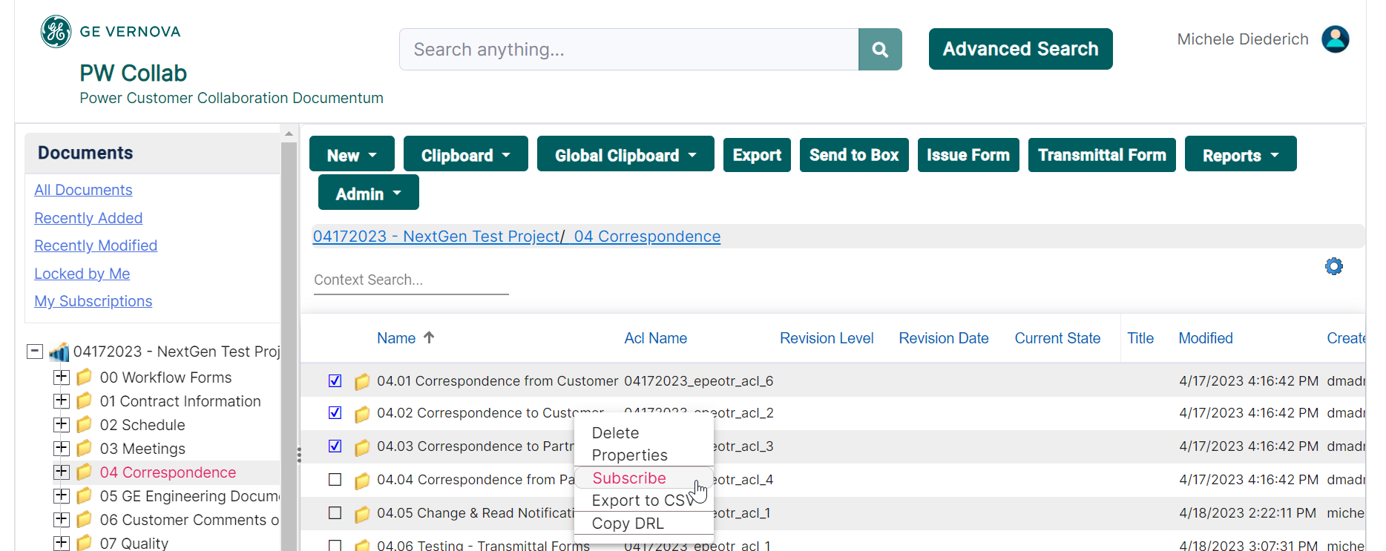
How to Subscribe
Navigate to and select the folder or file to subscribe to; multiple folders or files can be selected. Right click and select Subscribe. The folders or files will be linked in your My Subscriptions node.

Slide 4
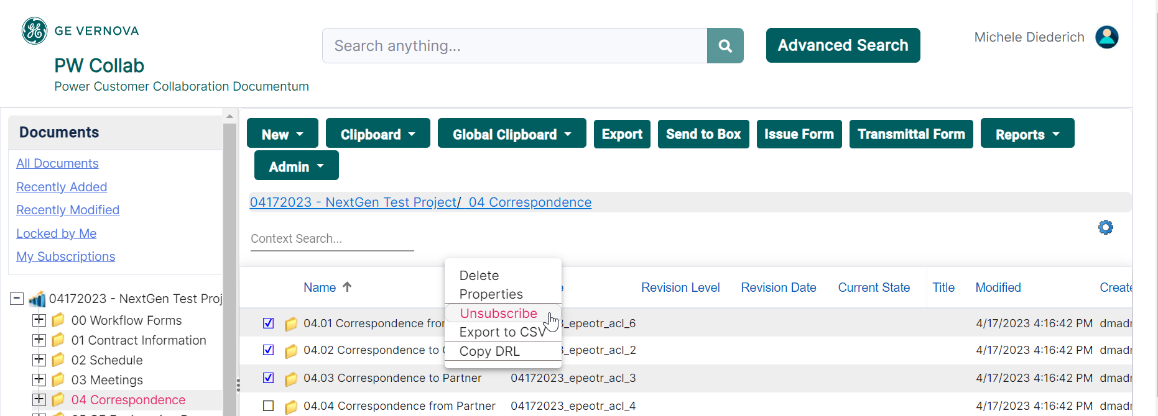
How to Unsubscribe
Navigate to and select the folder or file to unsubscribe; multiple folders or files can be selected. Right click and select Unsubscribe. The folders or files will be removed from your My Subscriptions node.

Slide 5
Documentum Support
If you encounter any issues with Documentum, please send an email to: ebusinesstechsupport@ps.ge.com and include the following information:
Full Name
Email Address
SSO
Project Name
Screen Shot of any Errors

