Slide 1
Documentum training Searching
Michele Diederich
March 2024

Slide 2
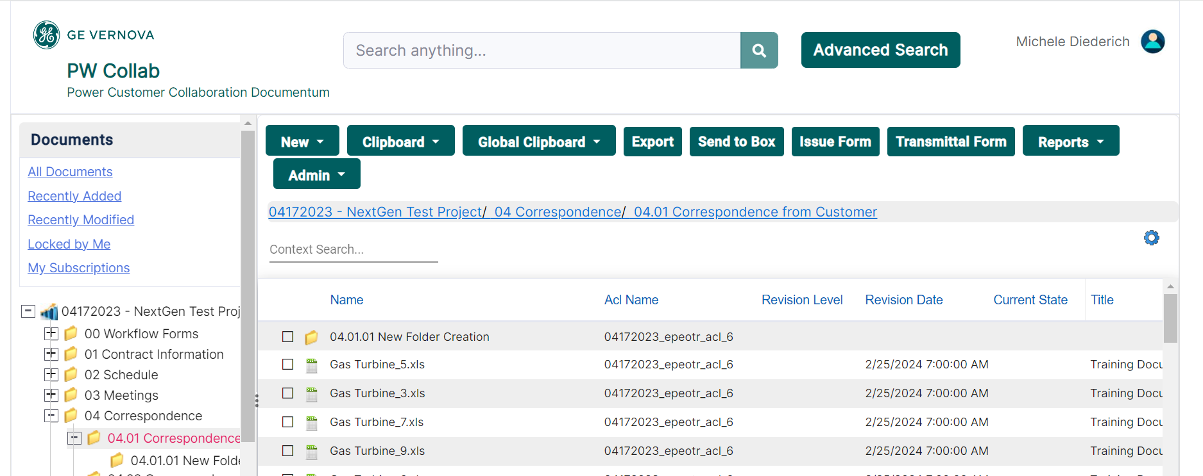
Context Search
The Context Search is a key word search on the Name and Title of documents and objects in the folder you are currently accessing. Type your key word in the search box and results will be listed.

Slide 3
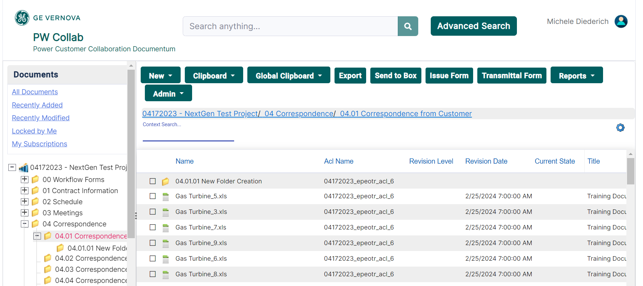
Simple Search
The Simple Search is located at the top of the page (in the middle). This search will search the Name, Title and Subject of all files and the content of any non-image files. The Simple Search searches the entire project you are currently accessing.

Slide 4
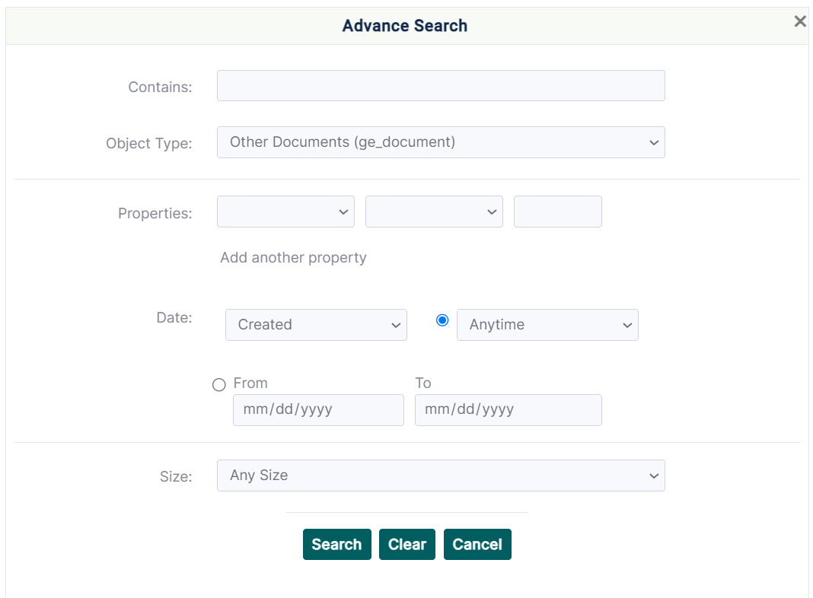
Advanced Search
The Advanced Search is located to the right of the Simple Search. This search allows you to set up customized searches based on file properties, date and size. The Advanced Search will search the entire project you are currently accessing. The Contains field allows you to search the content of any non-image files.

Slide 5
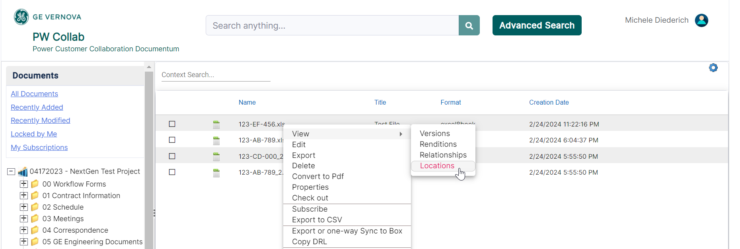
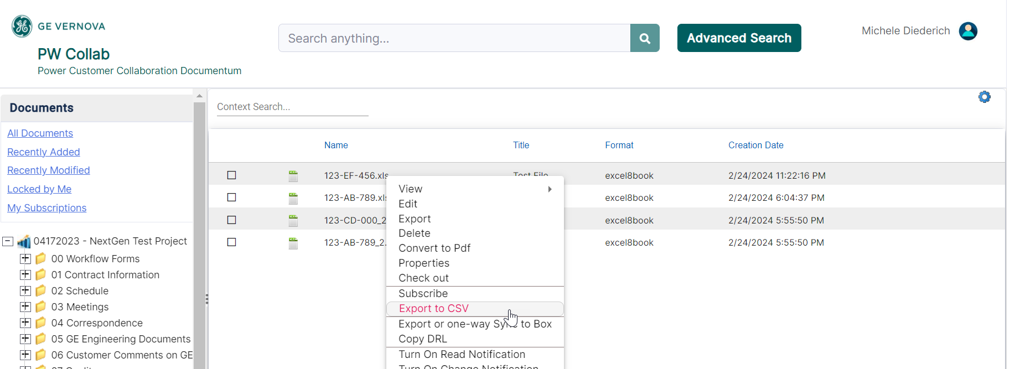
Exporting Search Results
To view the location of any file in the results, right click on the file and select View > Locations. The results from any Simple or Advanced Search can be exported to a CSV file. Right click anywhere in the search results and select Export to CSV and save in the desired location. The export will contain all file properties and can be sorted and filtered as needed.

Slide 6
Documentum Support
If you encounter any issues with Documentum, please send an email to: ebusinesstechsupport@ps.ge.com and include the following information:
Full Name
Email Address
SSO
Project Name
Screen Shot of any Errors

