Slide 1
Documentum training Opening PDF’s in a Program
Michele Diederich
March 2024

Slide 2
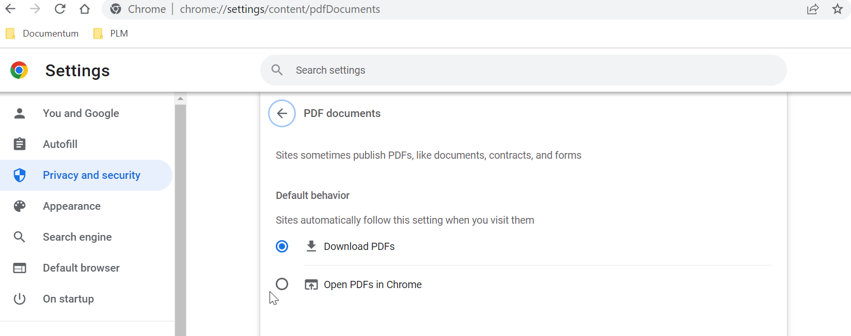
Opening PDF’s in Chrome
Open Chrome browser. Click the three dots in the upper right corner. Select Settings. Under Privacy and Security click Site Settings. Scroll down to PDF documents under Additional content settings and Select Download PDF’s.

Slide 3
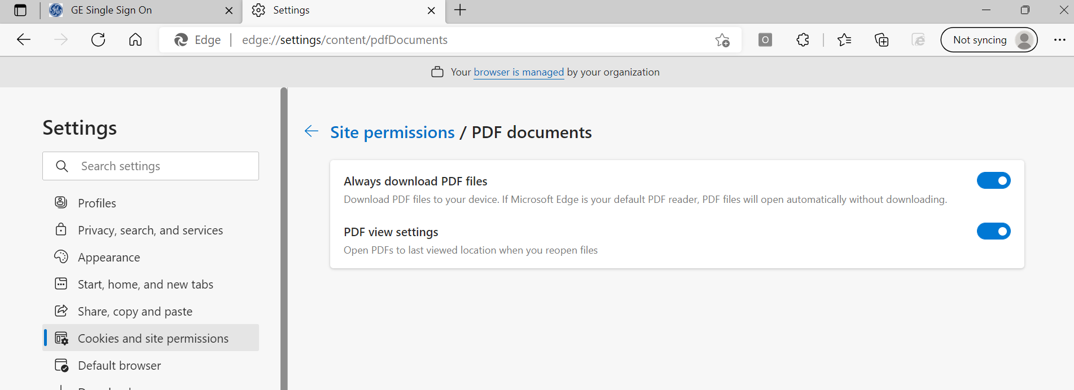
Opening PDF’s in Edge
Open Edge browser. Click the three dots in the upper right corner. Select Settings then select Cookies and site permissions. Scroll down to PDF documents and turn on Always download pdf files.

Slide 4
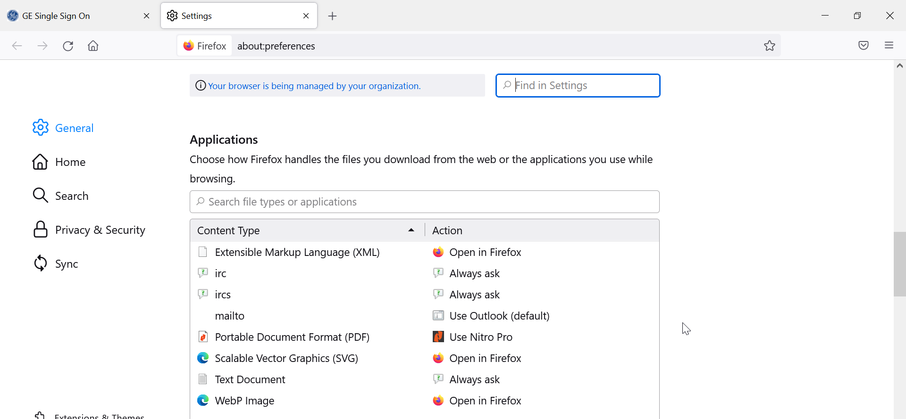
Opening PDF’s in Firefox
Open Firefox browser. Click the three lines in the upper right corner. Select Settings. Scroll down to Applications. Find Portable Document Format (PDF). In the Action column select Use Other and select the program you use to open PDF’s.

Slide 5
Documentum Support
If you encounter any issues with Documentum, please send an email to: ebusinesstechsupport@ps.ge.com and include the following information:
Full Name
Email Address
SSO
Project Name
Screen Shot of any Errors

