Slide 1
Documentum training Navigation and File basics
Michele Diederich
March 2024

Slide 2
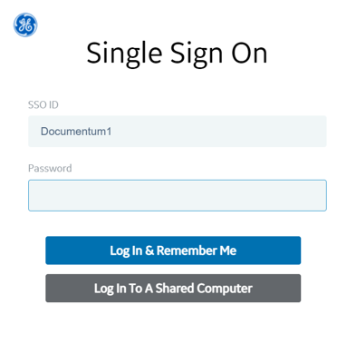
Login
Click the link for Power Customer Collaboration Documentum. Enter SSO, click Next, enter your password and click Log In.
Non-Export Control - https://collaborationspace.ge-energy.com/nextgenui/ Export Control - https://collaborationspace.ge-energy.com/nextgenuiec/

Slide 3
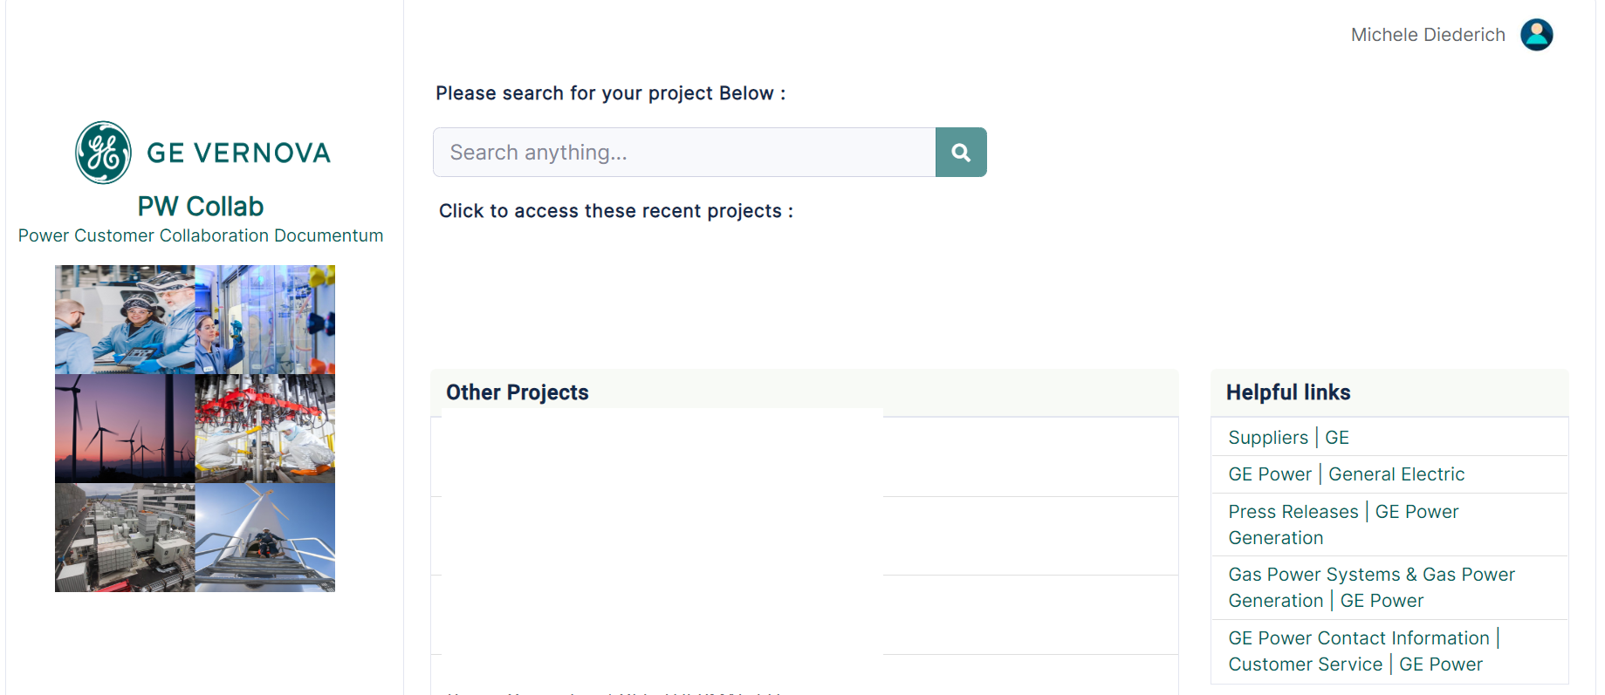
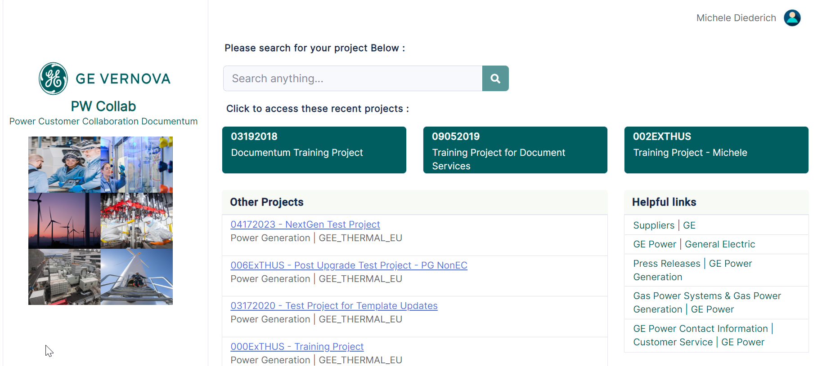
Access a Project
Enter the IPS# or project name in the Search anything box and click listed result to access a project (initial login will not have any project data listed). Subsequent logins will show recently accessed projects.

Slide 4
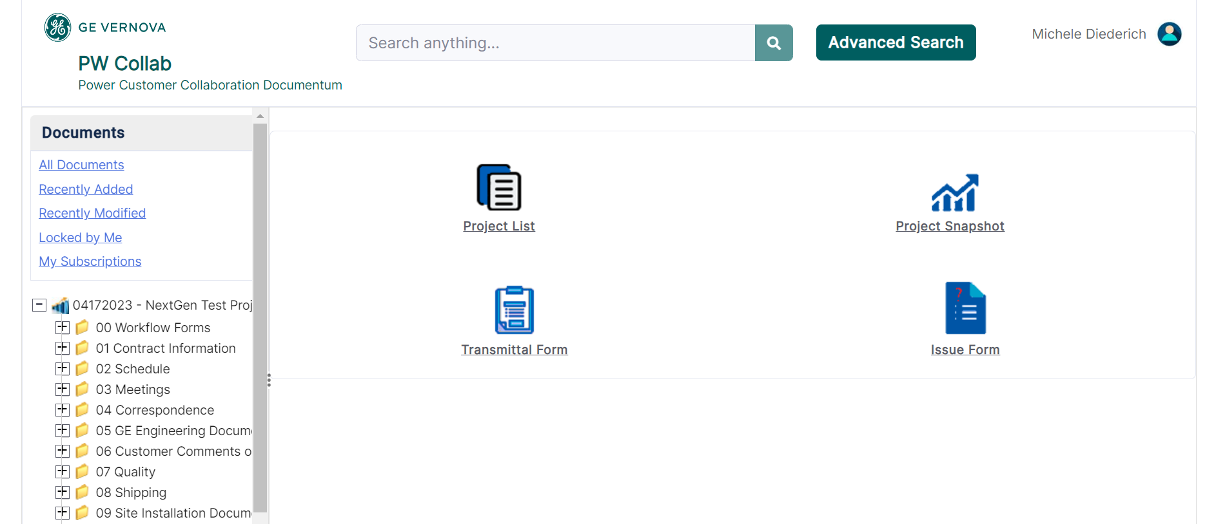
Review Home Page
The Home Page contains the project folder structure and shortcuts to Documents, Subscriptions, Project List, Project Snapshot and Forms.

Slide 5
Project List
Click the GE logo in the upper left corner of the page from anywhere in the project to return to the Home Page and access the Project List.

Slide 6
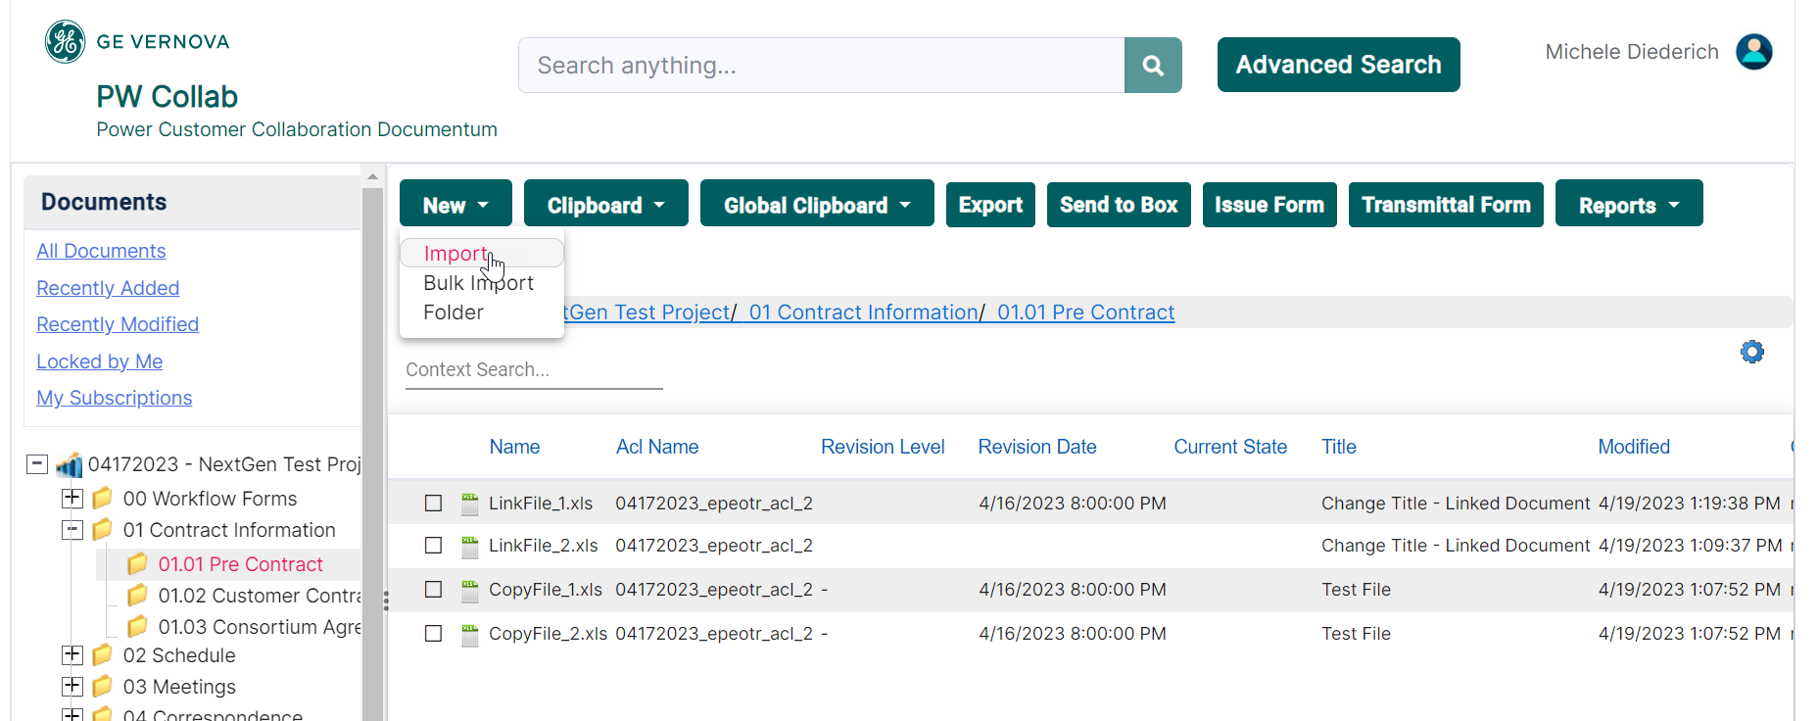
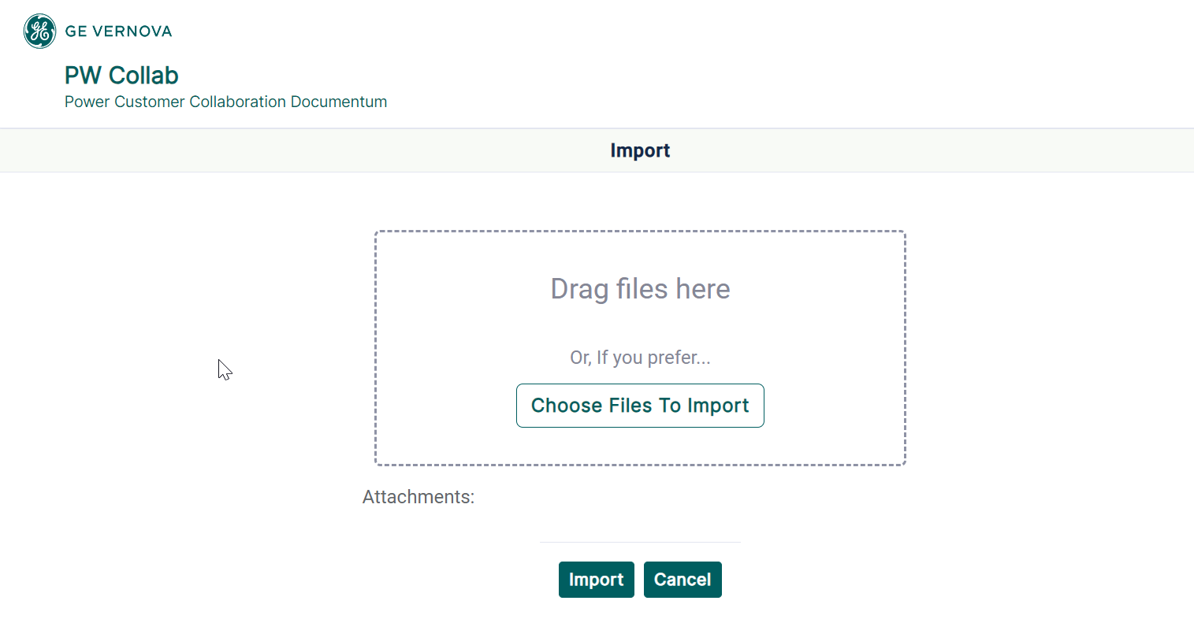
Import Files
Select folder where files will be imported to, click New > Import. You can either drag and drop files from your computer or click Chose Files To Import and locate the files on your computer.

Slide 7
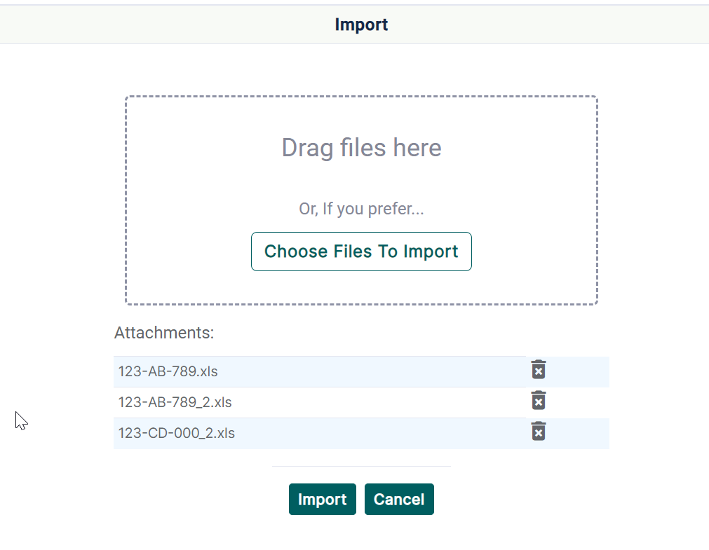
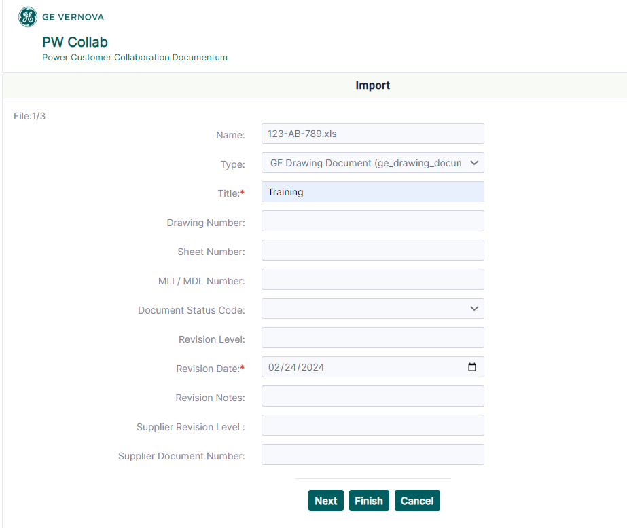
Import Files
Once files have been selected, click Import. Add required and optional properties and click Next or Finish. Next will allow you to add properties for each file in the import. Finish will apply the properties entered to all files in the import. All required fields are marked with a red asterisk.

Slide 8
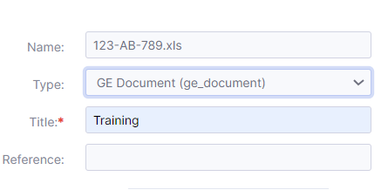
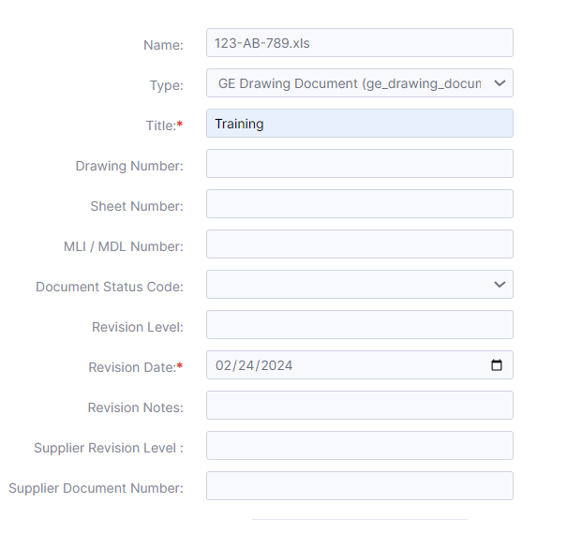
Import Files
During import a Type must be assigned to each file. The choices are GE Document or GE Drawing Document. The only difference in the two Types is the mandatory and optional properties that are included in the meta data.
GE Document (ge_document)
GE Drawing Document (ge_drawing_document)

Slide 9
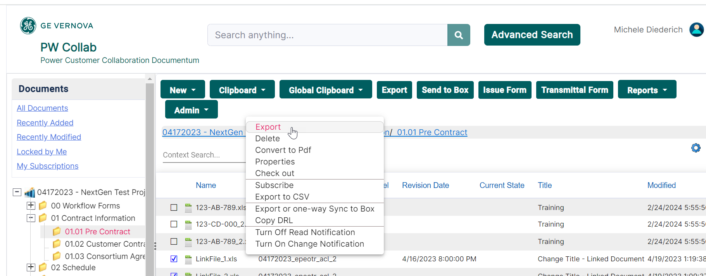
Export Files
Export files to save a copy on your computer. Select the file(s) to export, right click and select Export or click the Export button in the tool bar. The files will be saved in the default download location on your computer.

Slide 10
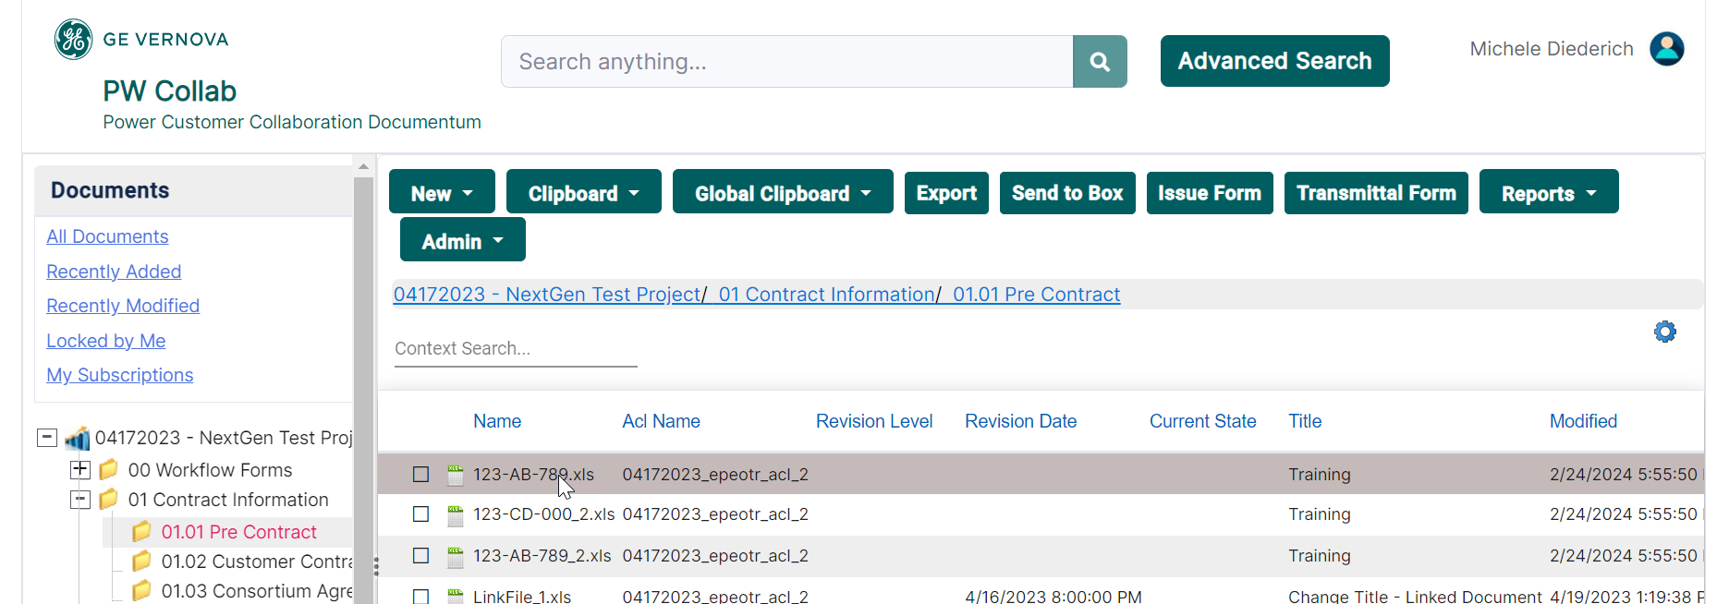
View Files
Double click on the file to be viewed. The file will be downloaded and can be opened for viewing.

Slide 11
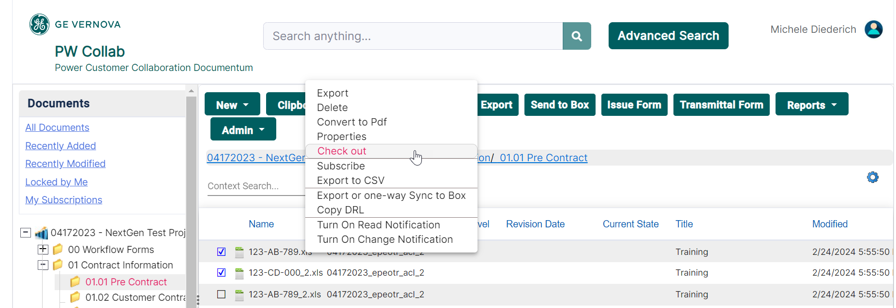
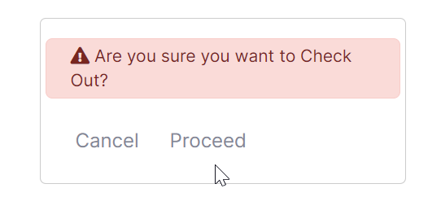
Check Out
Select file (multiple files maybe selected) to be checked out, right click and select Check Out > Proceed. The file will be saved in the default download location on your computer. The file will be locked, showing a key for the lock owner and a lock for all other users. Changes to the file cannot be made by other users while locked.

Slide 12
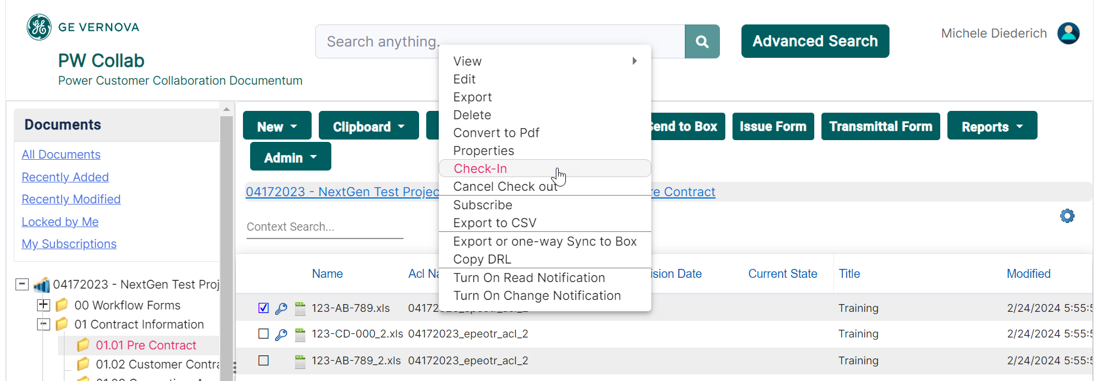
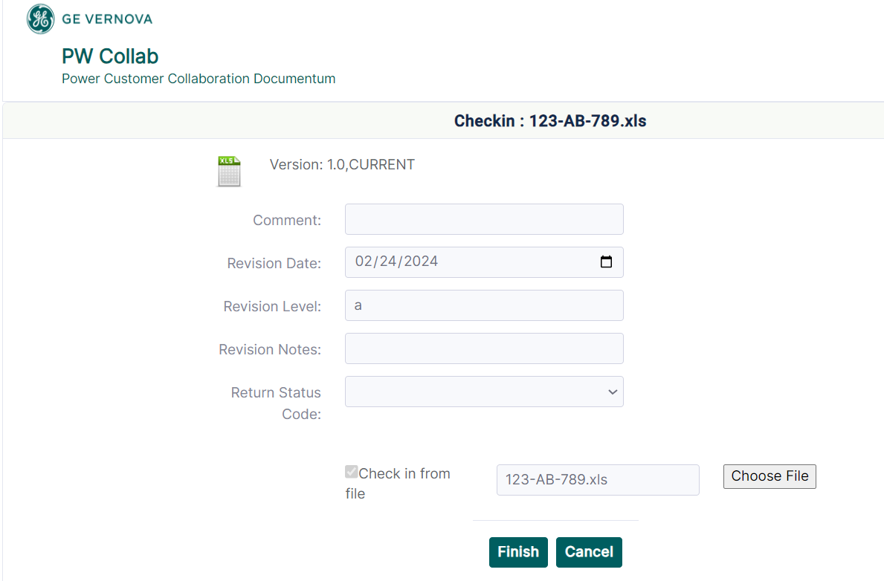
Check In
After making changes to the file on your computer or saving an updated version of the file on your computer, the file can be checked-in. Select the file to be checked-in, right click and select Check-In. Add meta data as needed and select Choose File, navigate to the saved version on your computer, select it and click Finish. The latest version of the file will now be shown in the folder.

Slide 13
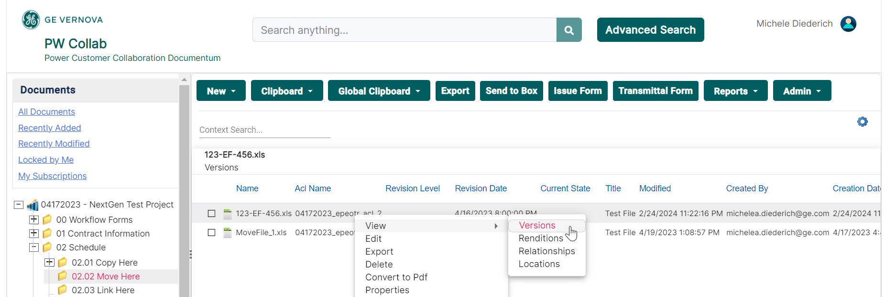
View Versions
Select file, right click and View > Versions. All versions of the file will be listed with a link to the folder location, or the file can be exported from the list.

Slide 14
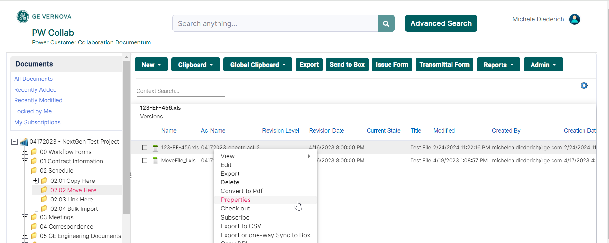
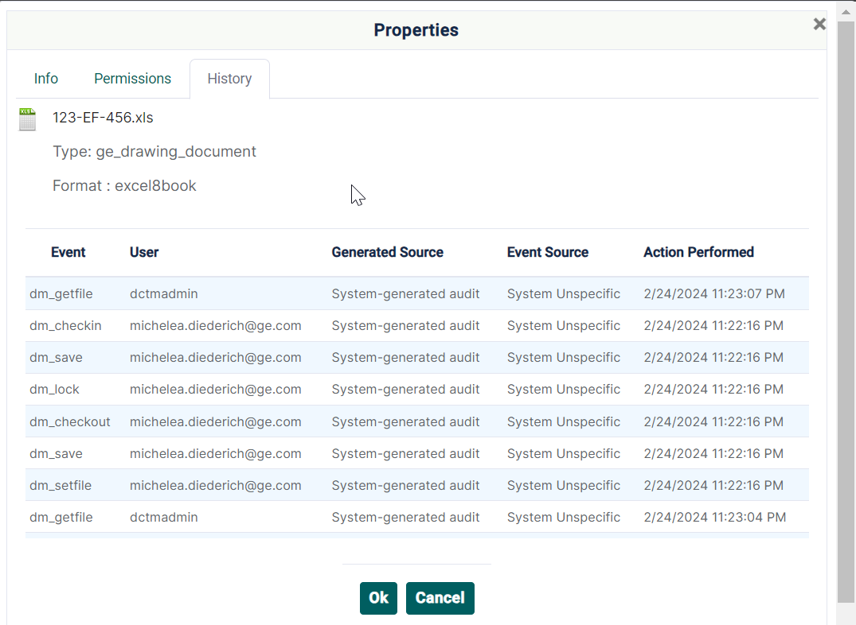
View File History
Select file, right click and select Properties. On the Properties page, click the History tab. The History tab lists all Events, Users and Date/Time of each event.

Slide 15
Documentum Support
If you encounter any issues with Documentum, please send an email to: ebusinesstechsupport@ps.ge.com and include the following information:
Full Name
Email Address
SSO
Project Name
Screen Shot of any Errors

