Slide 1
Documentum training Issue Form
Michele Diederich
March 2024

Slide 2
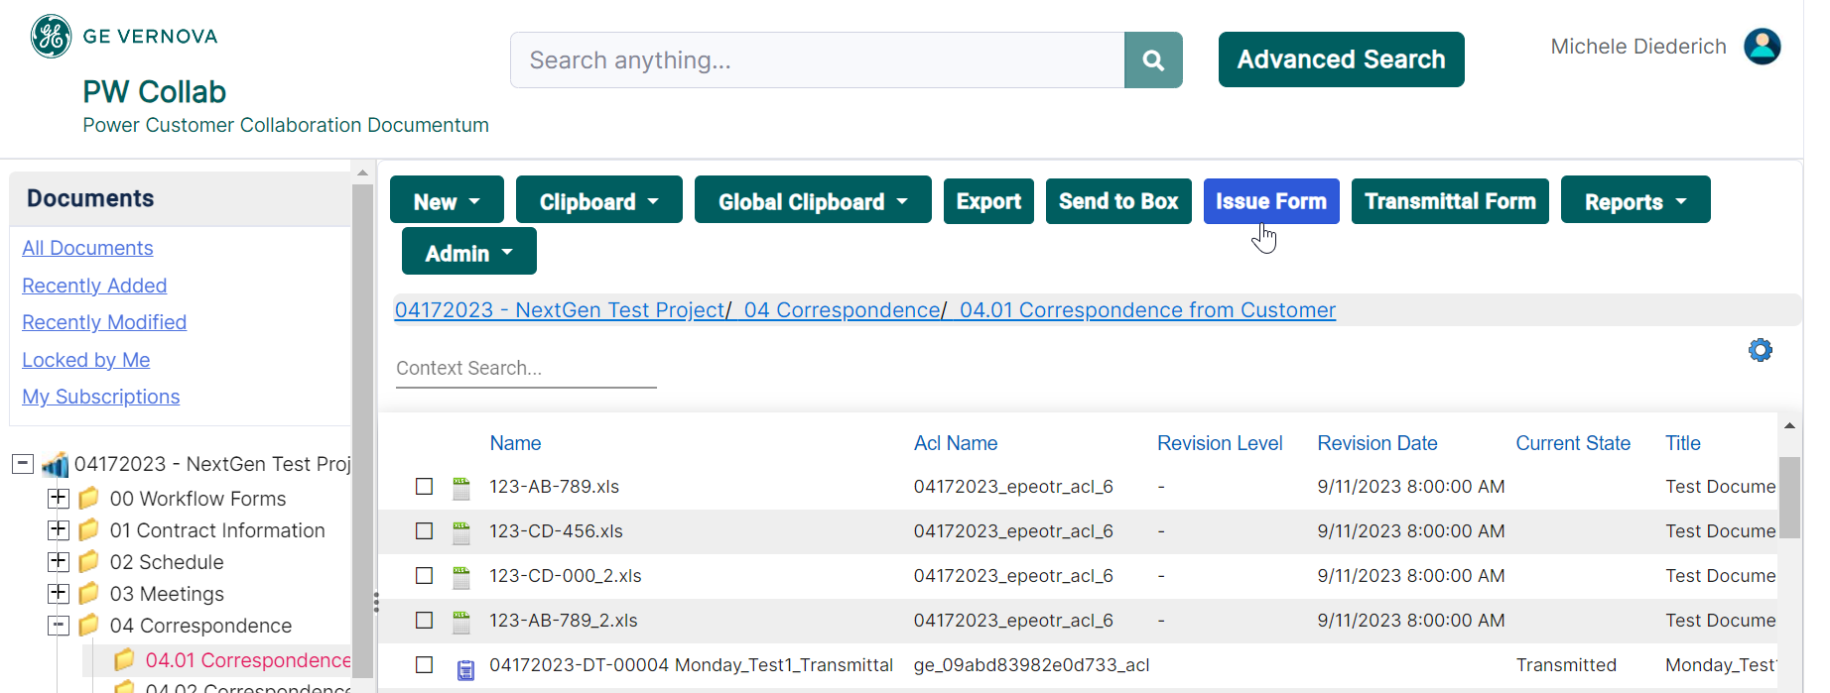
Create an Issue Form
Select the folder from the Navigation Tree where the form is to be created and click Issue Form in the tool bar. Note: Issue Forms are private; only the Creator, Issue Owner and Reviewers can view and access the form.

Slide 3
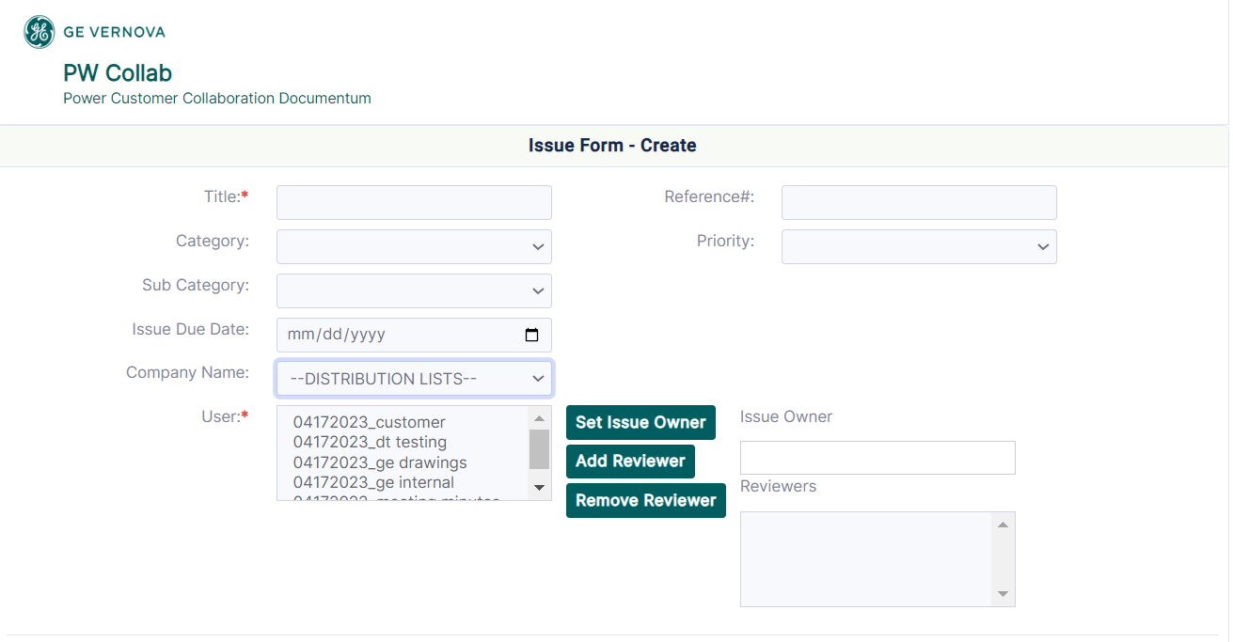
Create an Issue Form
Complete all required fields (marked with a red asterisk) and optional fields as needed for the specific business process.
Choose a Company Name from the drop down to populate the User box. Highlight the user to be the Issue Owner and click Set Issue Owner. Use the same process to add as many Reviewers as needed.

Slide 4
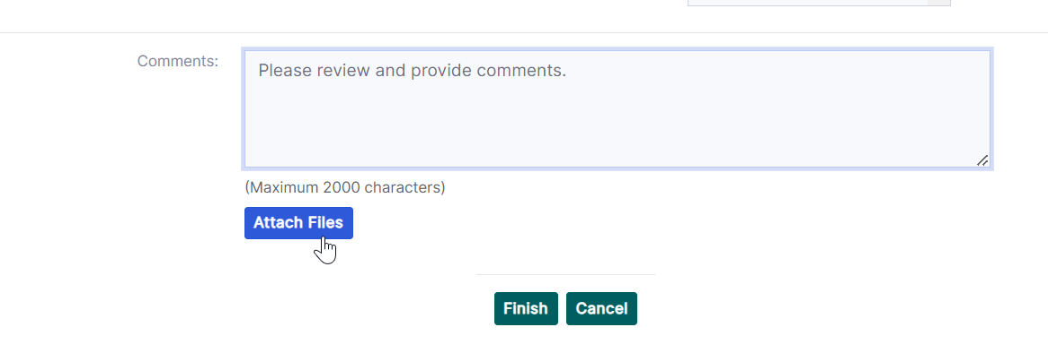
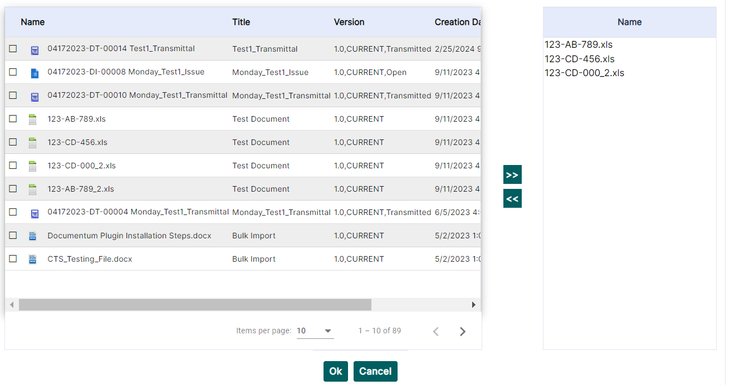
Create an Issue Form
Add attachments and comments as needed. Attachments must be imported to the project before the form is created.

Slide 5
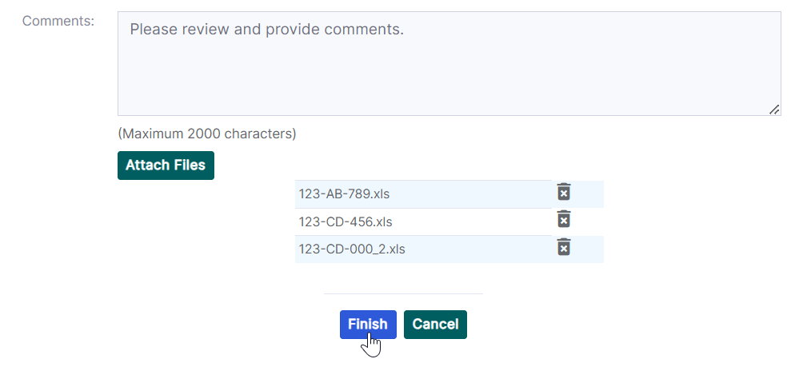
Create an Issue Form
Click Finish to create the Issue Form.

Slide 6
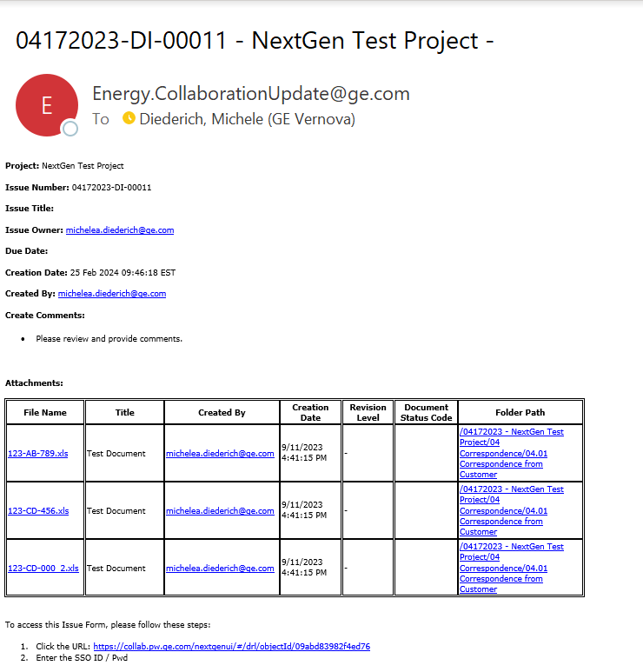
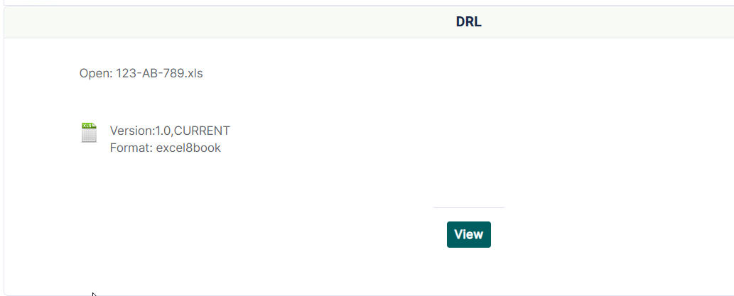
Issue Form Email
An email will be sent to the Creator, Issue Owner and Reviewers selected on the form. From this email users will be able to use the links to view the form and any attachments.

Slide 7
View an Issue Form
Navigate to the project where the form was created and select the folder it was created in or access the form in the Issue Forms folder located under 00 Workflow Forms. Double click on the form to view.

Slide 8
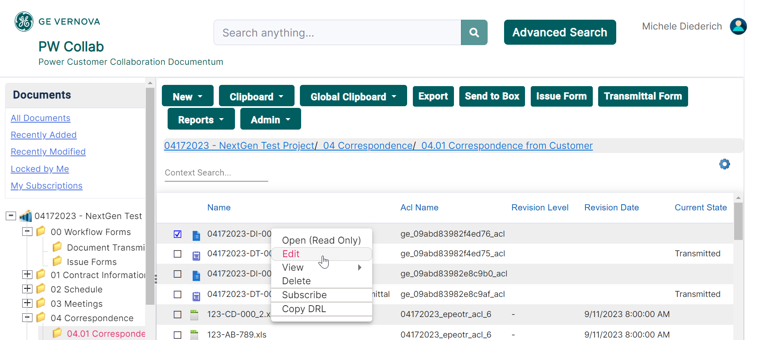
Edit an Issue Form
Navigate to the project where the form was created and select the folder it was created in or access the form in the Issue Forms folder located under 00 Workflow Forms. Right click and select Edit to make changes to the form.

Slide 9
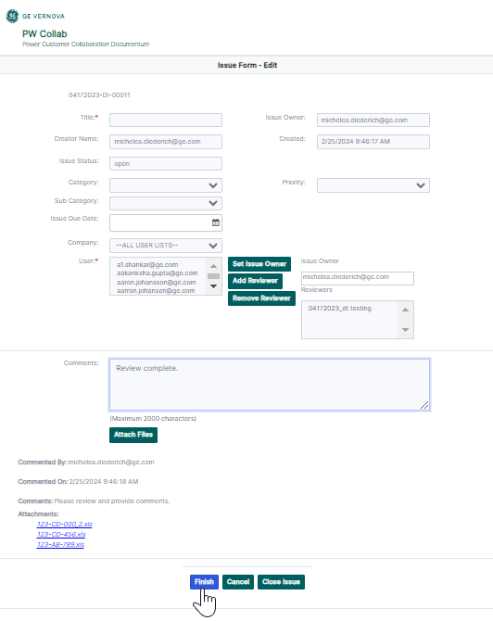
Edit an Issue Form
When the form opens, you may add attachments and/or comments. Then click Finish to save changes. The Issue Owner and Reviewers will receive an email notification. From the email users will be able to use the links to view the form and any attachments.

Slide 10
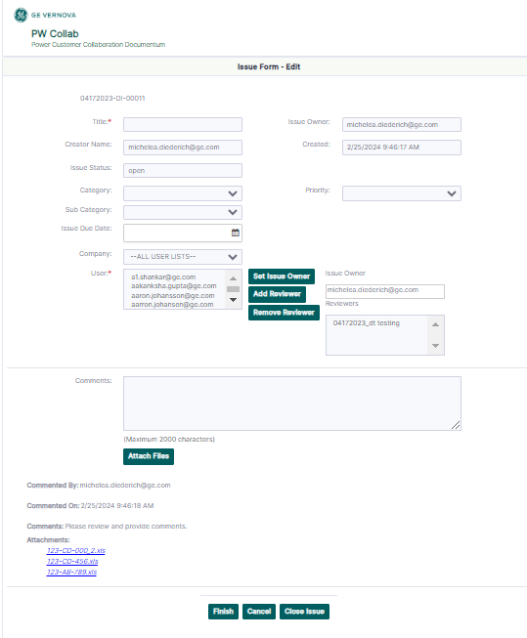
Issue Owner – Additional Actions
When editing the form, the Issue Owner can reassign the form and add or remove Reviewers.

Slide 11
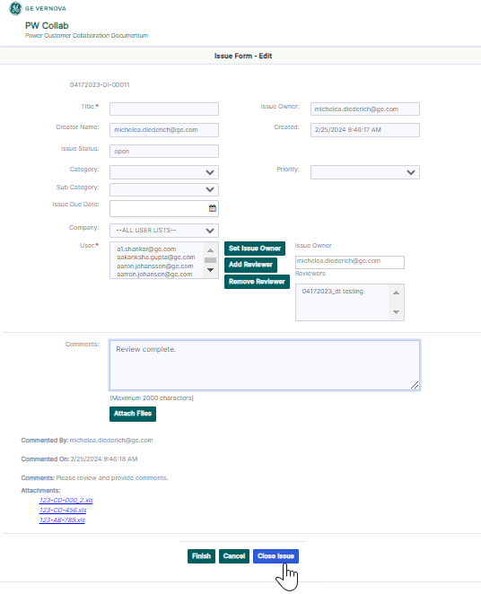
Close an Issue Form
Navigate to the project where the form was created and select the folder it was created in or access the form in the Issue Forms folder located under 00 Workflow Forms. Right click and select Edit to make changes to the form. Make any changes to the form and click Close Issue. Only the Issue Owner has permission to close an Issue Form.

Slide 12
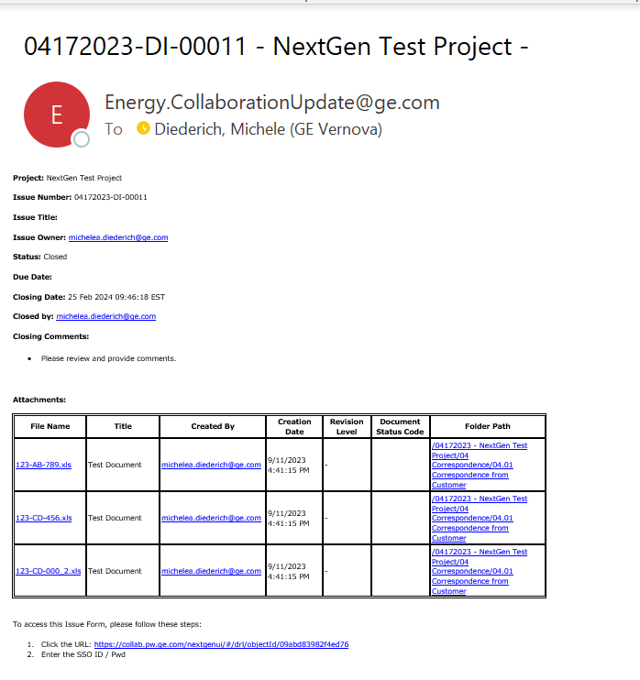
Closed Issue Form Email
A closed email notification is sent to the Creator, Issue Owner and Reviewers. From this email users will be able to use the links to view the form and any attachments in Read Only Mode.

Slide 13
Documentum Support
If you encounter any issues with Documentum, please send an email to: ebusinesstechsupport@ps.ge.com and include the following information:
Full Name
Email Address
SSO
Project Name
Screen Shot of any Errors

