Slide 1
Documentum training Global CLipboard
Michele Diederich
March 2024

Slide 2
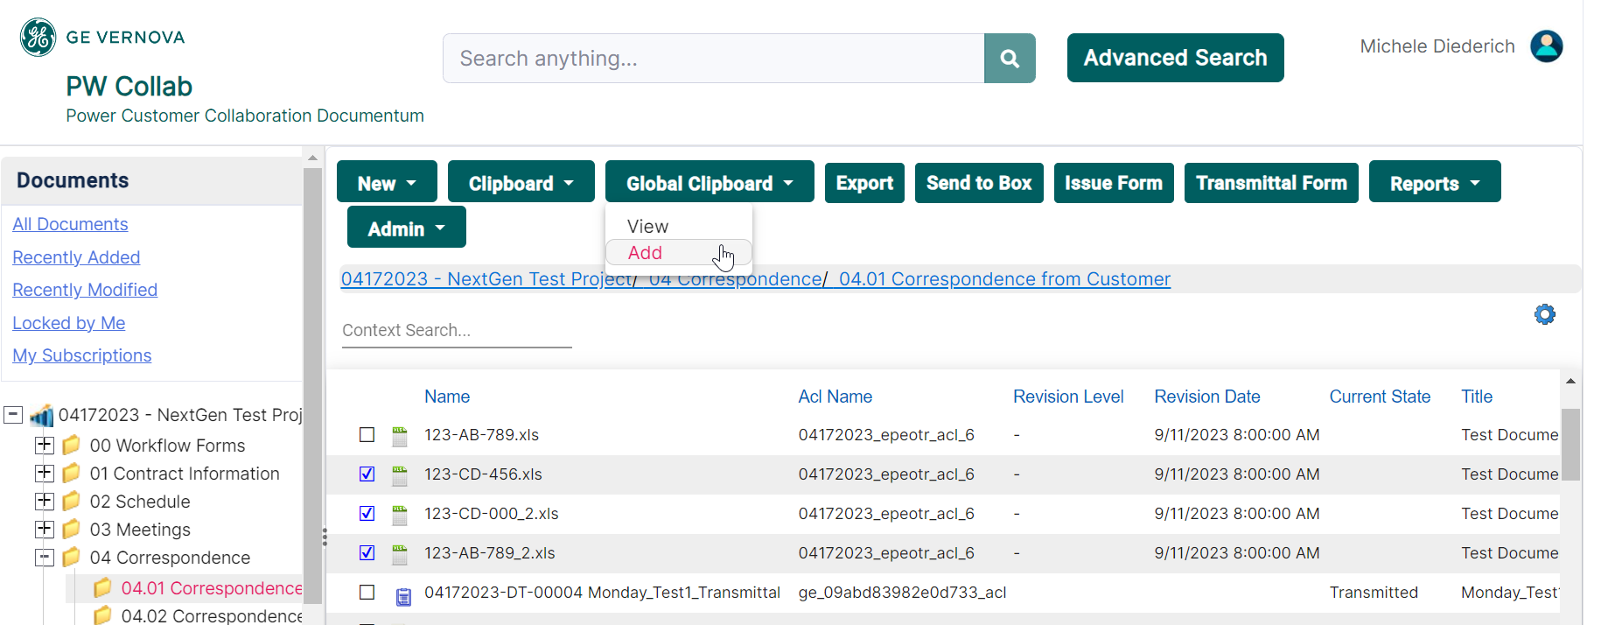
Global Clipboard
Select any files, click Global Clipboard > Add.

Slide 3
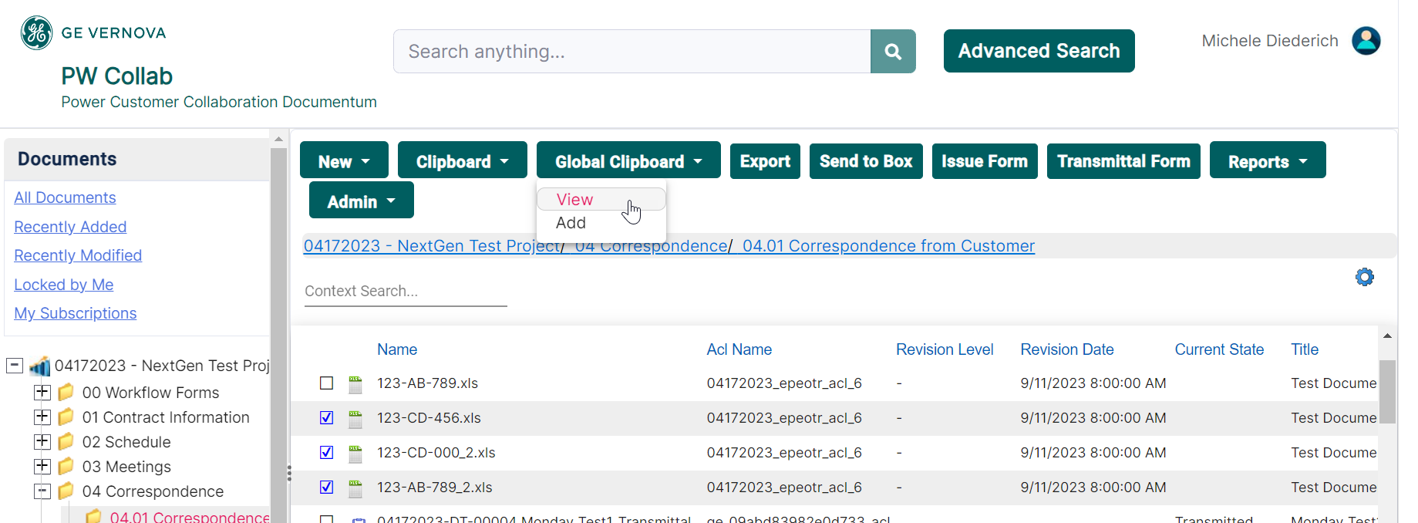
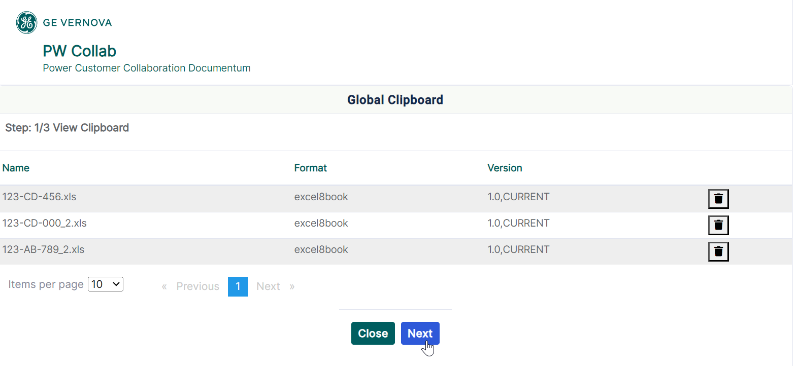
Global Clipboard
After adding the files, click Global Clipboard > View and then Next to search for the project to copy to.

Slide 4
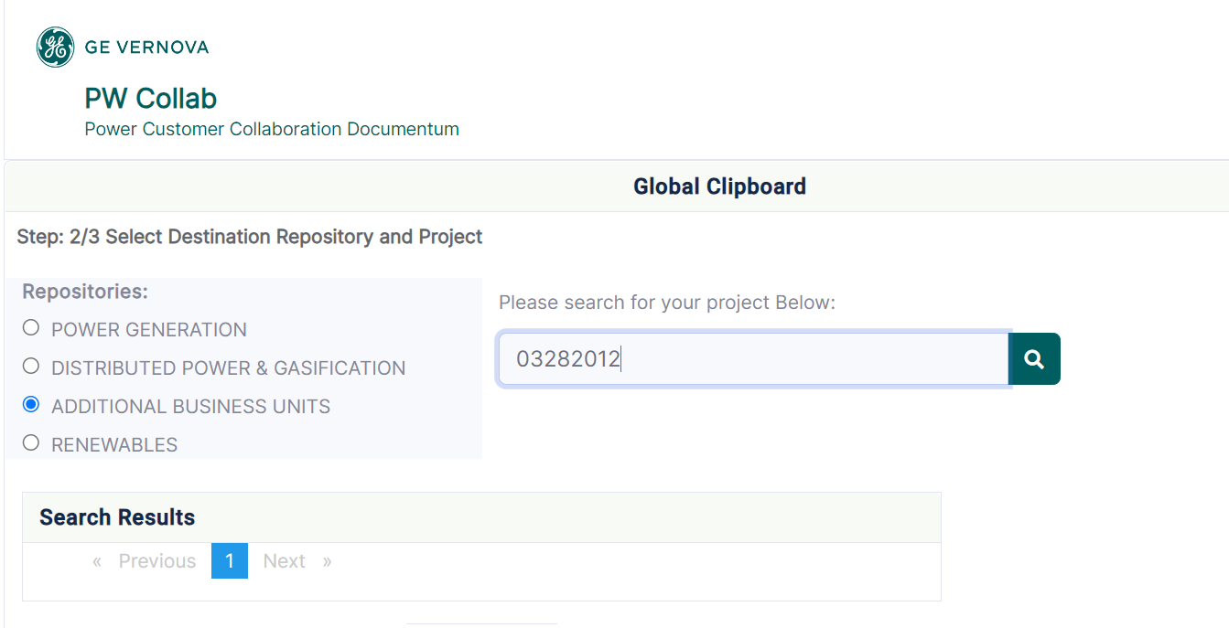
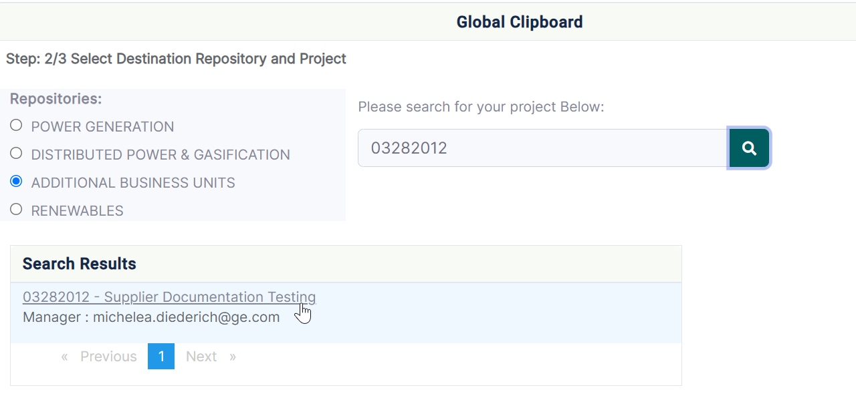
Global Clipboard
Select the target Repository and search for the project. When search results are listed, click the project to go to the next page and select the folder to copy to.

Slide 5
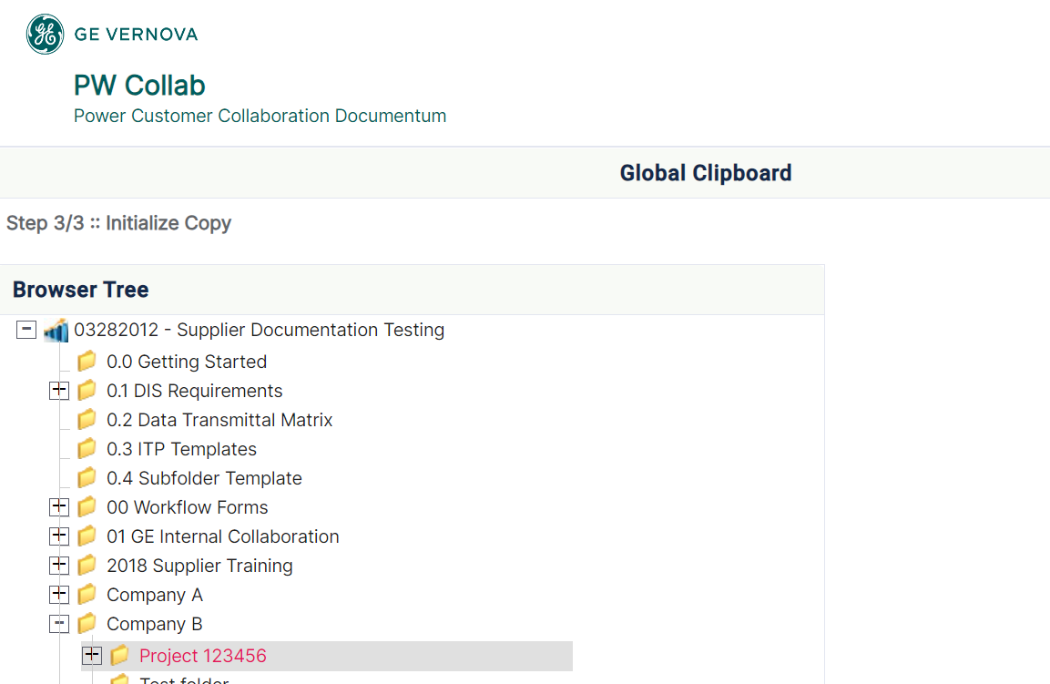
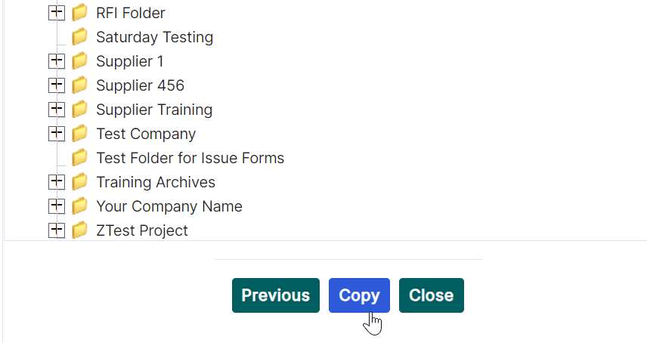
Global Clipboard
Select the folder from the Browser Tree to copy files to, scroll down and click Copy. Copy function will be initiated.

Slide 6
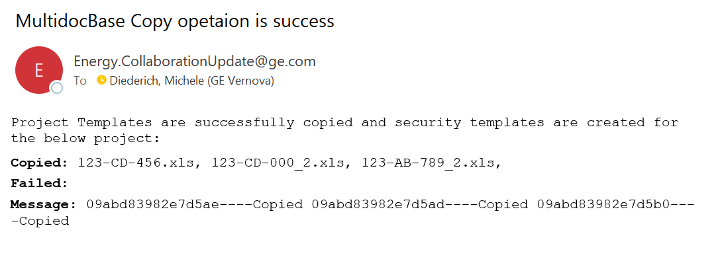
Global Clipboard
A confirmation email will be received once the copy has been completed.

Slide 7
Documentum Support
If you encounter any issues with Documentum, please send an email to: ebusinesstechsupport@ps.ge.com and include the following information:
Full Name
Email Address
SSO
Project Name
Screen Shot of any Errors

