Slide 1
Documentum training
View Relationships/batch export
Michele Diederich
July 2025

Slide 2
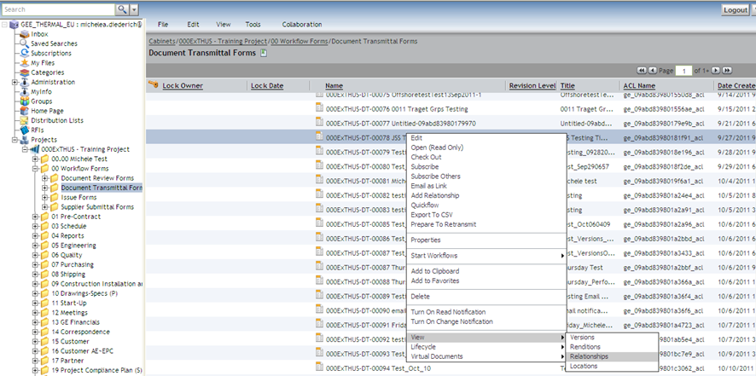
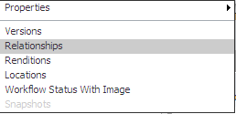
View Relationships
  Select any form (Document Transmittal or Issue Form) in the 00 Workflow Forms folder or the folder where it was created. Right click and select View > Relationships (DT’s). From the View menu select Relationships (Issue Forms).

Slide 3
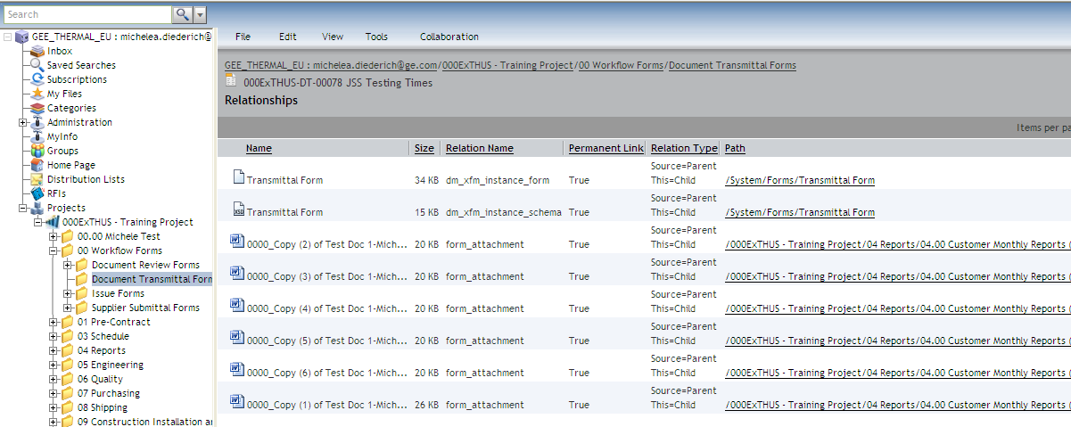
View Relationships
  All files attached (linked) to the selected form will be listed.

Slide 4
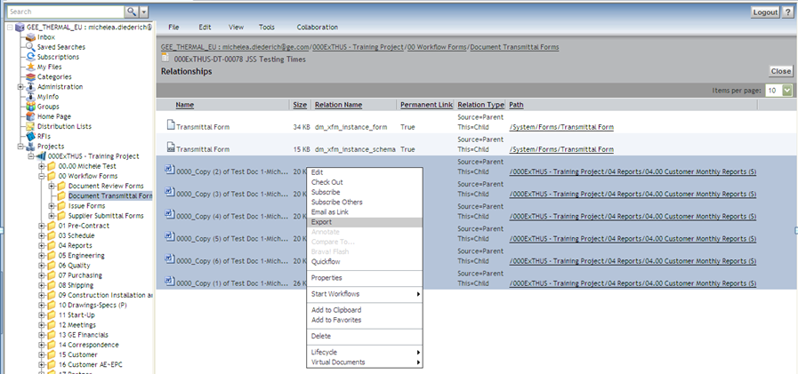
Batch Export
  All files can be exported at once. Select all files, right click, select Export and follow the process to save files.

Slide 5
Documentum Support
  If you encounter any issues with Documentum, please send an email to: nucleardocumentumsupport@gevernova.com and include the following information:
      Full Name
      Email Address
      SSO
      Project Name
      Screen Shot of any Errors

