Slide 1
Documentum training
Transmittal Form
Michele Diederich
July 2025

Slide 2
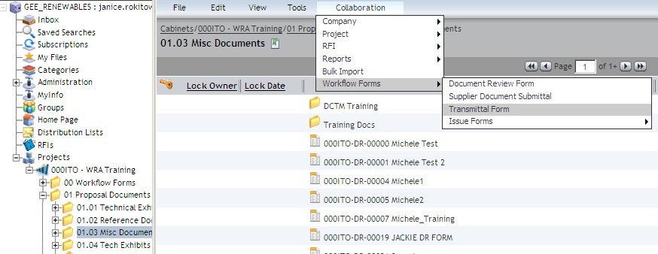
Create a Transmittal Form
  Navigate to the folder in the project where the Transmittal Form should be created. From the Collaboration menu, select Workflow Forms > Transmittal Form.

Slide 3
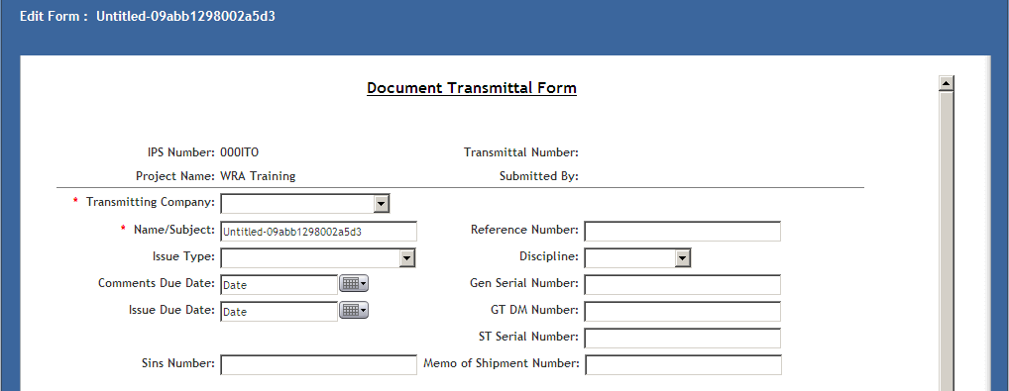
Create a Transmittal Form
  Complete all required fields (marked with a red asterisk) and any optional fields as needed for the business process.

Slide 4
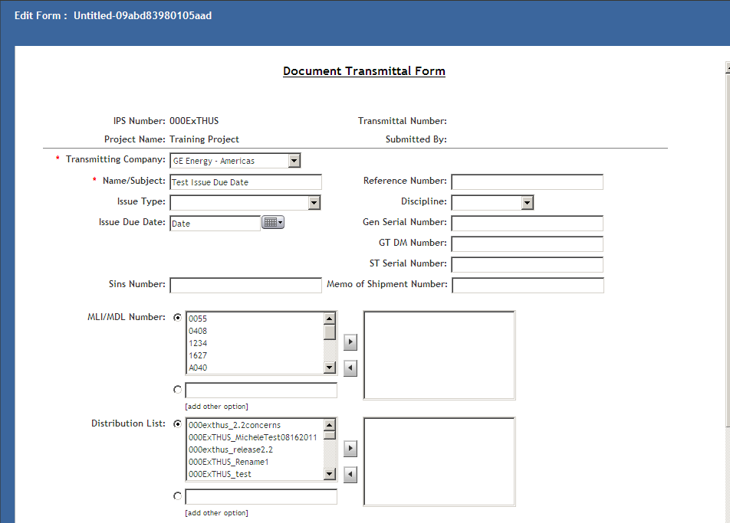
Create a Transmittal Form
  New MLI/MDL codes can be added using the Add other option field. New codes will be available on future Transmittal Forms. From the Distribution List field, select the project specific DL’s and/or individual users to receive the Transmittal Form.

Slide 5
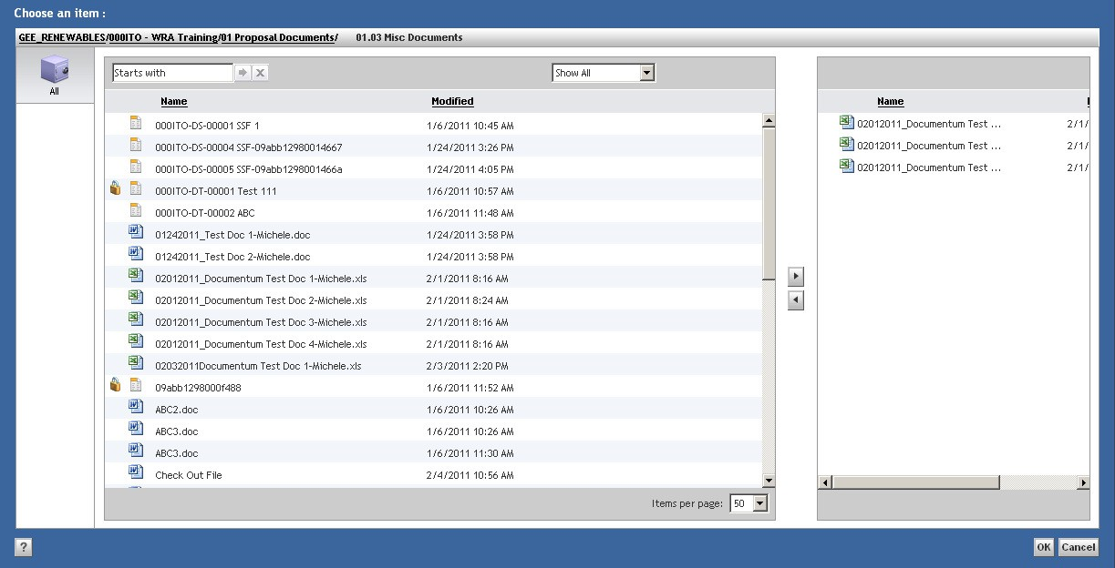
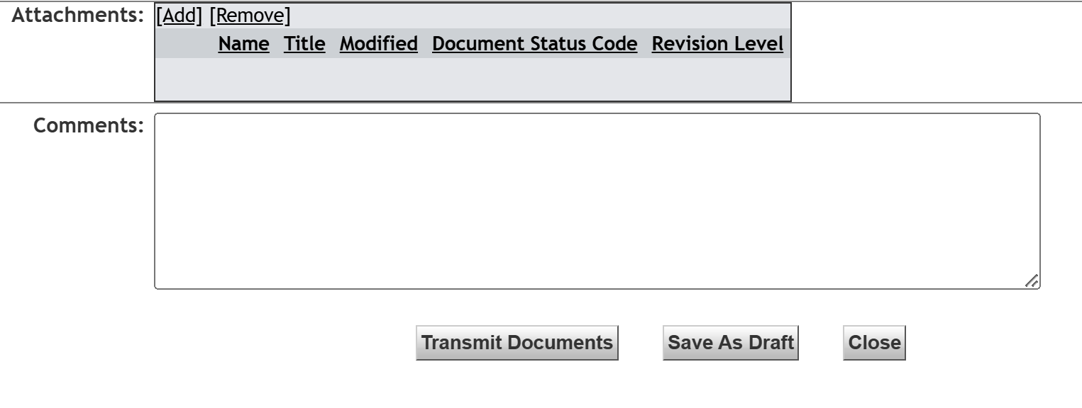
Create a Transmittal Form
  Click Attachments to add files. Select files (must be previously imported to the project) to be added and click OK. Add comments as needed and click Transmit Documents to create the Transmittal Form.

Slide 6
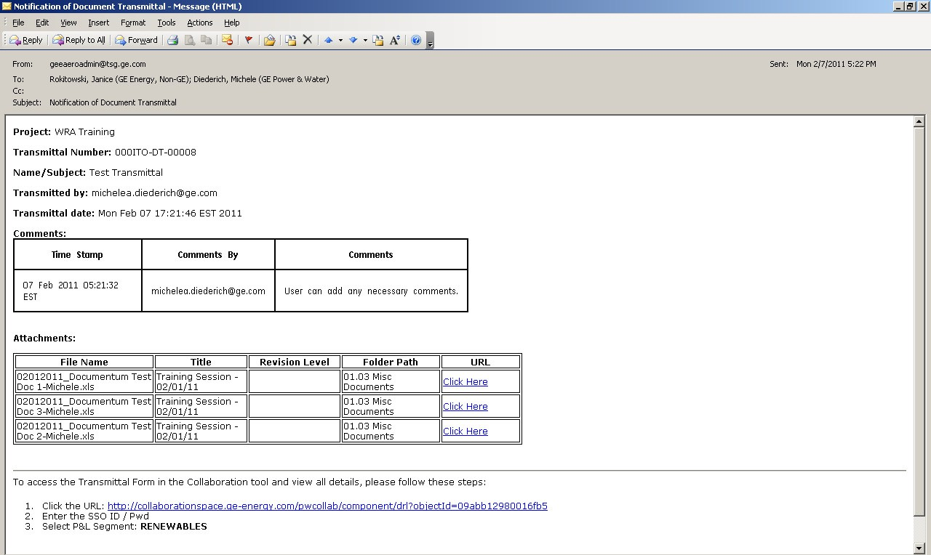
Transmittal Form Notification
  An email notification will be sent to all those selected for distribution. The Transmittal Form and attachments can be accessed from the email notification using the links.

Slide 7
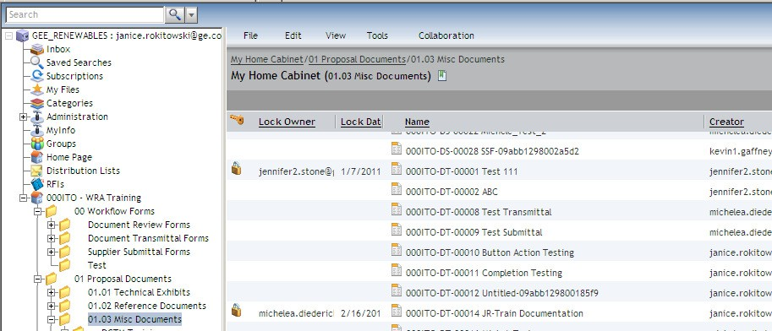
View a Transmittal Form
  Navigate to the folder in the project where the Transmittal Form was created or the Transmittal Forms Folder under 00 Workflow Forms. Double click on the form to open it.

Slide 8
Documentum Support
  If you encounter any issues with Documentum, please send an email to: nucleardocumentumsupport@gevernova.com and include the following information:
      Full Name
      Email Address
      SSO
      Project Name
      Screen Shot of any Errors

