Slide 1
Documentum training System Fundamentals
Michele Diederich
July 2025

Slide 2
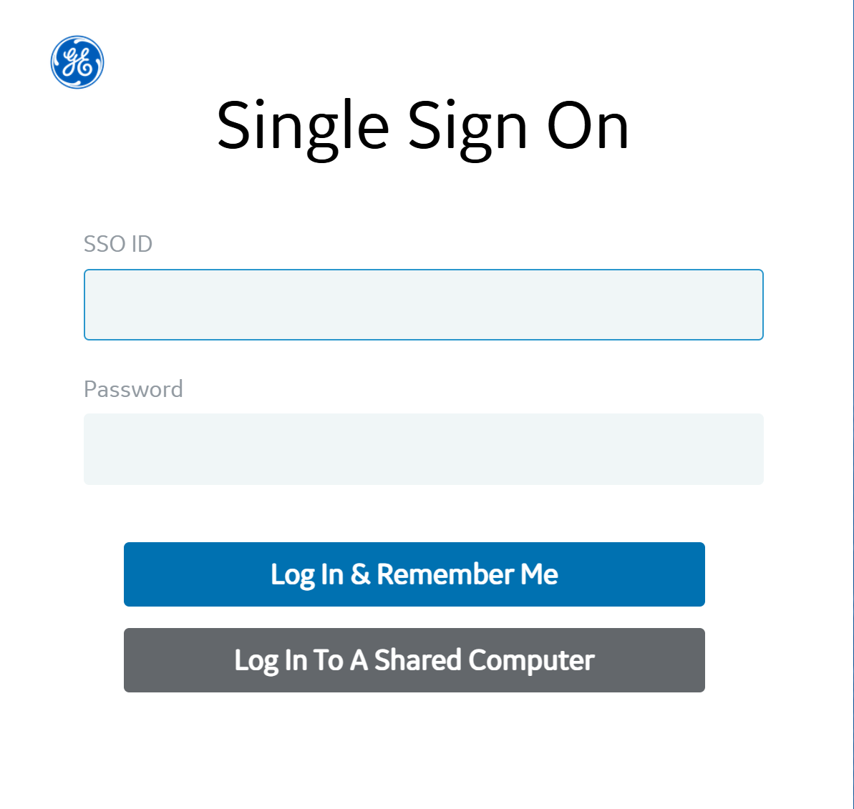
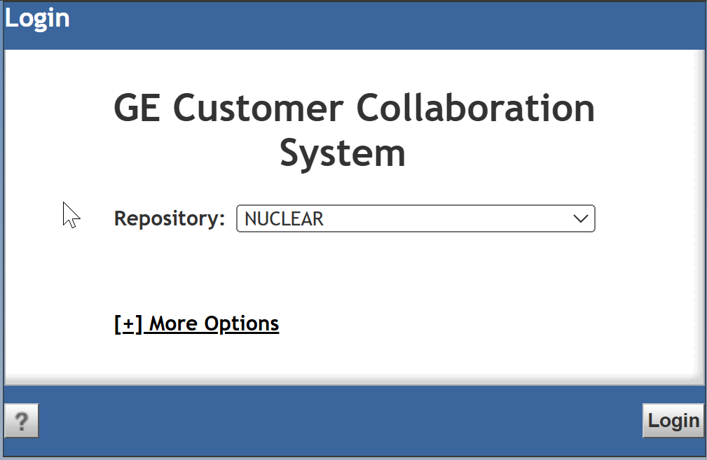
Login
Link: https://collaborationspace.ge-energy.com/pweccollab/. Enter SSO and Password, click Log In & Remember Me. Nuclear will be pre-populated in the Repository drop down. Click Login.

Slide 3
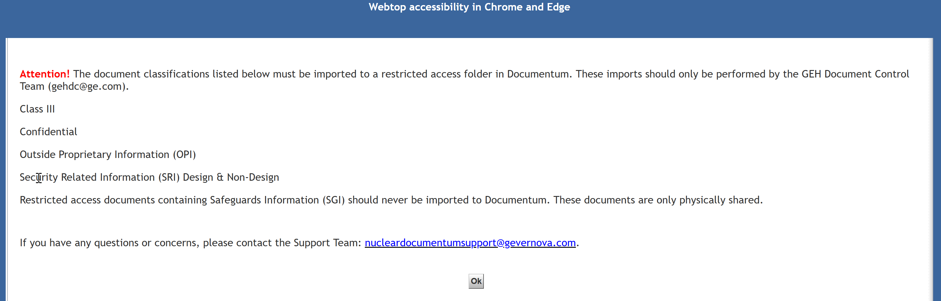
Restricted Access Documents Acknowledgement
A pop-up will be displayed with information related to Restricted Access documents. Please read and click OK. This pop-up will be displayed each time you log into Documentum.

Slide 4
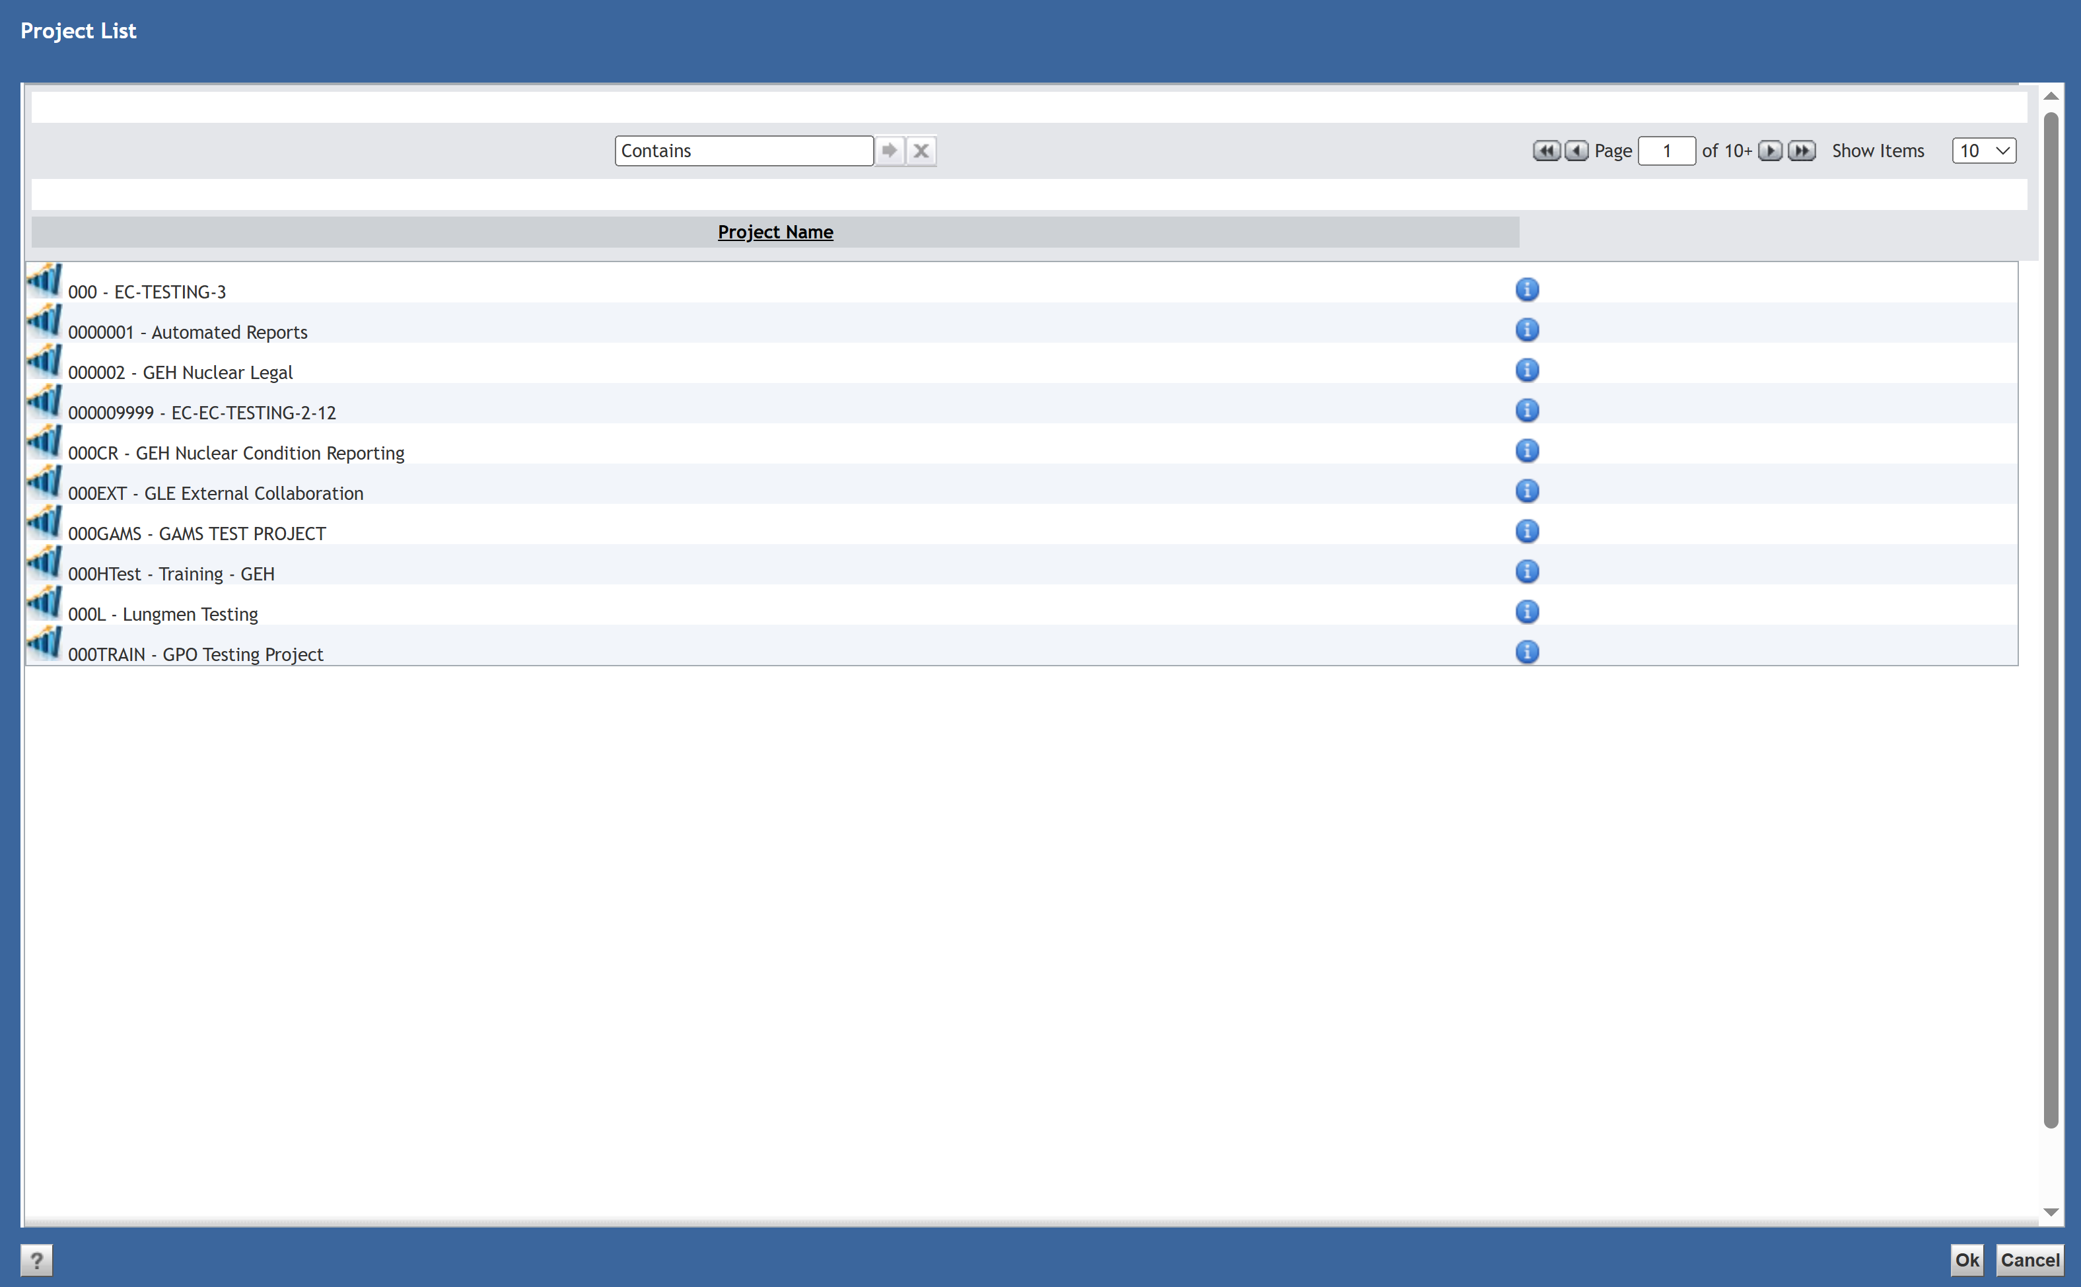
Access a Project
If the project you need to access is not shown in the list, use the Contains box to search for it. When the project is displayed, double click on the name or highlight and click OK to access.

Slide 5
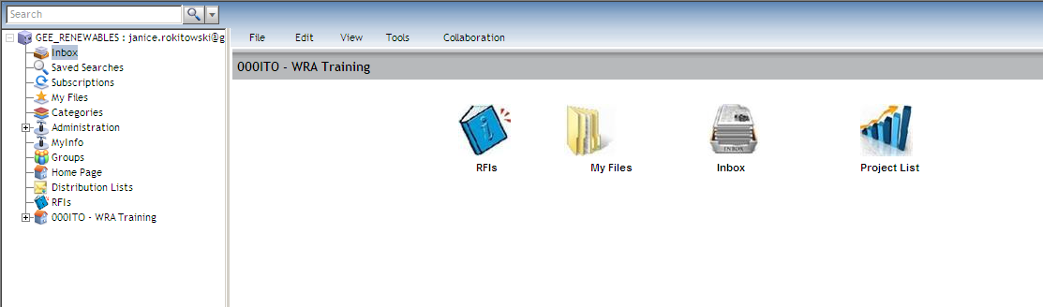
Review Home Page
The Home Page can be accessed from the Navigation Tree. My Files displays a 7-day history of the files you have imported or checked out and the forms you have created. The Project List will be used to navigate between projects you have access to.

Slide 6
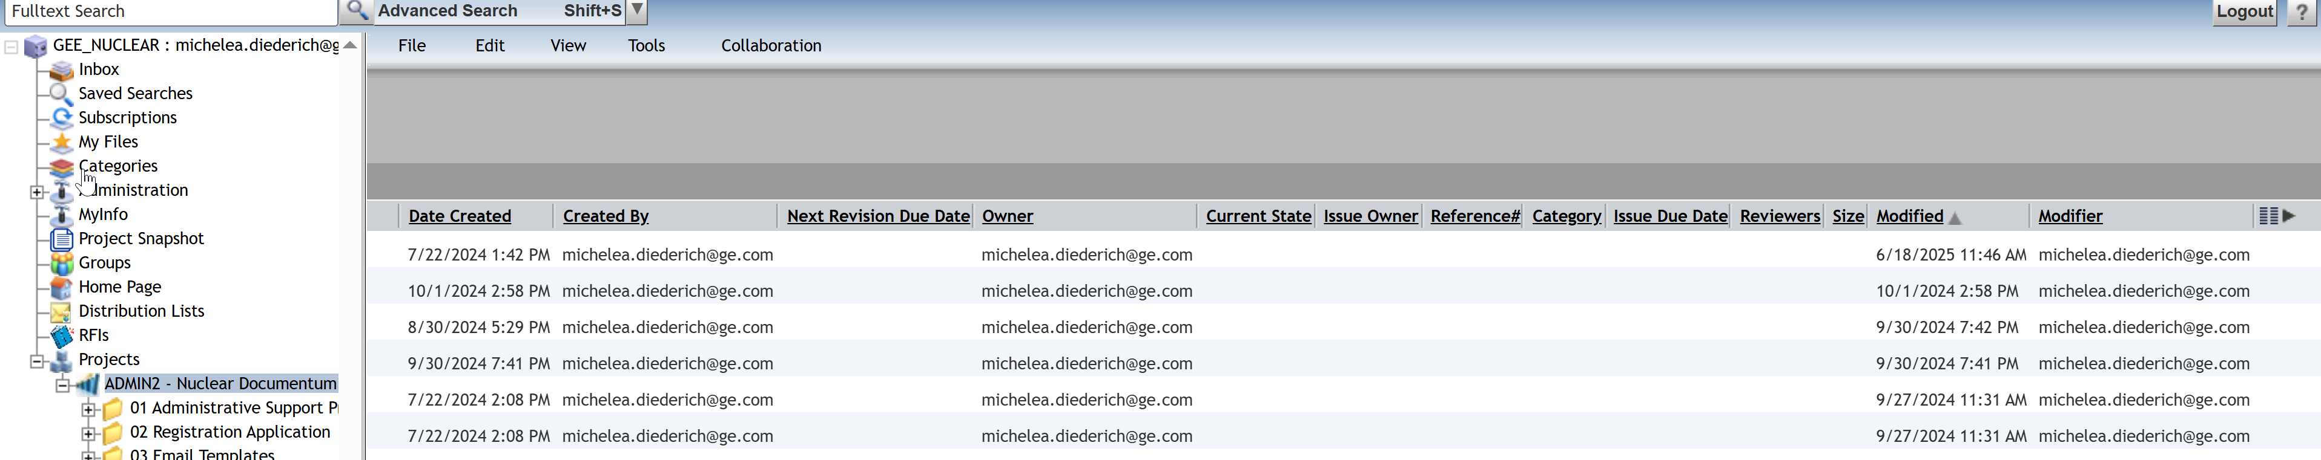
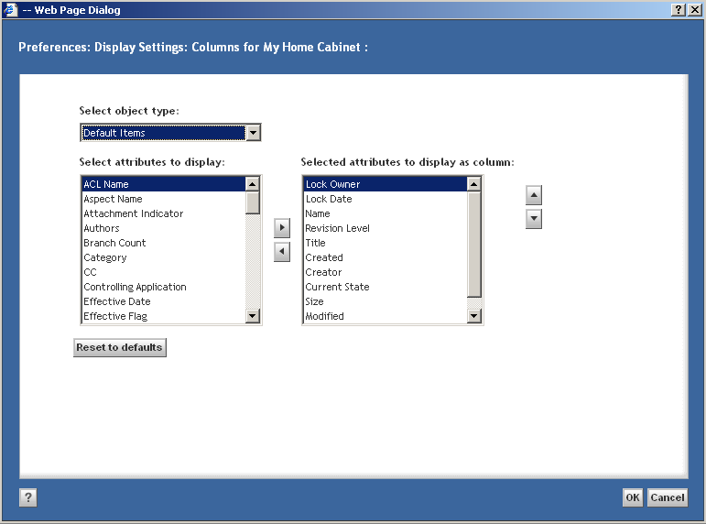
Customize Workspace Columns
Click the Column Preferences icon (far right of the screen). Current columns in view are shown in the box on the right. Columns to add are in the box on the left. Use the middle arrows to add/remove columns and use the arrows on the right side to rearrange columns. Click OK to save.

Slide 7
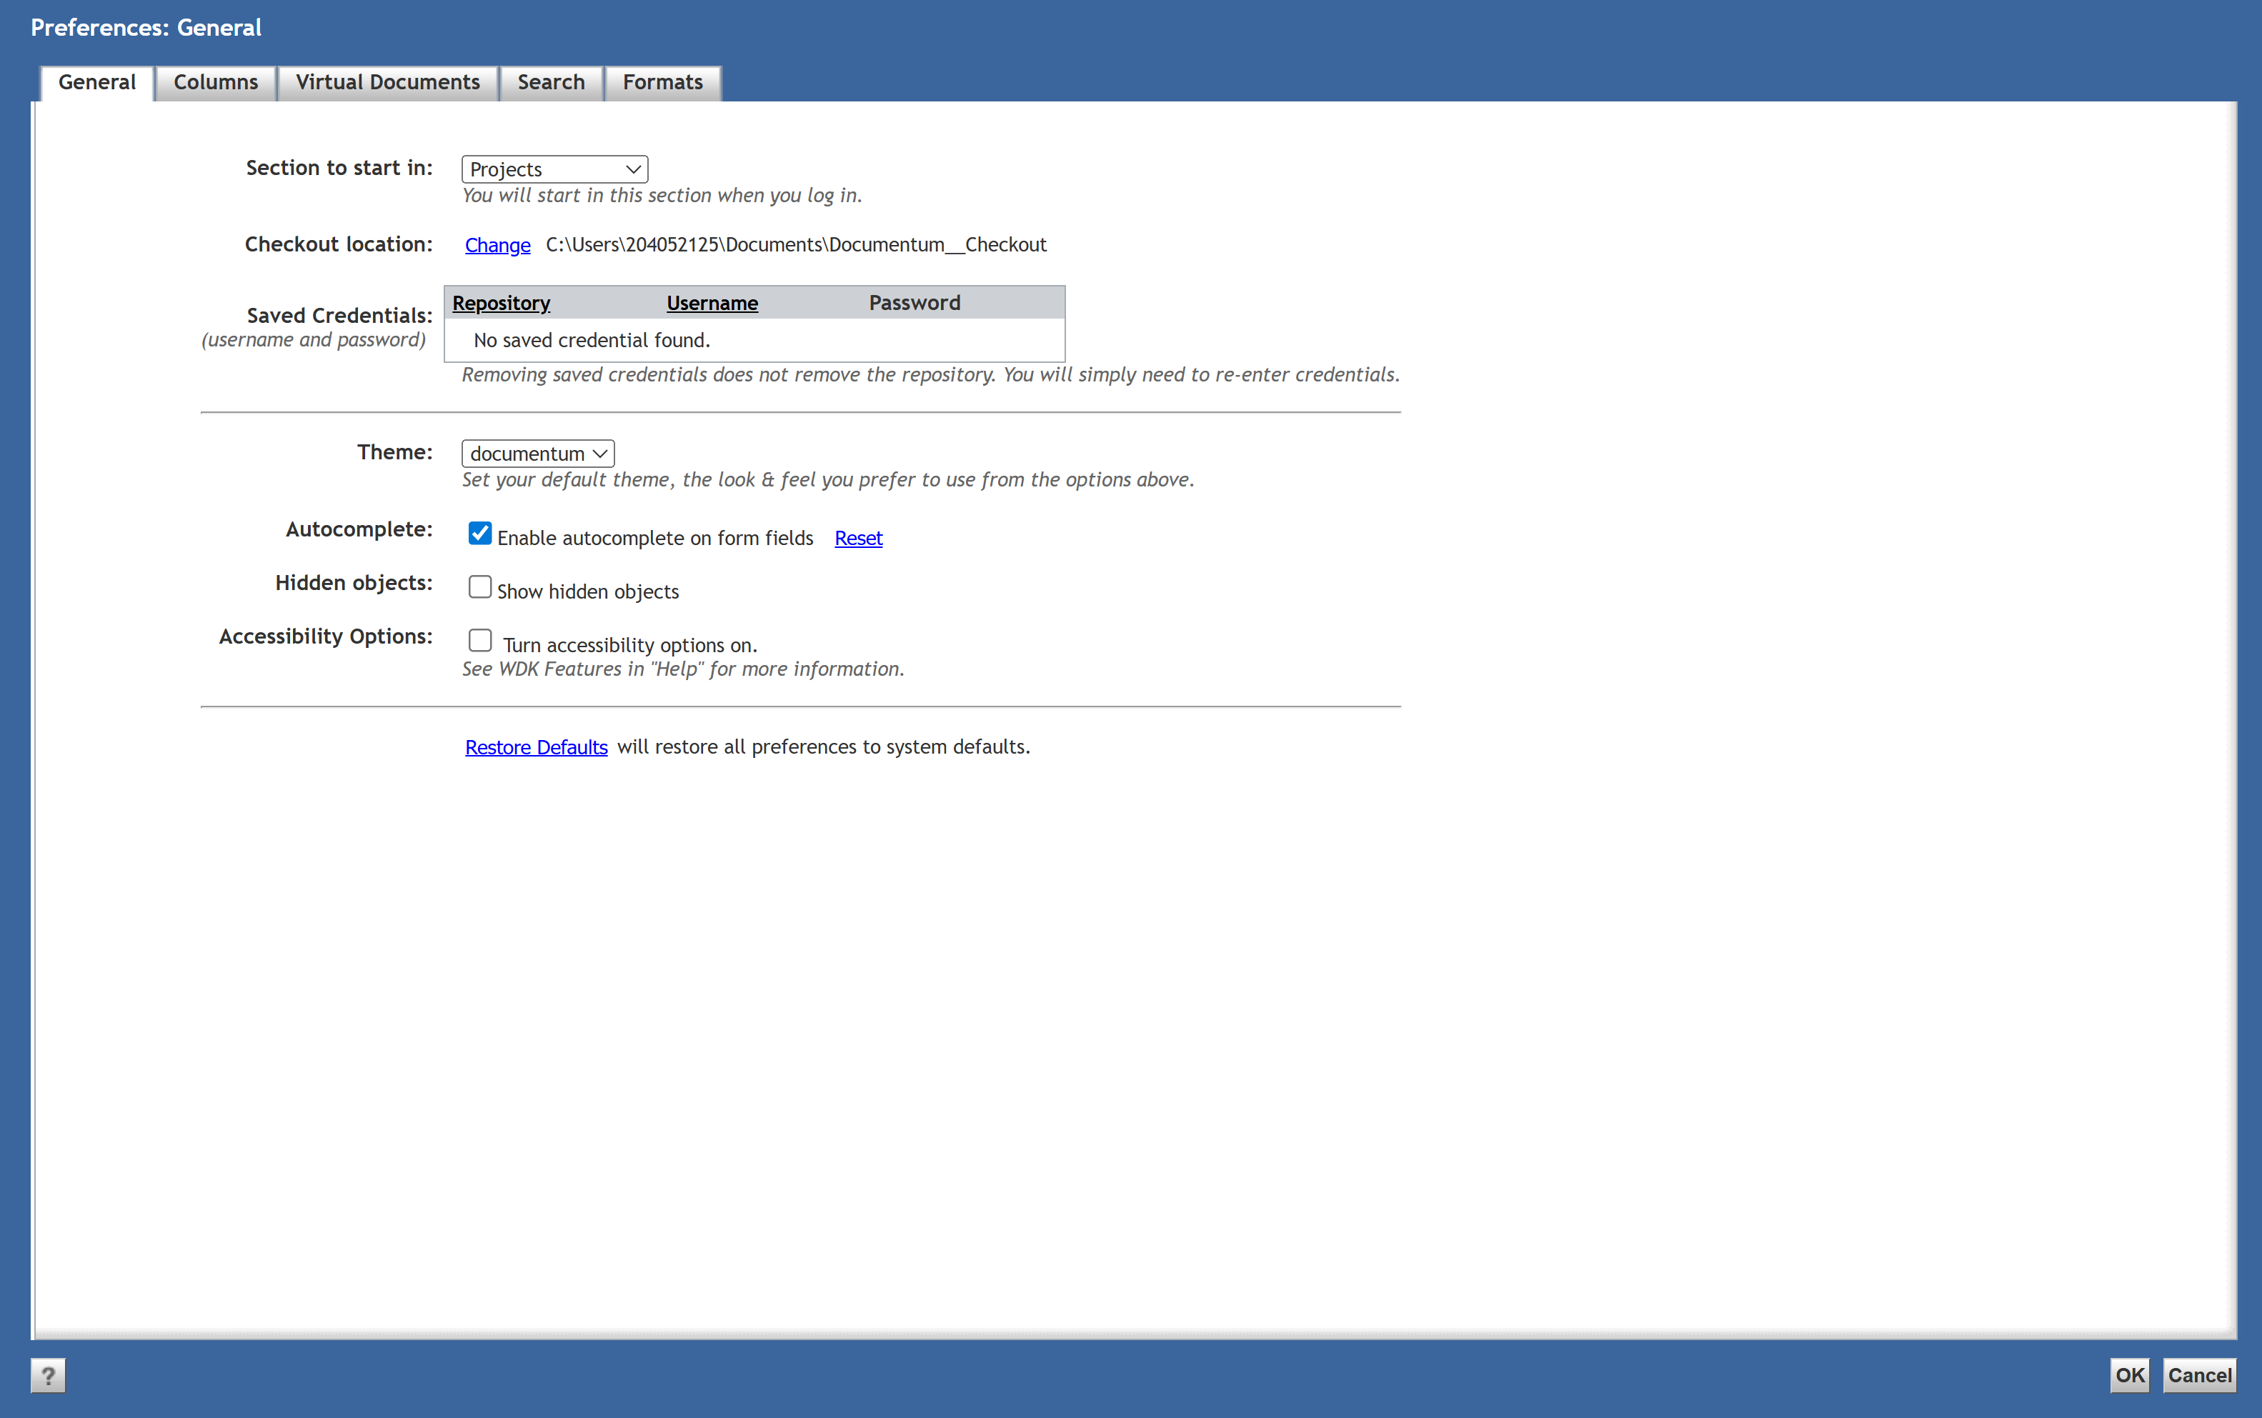
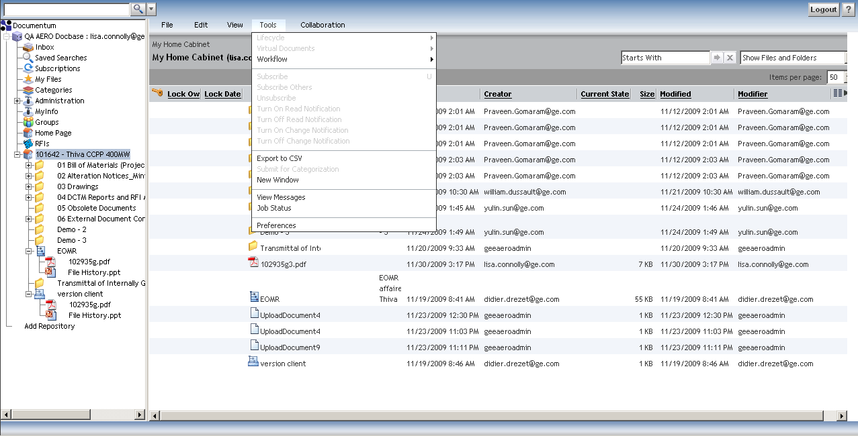
Create a Check Out Folder
Create a folder named Documentum Check Out on your computer. From the Tools menu, select Preferences. Click Change in the Checkout location field and select the folder you created on your computer. Click OK to save the change. Anytime you Check Out a file, it will be saved in this folder.

Slide 8
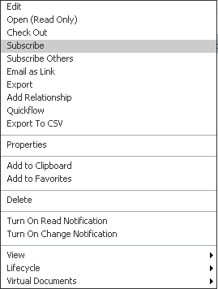
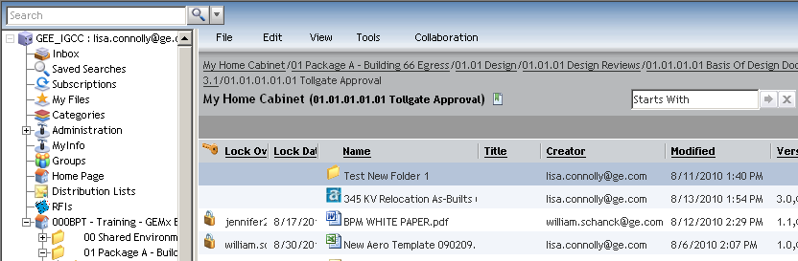
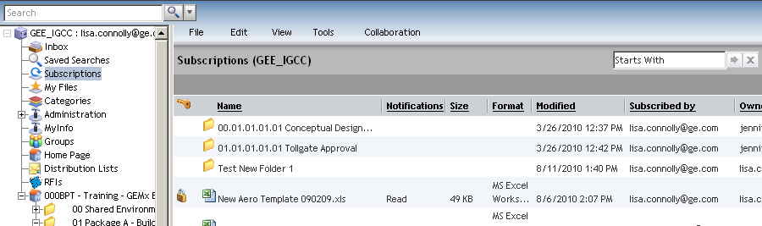
Subscriptions
Subscriptions are used as short cuts (like bookmarks in your browser) to navigate quickly to frequently accessed files or folders in a project. They are saved in the Subscriptions node in the Navigation Tree. To Subscribe to a file or folder right click on the item and select Subscribe. From the Subscriptions node, double click on the file or folder to access.

Slide 9
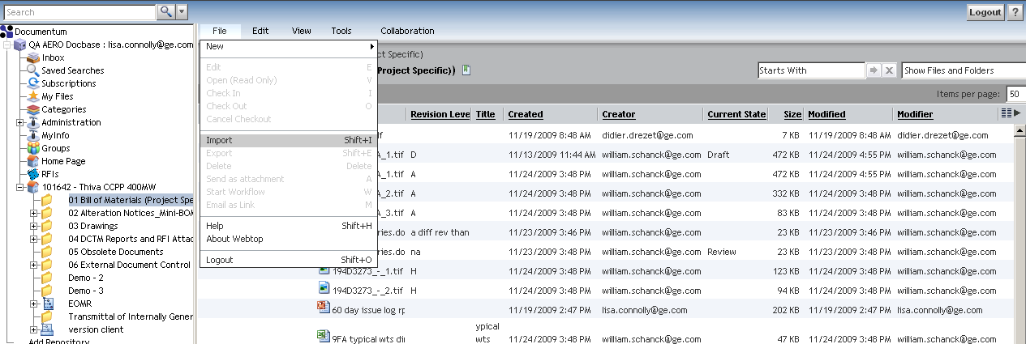
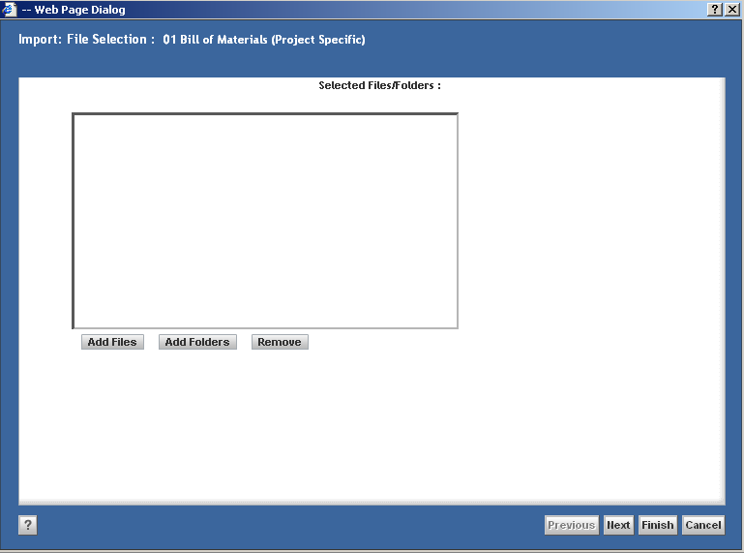
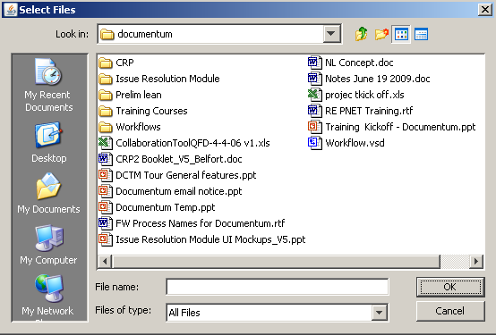
Import Files
To import files, navigate to the folder where the files will be imported to. From the File menu, select Import. Click Add Files and select one or more files from your computer. Click OK.

Slide 10
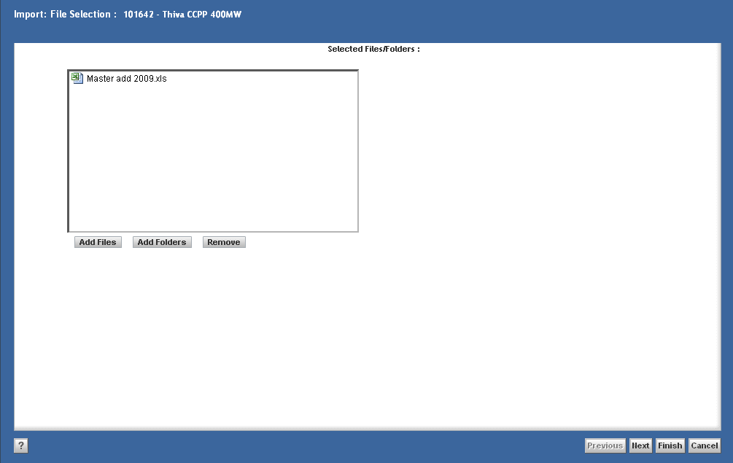
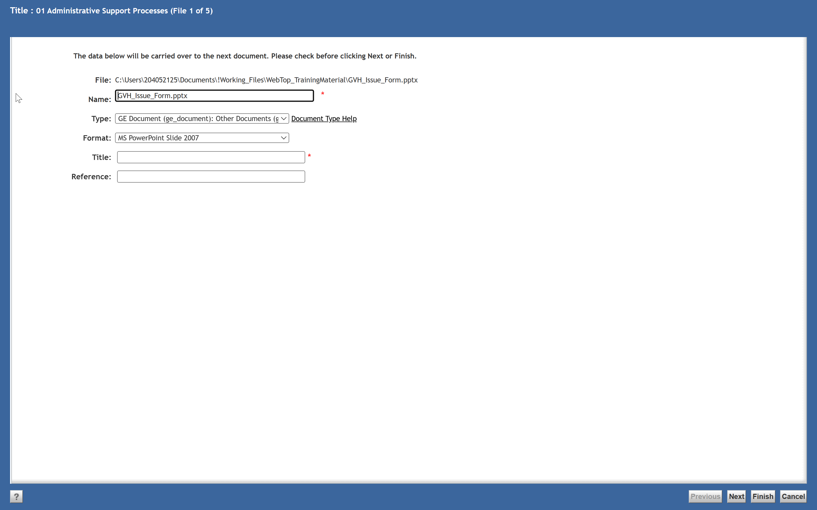
Import Files
Click Next to go to the file properties screen. Select Type (see next slide for more information) from the drop-down menu. Enter the required (marked with a red asterisk) and optional file properties. Click Next to advance through the list of files until you reach the last file. Click Finish.

Slide 11
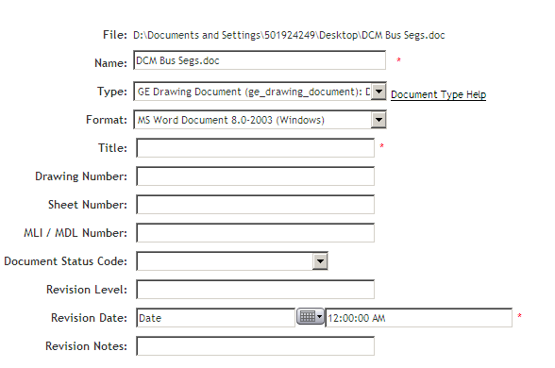
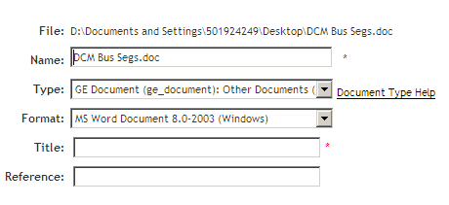
File Types
Displayed below are the files properties for each of the Types with mandatory fields noted.
ge_drawing_document (or Drawing or Specification)
ge_document (or Other Documents)
Name – mandatory Title – mandatory Revision Date – mandatory
Name – mandatory Title – mandatory

Slide 12
Import Folders
To import a folder, navigate to the folder where the folder will be imported to. From the File menu, select Import. Click Add Folders and select one or more folders from your computer. Click OK.

Slide 13
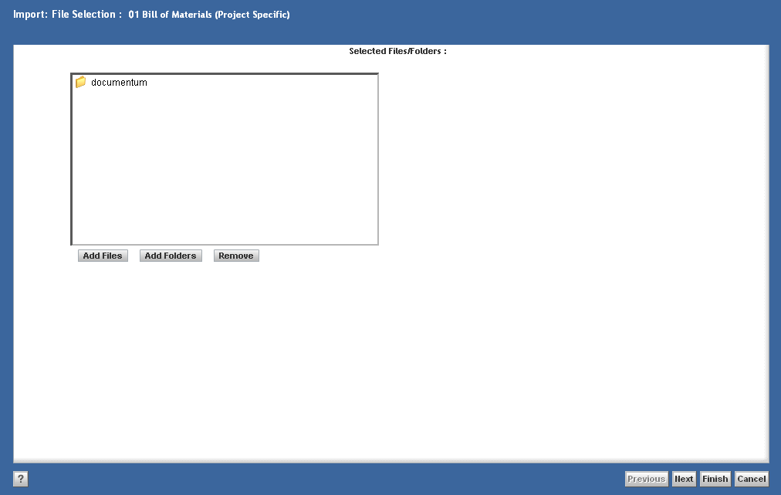
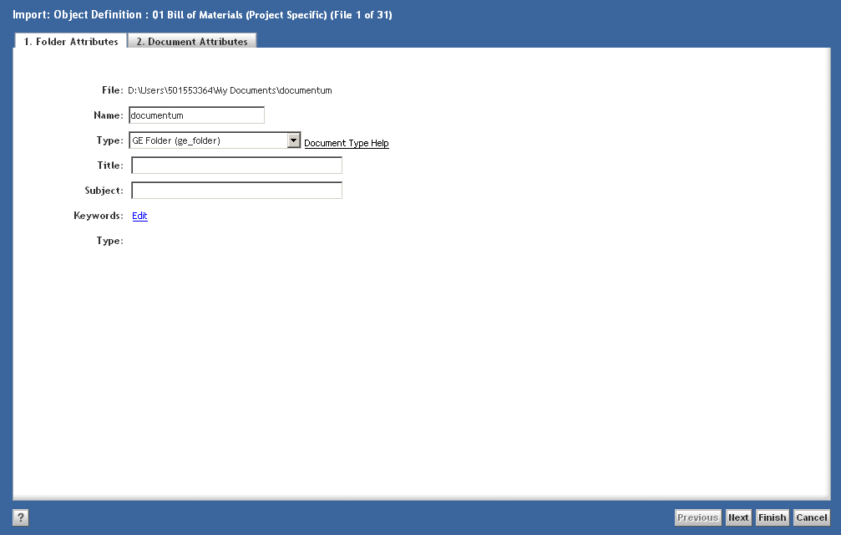
Import Folders
Click Next to go to the folder properties screen. Select GE Publish Folder in the Type field. Enter the required (marked with a red asterisk) and optional folder properties. Click Next to access the file properties for the files in the folder. Add file properties for each, using Next to advance through the files until you reach the last file. Click Finish.

Slide 14
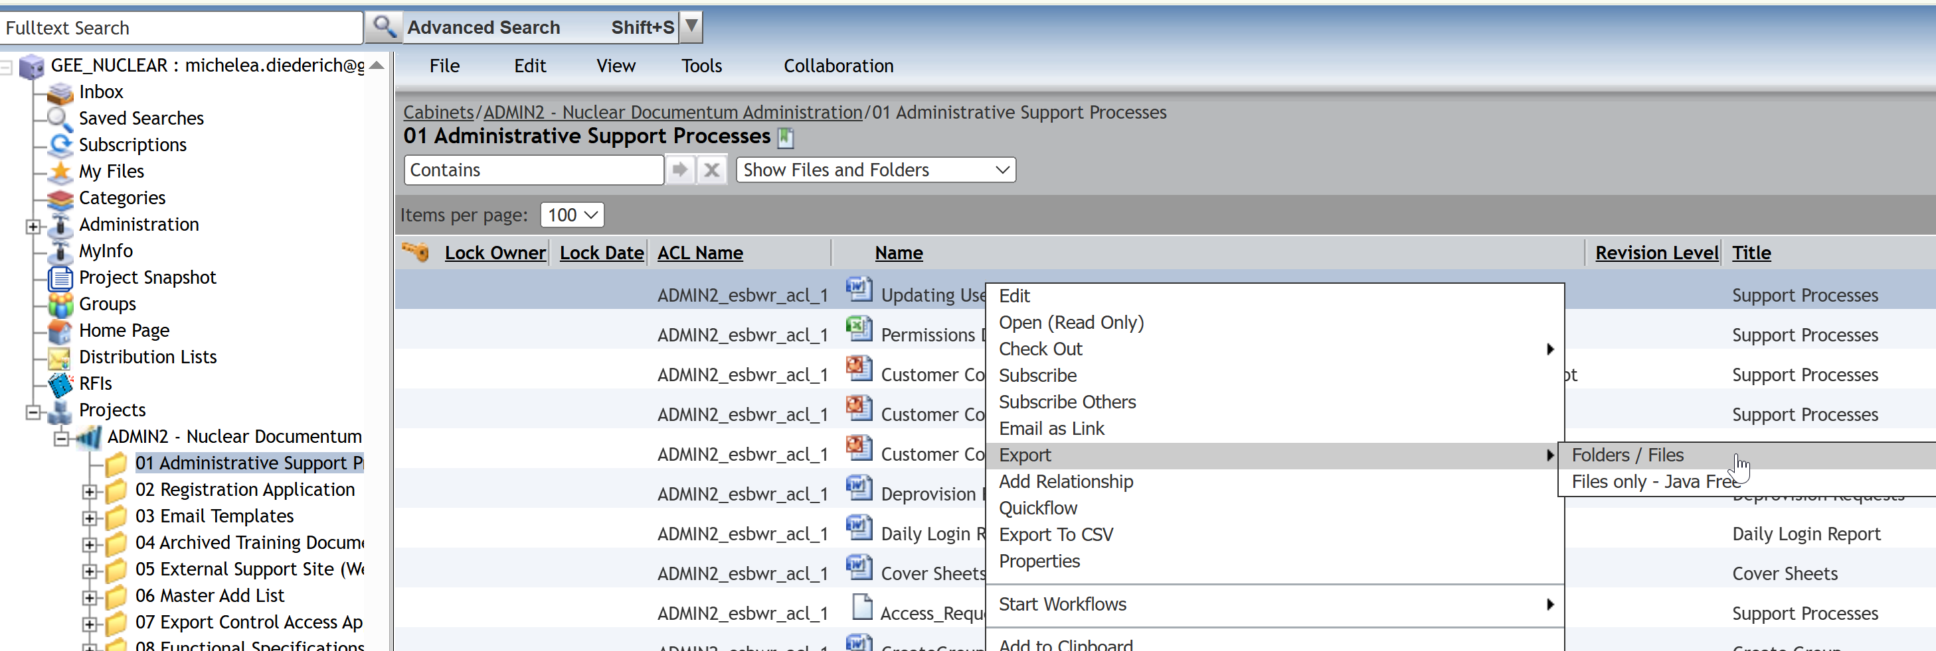
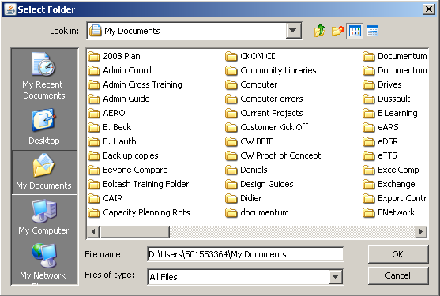
Export Files
To export files, select one or more files, right click and select Export > Folders / Files or Files only – Java Free (see Java Free guide for details). Select the location on your computer where you want to save the files and click OK.

Slide 15
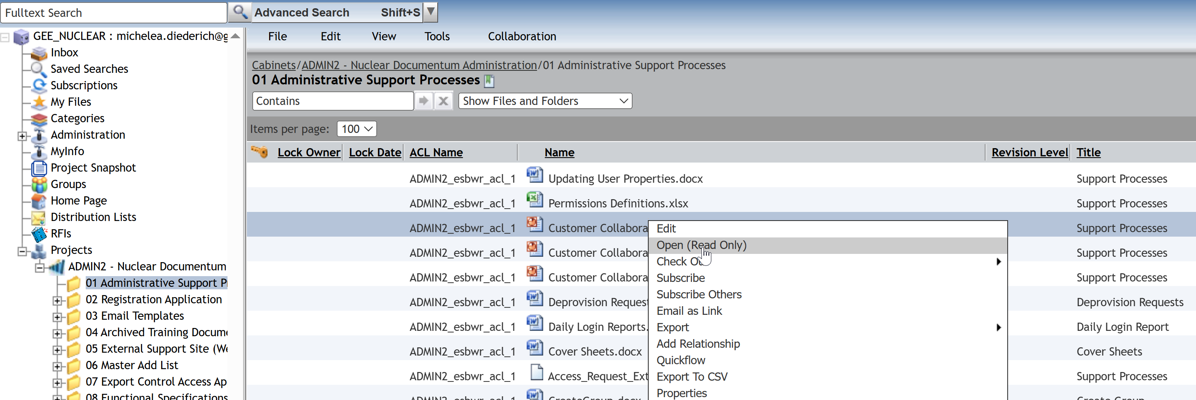
View Files
To view a file, double click on the file or select the file and right click > Open (Read Only).

Slide 16
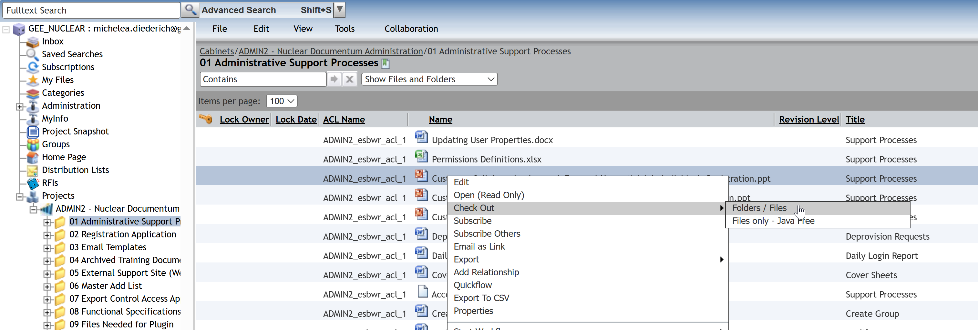
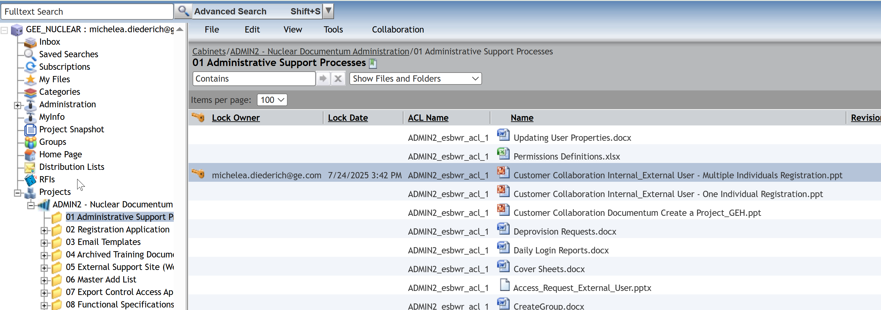
Check Out Files (Version Control)
To Check Out files, select one or more files, right click and select Check Out > Folders / Files. The file will show a key for you and a lock for all other users.

Slide 17
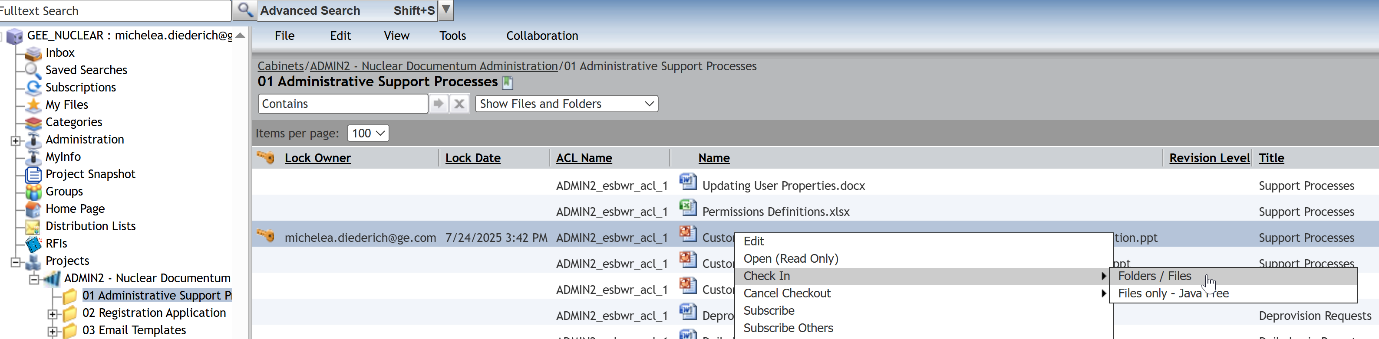
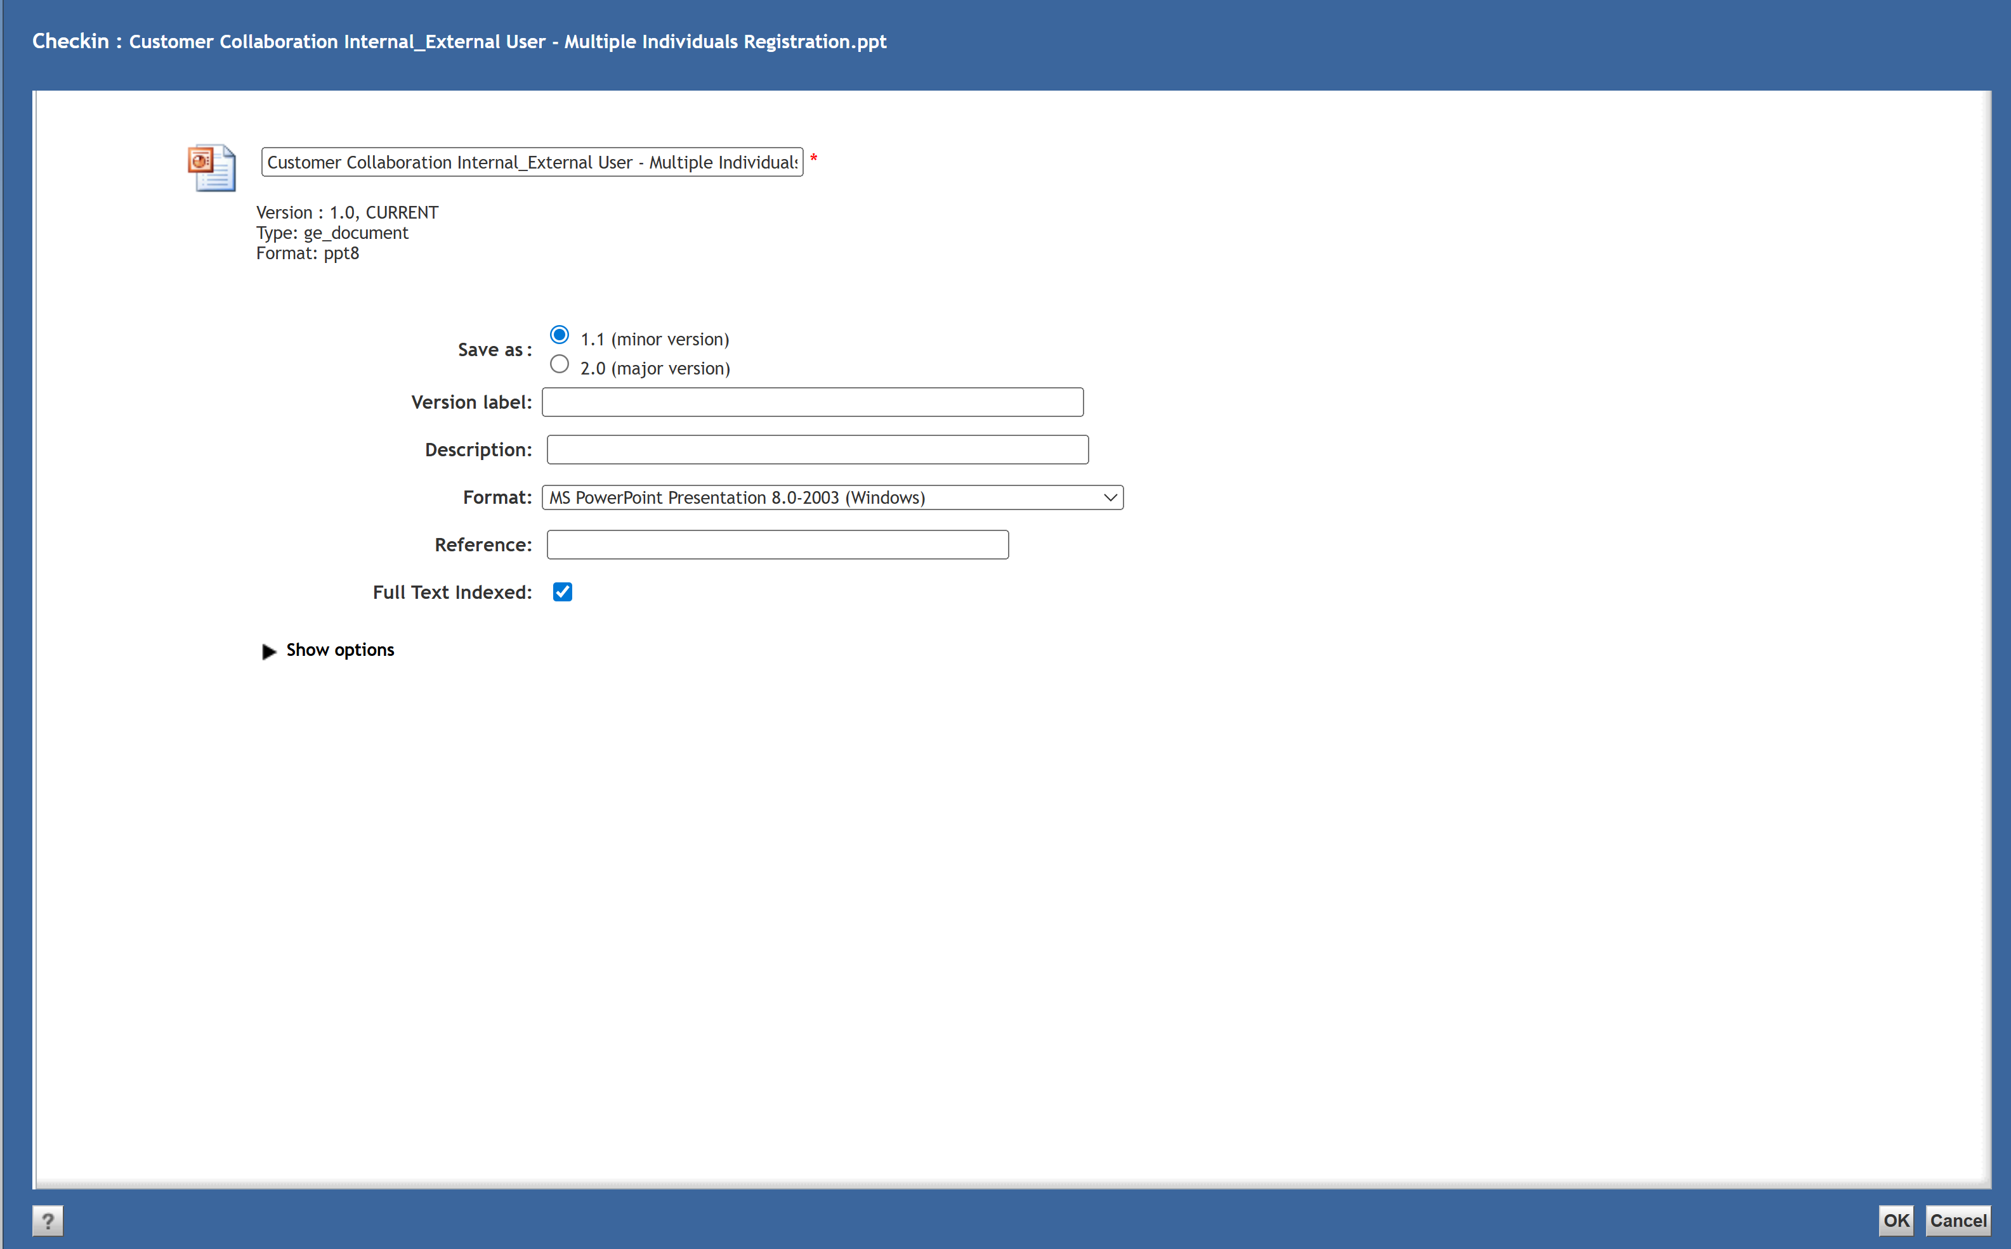
Check In Files (Version Control)
To Check In a file that you checked out and edited on your computer, right click and select Check In > Folders / Files. Add the files properties as needed and click OK. The version will be placed on top of the original file.

Slide 18
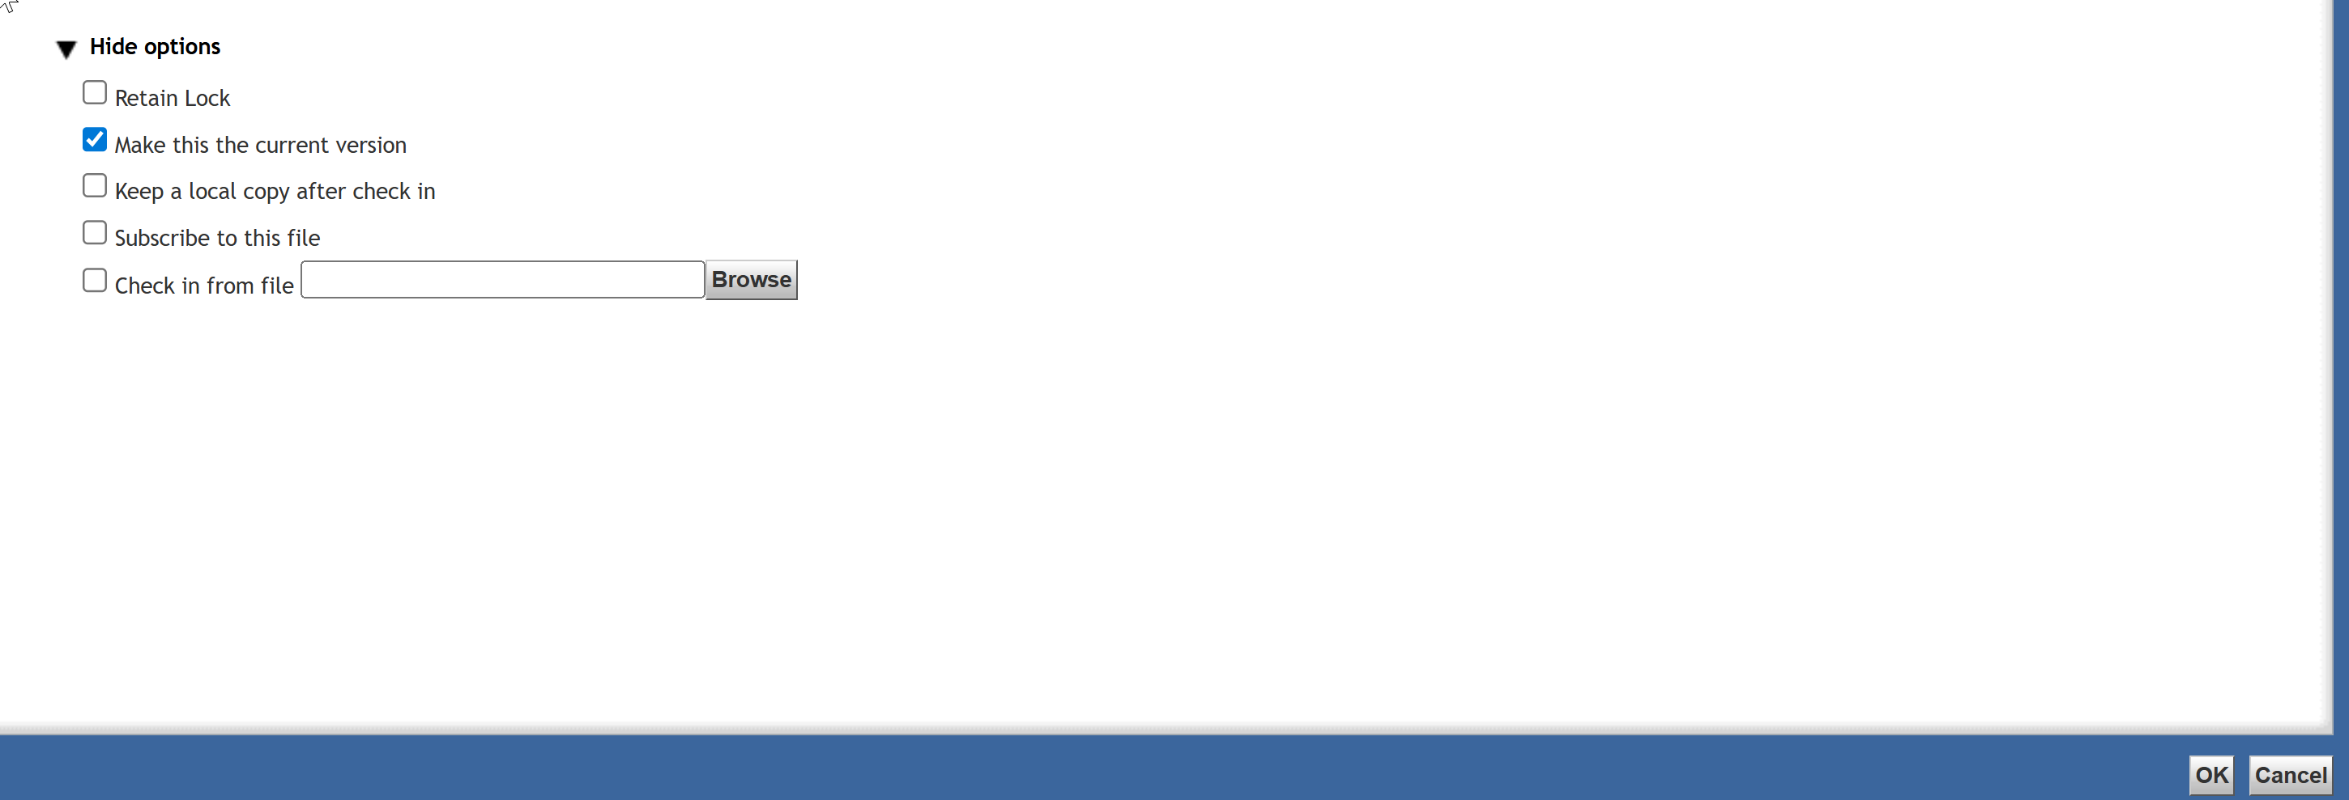
Check In Files (Version Control)
To Check In a file from a file you have saved on your computer (from another source), right click and select Check In > Folders / Files. Add the files properties as needed and click Show options. Click Browse in the Check in from a file field and select the saved file from your computer. The version will be placed on top of the original file.

Slide 19
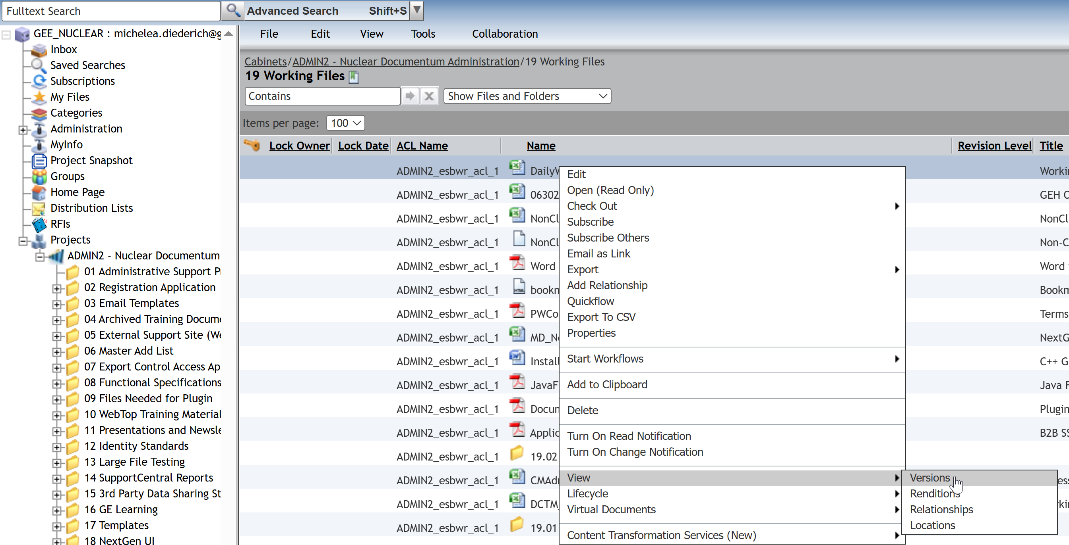
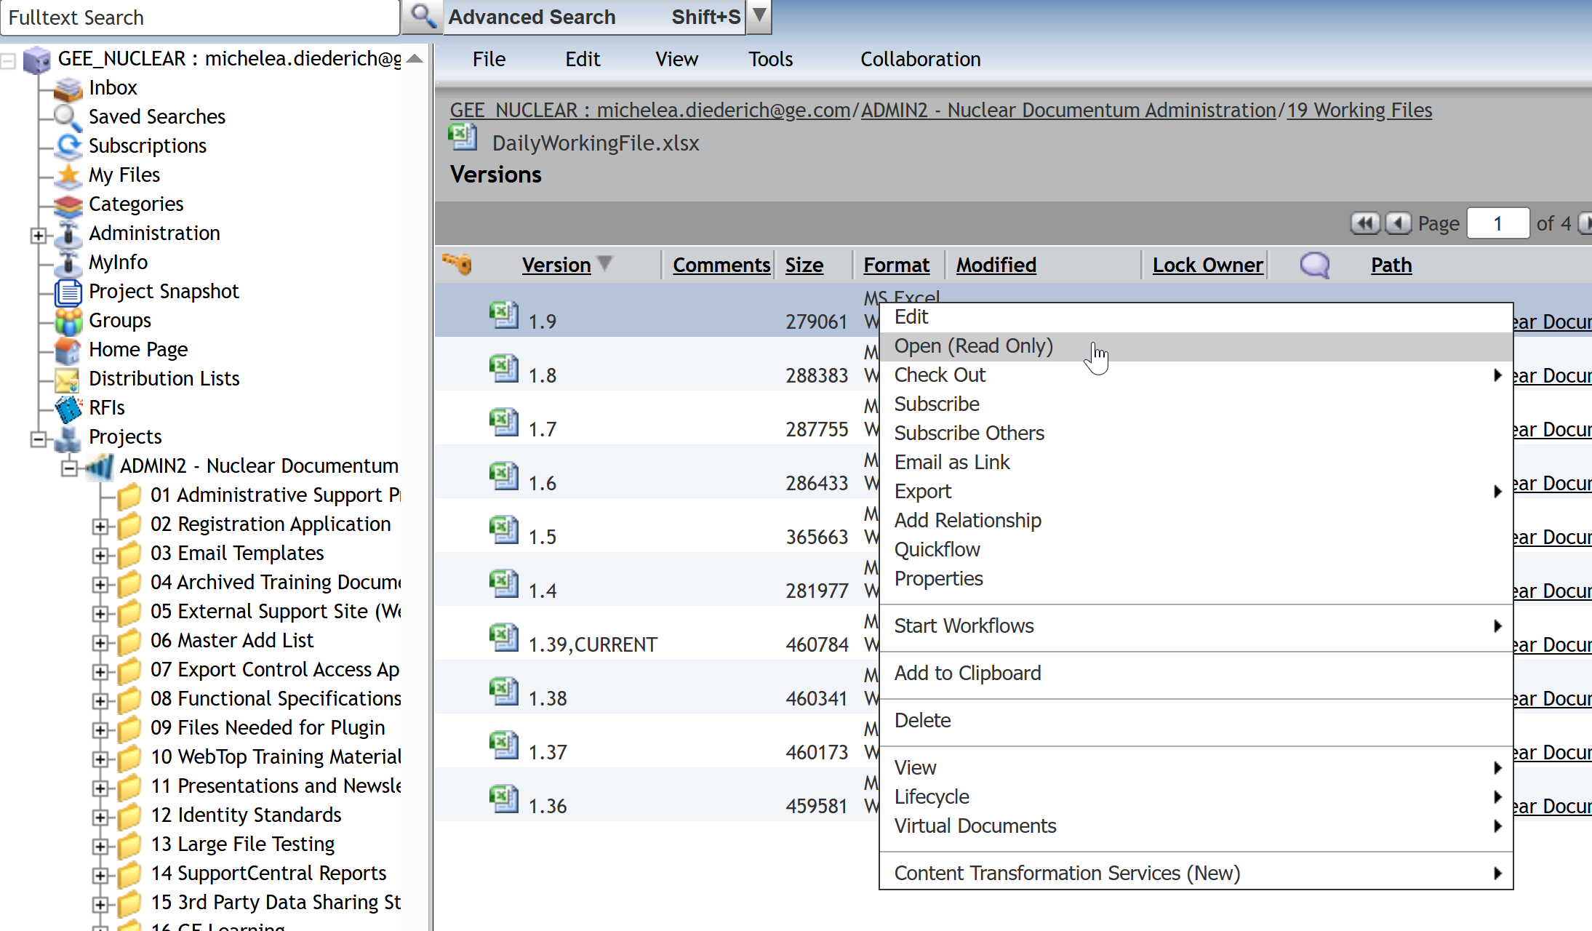
View Versions
To view versions of a file, right click on the file and select View > Versions. All previous imported versions of the file will be listed. To view any version, right click and select Open (Read Only).

Slide 20
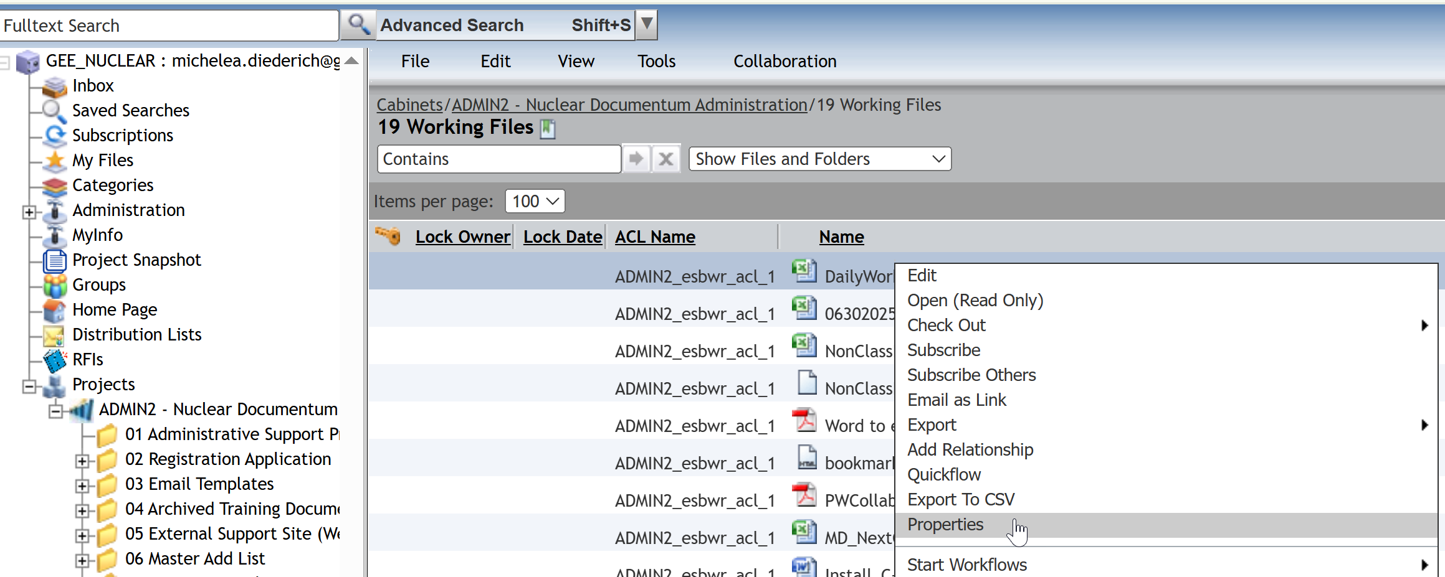
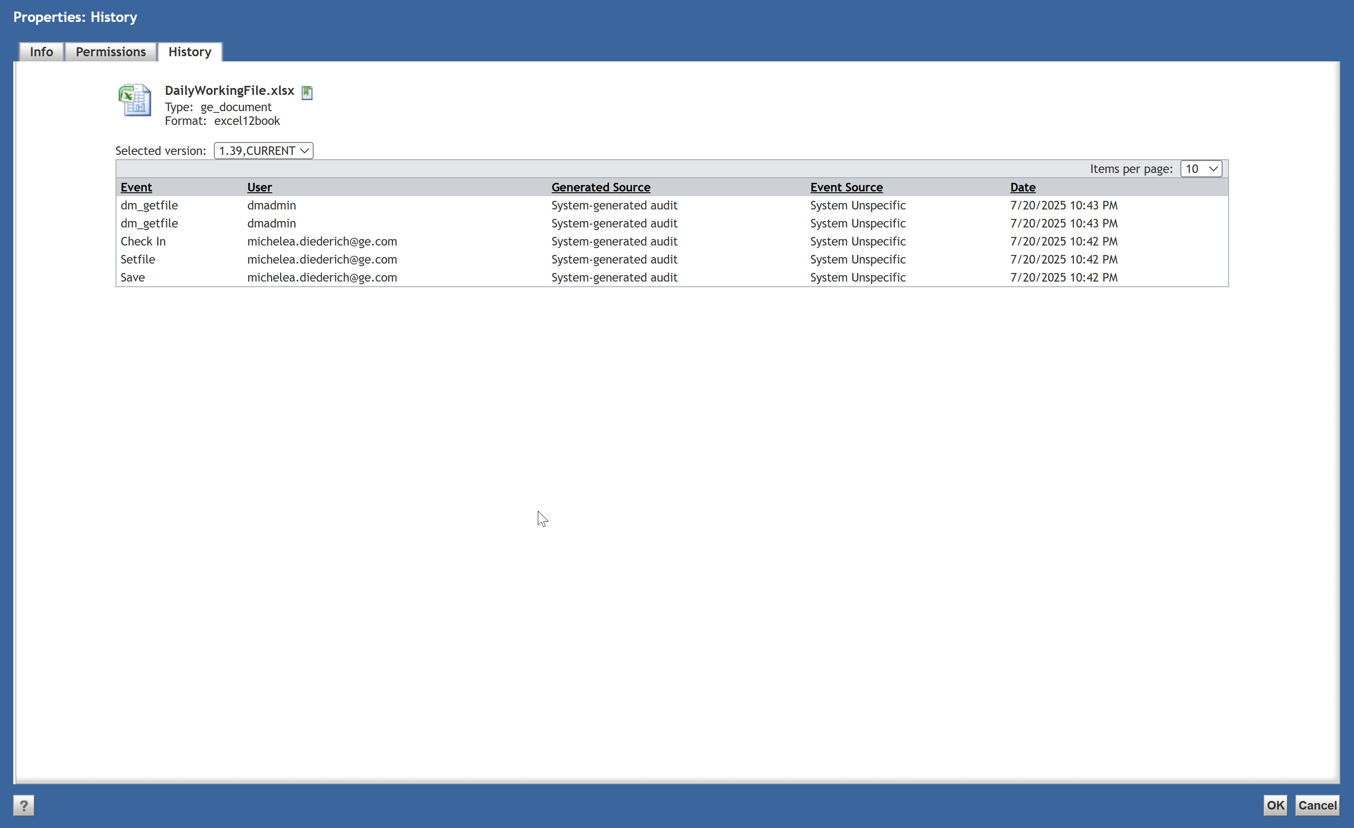
View File History
To view the file history, right click on the file and select Properties then click the History tab. A list of all activities on the file will be displayed with the Event, User and Date/Time. The latest version will be displayed; other versions can be selected from the drop-down box.

Slide 21
Documentum Support
If you encounter any issues with Documentum, please send an email to: nucleardocumentumsupport@gevernova.com and include the following information:
Full Name
Email Address
SSO
Project Name
Screen Shot of any Errors

