Slide 1
Documentum training
Searching
Michele Diederich
July 2025

Slide 2
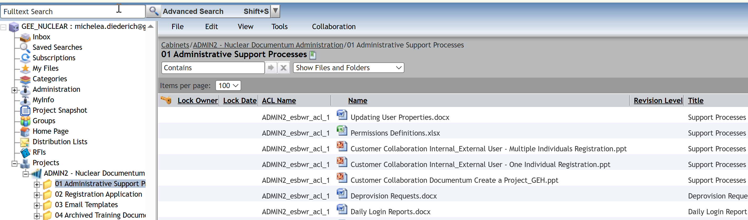
Active Workspace Search
  The Active Workspace Search, Contains box in the grey header, will search the Name of all files and forms in the current folder you are accessing.

Slide 3
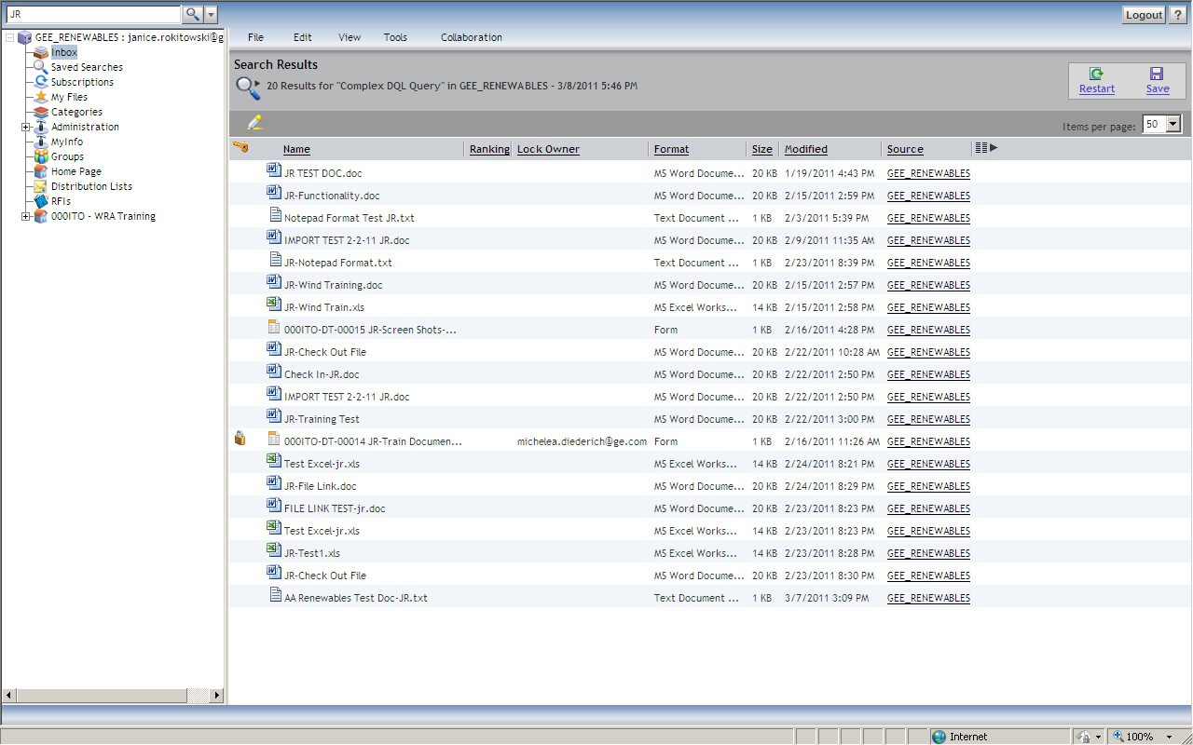
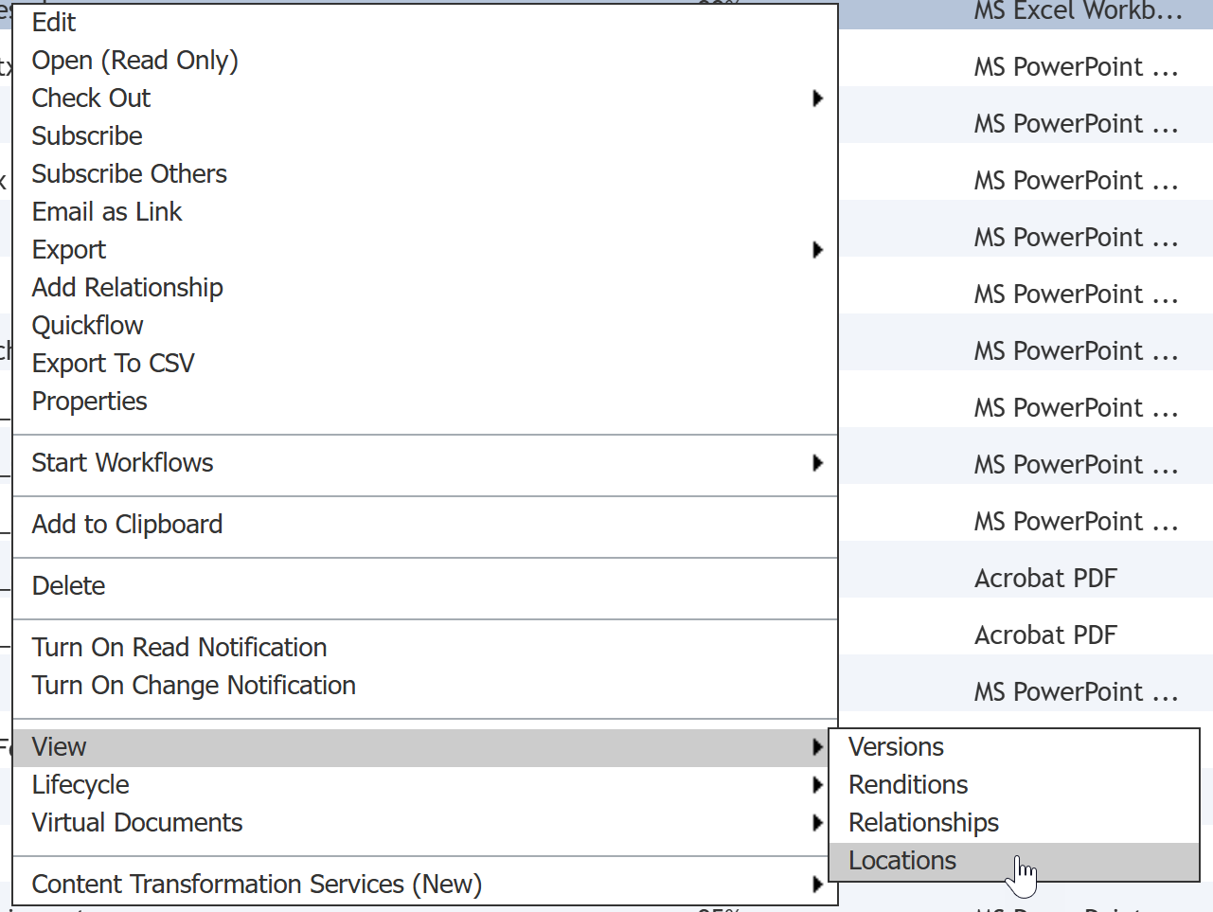
Fulltext Search
  The Fulltext Search, top left of the screen, will search the Name, Title, Subject and content of all documents (non-image files) and forms in the current project. To find the location of any item in the search results, right click and select View > Locations.

Slide 4
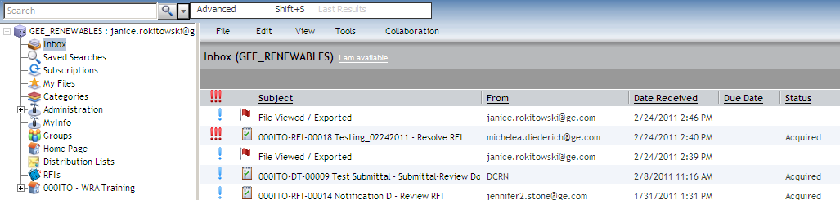
Advanced Search
  The Advanced Search, located to the right of the Fulltext Search, allows you to perform a customized search using one or more properties and/or date.

Slide 5
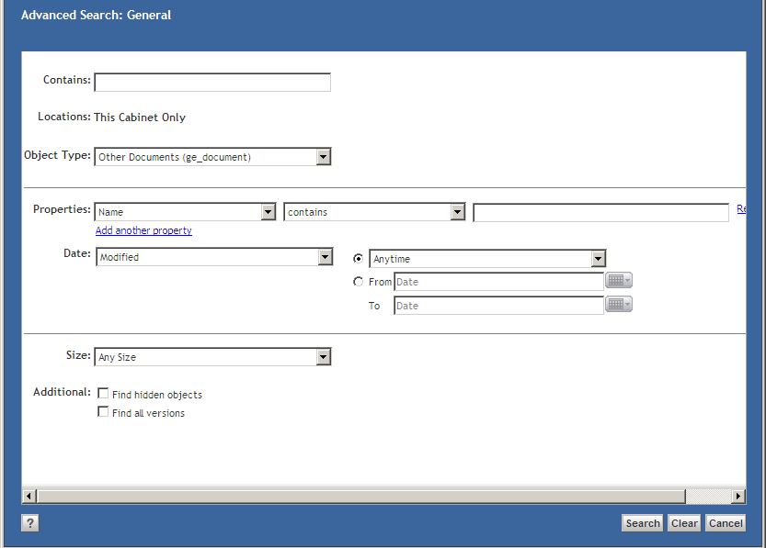
Advanced Search
  Enter the search criteria and click Search. The Contains box at the top of the page performs the same search as the Fulltext Search.

Slide 6
Advanced Search
  To find the location of any item in the search results, right click and select View > Locations.

Slide 7
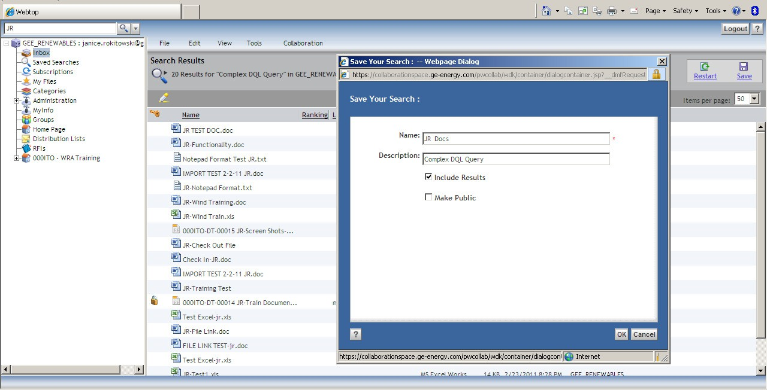
Save a Search
  After the search results are listed, click Save. Enter a name for the search, check the Include Results box to save current results. The saved search will default to Private; check Make Public to share with other individuals who have access to the project. Click OK to save.
z

Slide 8
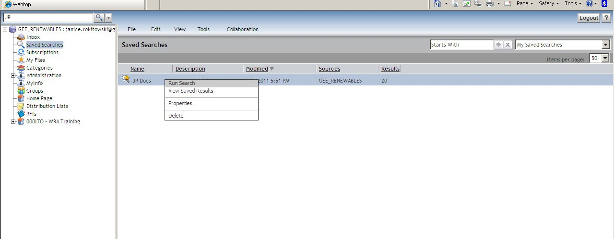
Run a Saved Search
  To run a Saved Search, select the Search (from the Saved Searches node), right click and choose Run Search. The most current data matching the search criteria will be returned.

Slide 9
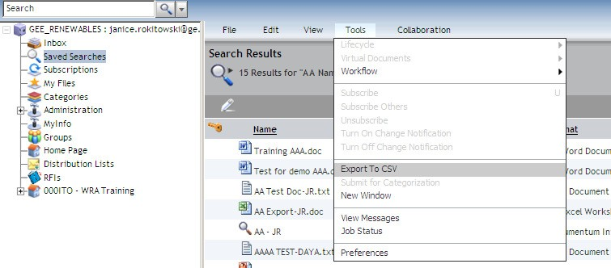
Export Search Results
  The results of a Fulltext Search or Advanced Search can be exported and saved as an Excel file. From the Tools menu, select Export to CSV and save the file.

Slide 10
Documentum Support
  If you encounter any issues with Documentum, please send an email to: nucleardocumentumsupport@gevernova.com and include the following information:
      Full Name
      Email Address
      SSO
      Project Name
      Screen Shot of any Errors

