Slide 1
Documentum training Issue Form
Michele Diederich
July 2025

Slide 2
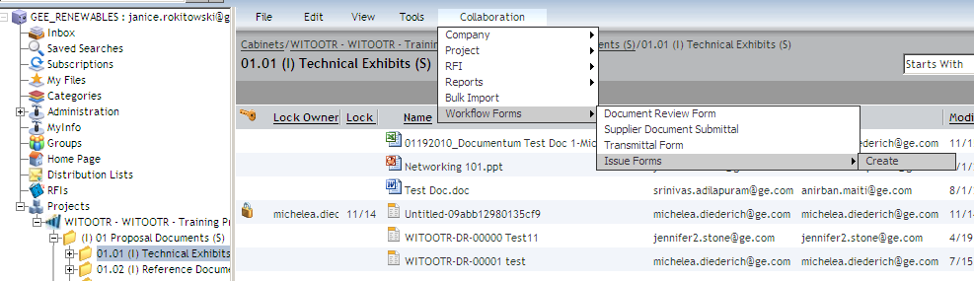
Create an Issue Form
Navigate to the folder in the project where the Issue Form should be created. From the Collaboration menu, select Workflow Forms > Issue Forms > Create.

Slide 3
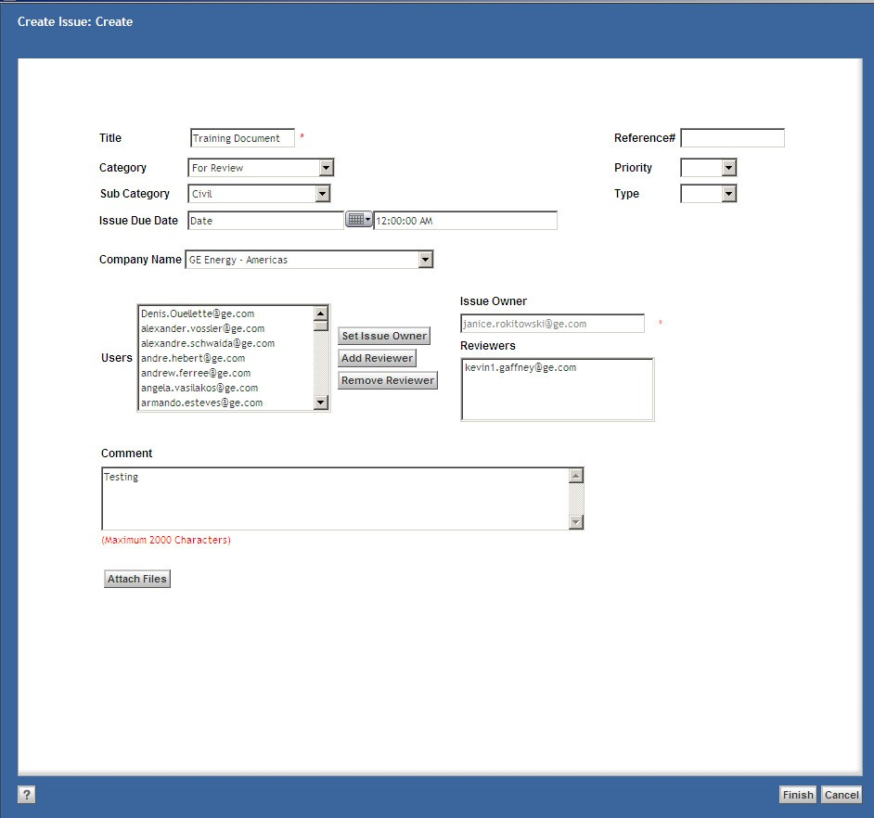
Create an Issue Form
Complete all required fields (marked with a red asterisk) and any optional fields as needed for the business process. Choose a Company Name from the drop down. Highlight the user to be the Issue Owner and click Set Issue Owner. Follow the same process to select Reviewers as needed. Click Add Files to add attachments (see next slide for details).

Slide 4
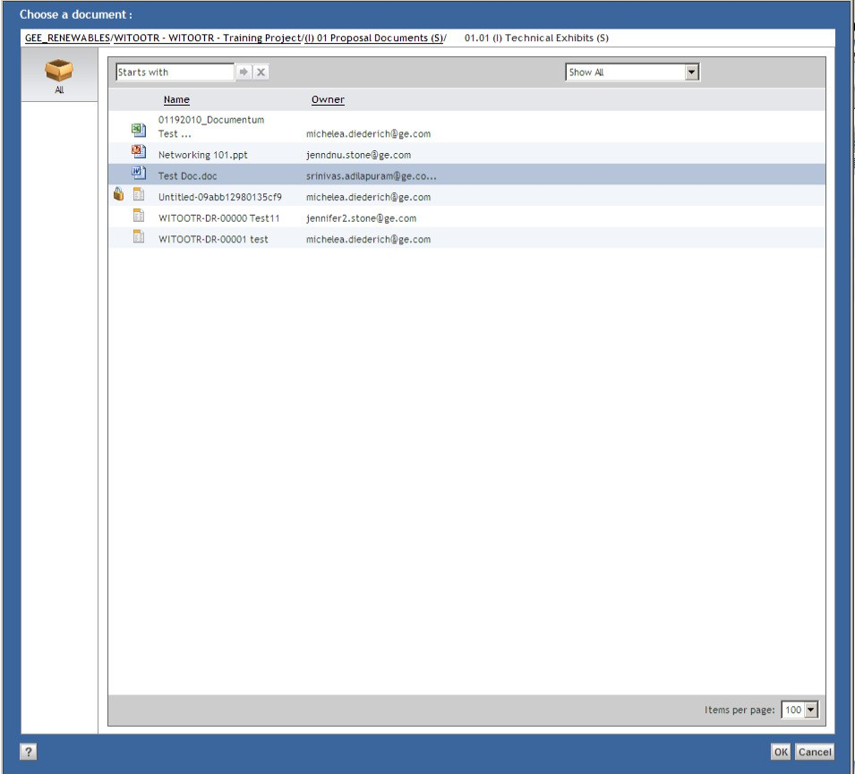
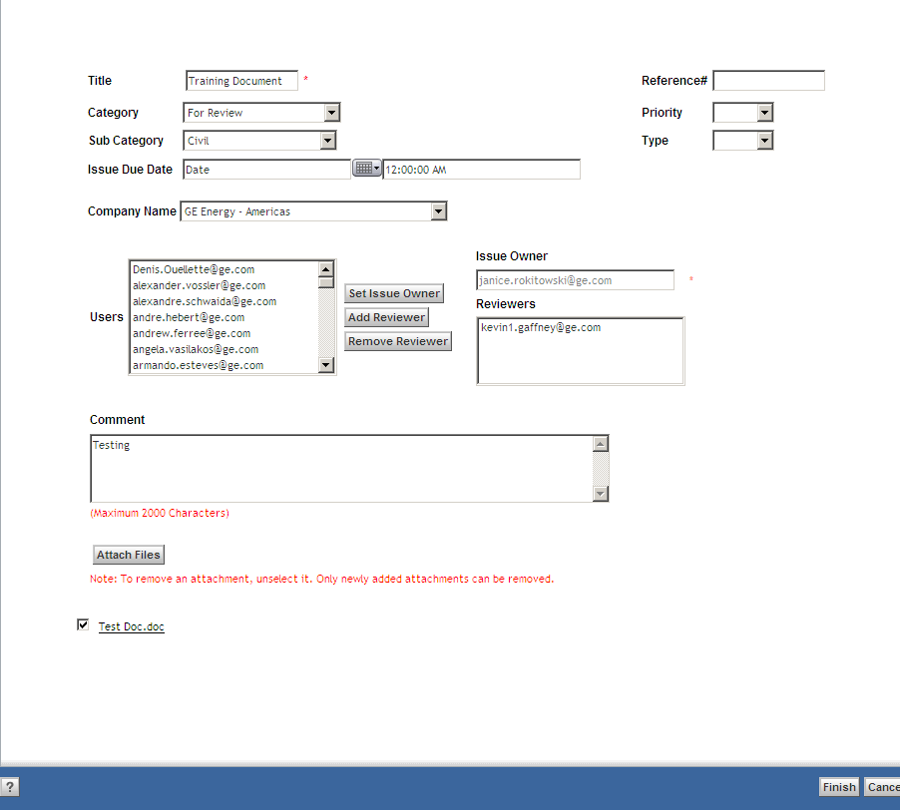
Create an Issue Form
Select files (must be previously imported to the project) to be added and click OK. Add comments as needed and click Finish to create the Issue Form.

Slide 5
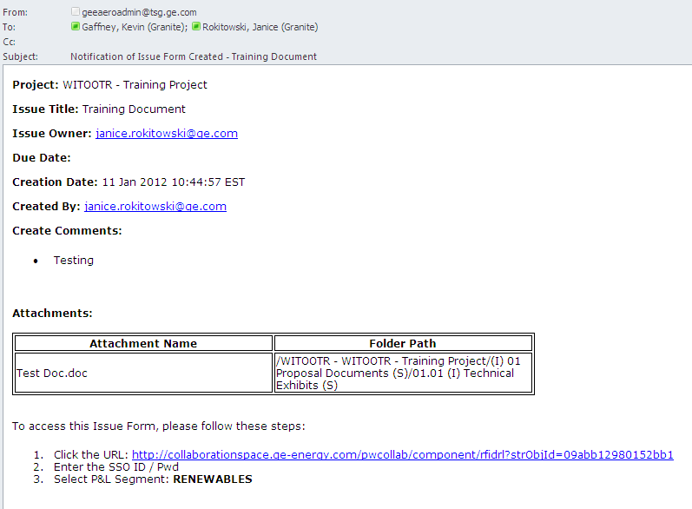
Create an Issue Form
The Creator, Issue Owner and Reviewers will receive an email notification. Users may access the Issue Form from the link in the email or navigate to the form in the project (see next slide).

Slide 6
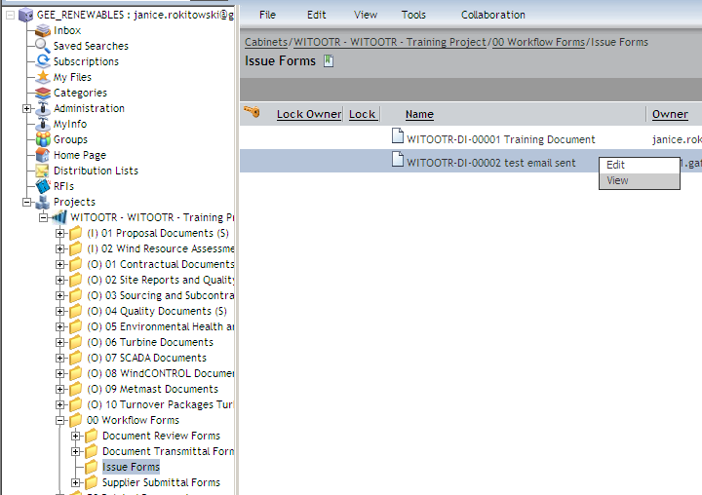
View an Issue Form
Navigate to the folder in the project where the Issue Form was created or the Issue Forms Folder under 00 Workflow Forms. Double click on the form or right click > View to open it.
Issues are ‘Private’ by default

Slide 7
Edit an Issue Form
The Creator, Issue Owner and Reviewers can add attachments and comments using the Edit function. Navigate to the folder in the project where the Issue Form was created or the Issue Forms Folder under 00 Workflow Forms, right click and select Edit.

Slide 8
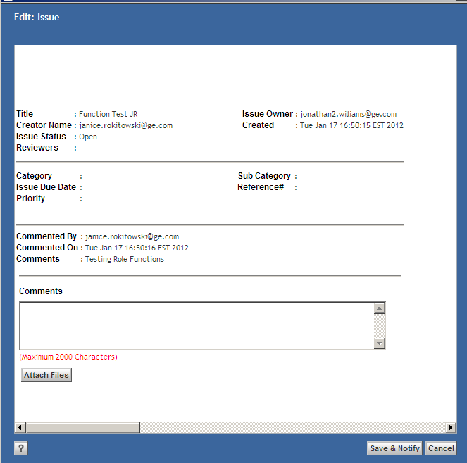
Edit an Issue Form
When the form opens, add attachments and comments as needed. Click Save & Notify to save the form and send an updated email notification. The Issue Owner and Reviewers will receive an email notification.

Slide 9
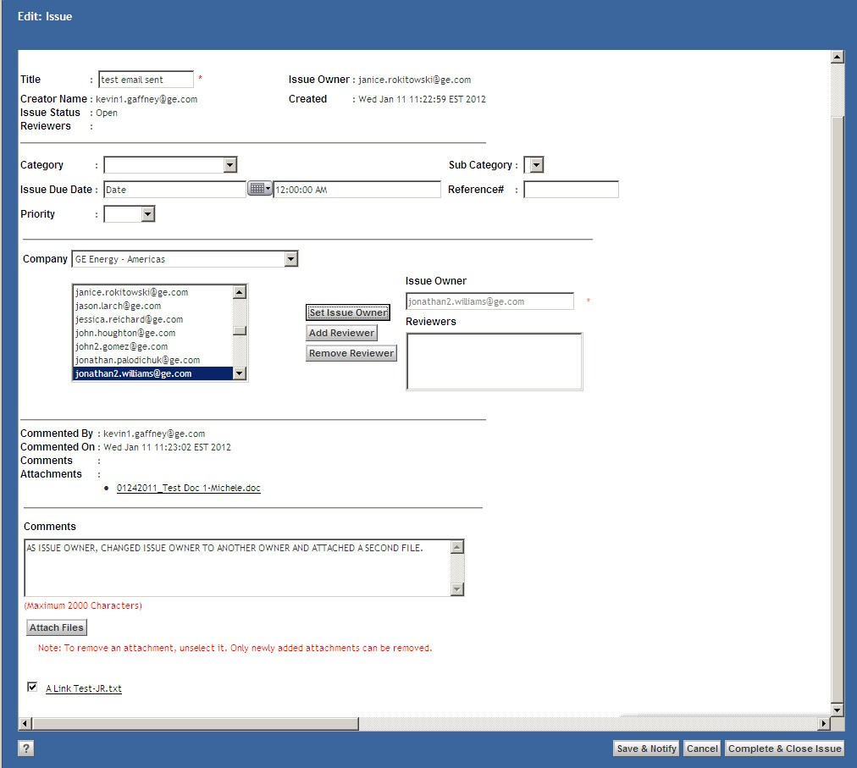
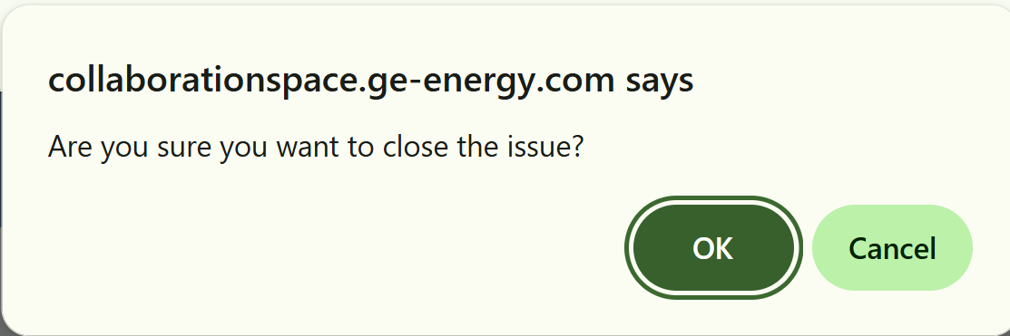
Issue Owner Actions & Close an Issue Form
The Issue Owner can change the Issue Owner, add or remove Reviewers, add comments and add attachments. Navigate to the folder in the project where the Issue Form was created or the Issue Forms Folder under 00 Workflow Forms, right click and select Edit. The Issue Owner is the only person who can close the Issue Form, using the Complete & Close Issue button. You will receive a confirmation dialog box. Click OK and the form will be closed. Click Cancel to keep the form open.

Slide 10
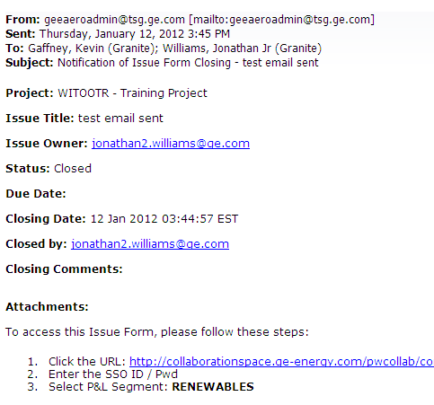
Close an Issue Form
When the Issue Form is closed, the Creator, Issue Owner and Reviewers will receive an email notification. The Issue Form is now read only in the system and cannot be edited.

Slide 11
Documentum Support
If you encounter any issues with Documentum, please send an email to: nucleardocumentumsupport@gevernova.com and include the following information:
Full Name
Email Address
SSO
Project Name
Screen Shot of any Errors

