Slide 1
Documentum training Create a New folder
Michele Diederich
July 2025

Slide 2
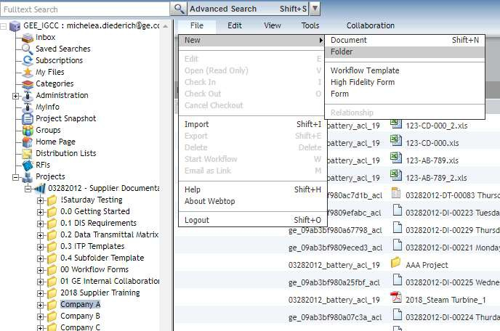
Create a New Folder
Navigate to the folder where the new folder is to be created. From the File menu, click New > Folder.

Slide 3
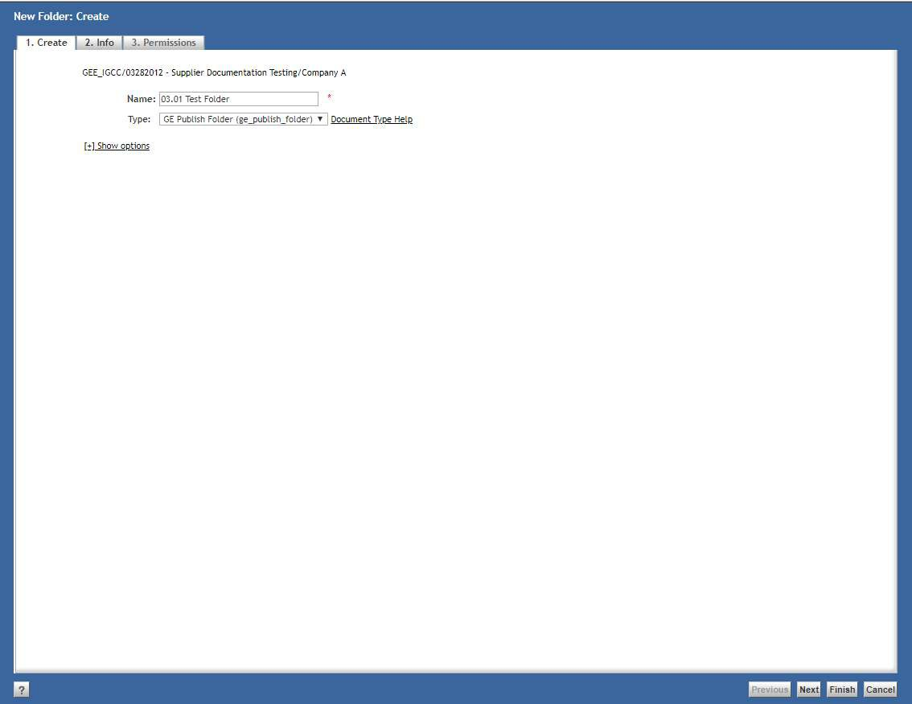
Create a New Folder
Enter the Name of the folder and click Finish. Commas, slashes, apostrophes and quotation marks should not be used in the name of the folder.

Slide 4
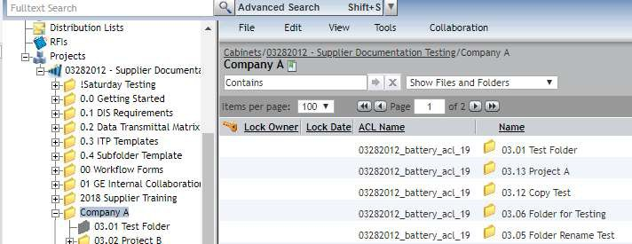
Create a New Folder
The new folder is created and ready for use.

Slide 5
Documentum Support
If you encounter any issues with Documentum, please send an email to: nucleardocumentumsupport@gevernova.com and include the following information:
Full Name
Email Address
SSO
Project Name
Screen Shot of any Errors

