Slide 1
Documentum training copy, link, and move files
Michele Diederich
July 2025

Slide 2
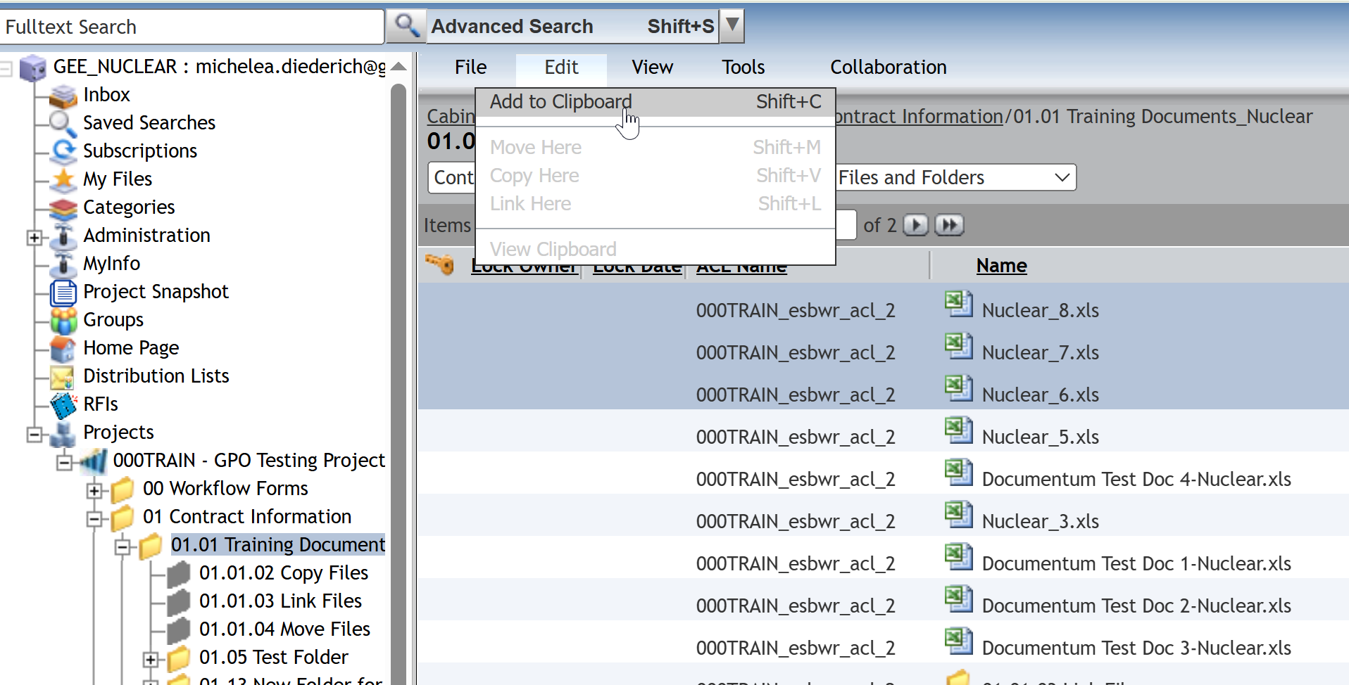
Copy a File
Select file(s) to be copied and click Edit > Add to Clipboard.

Slide 3
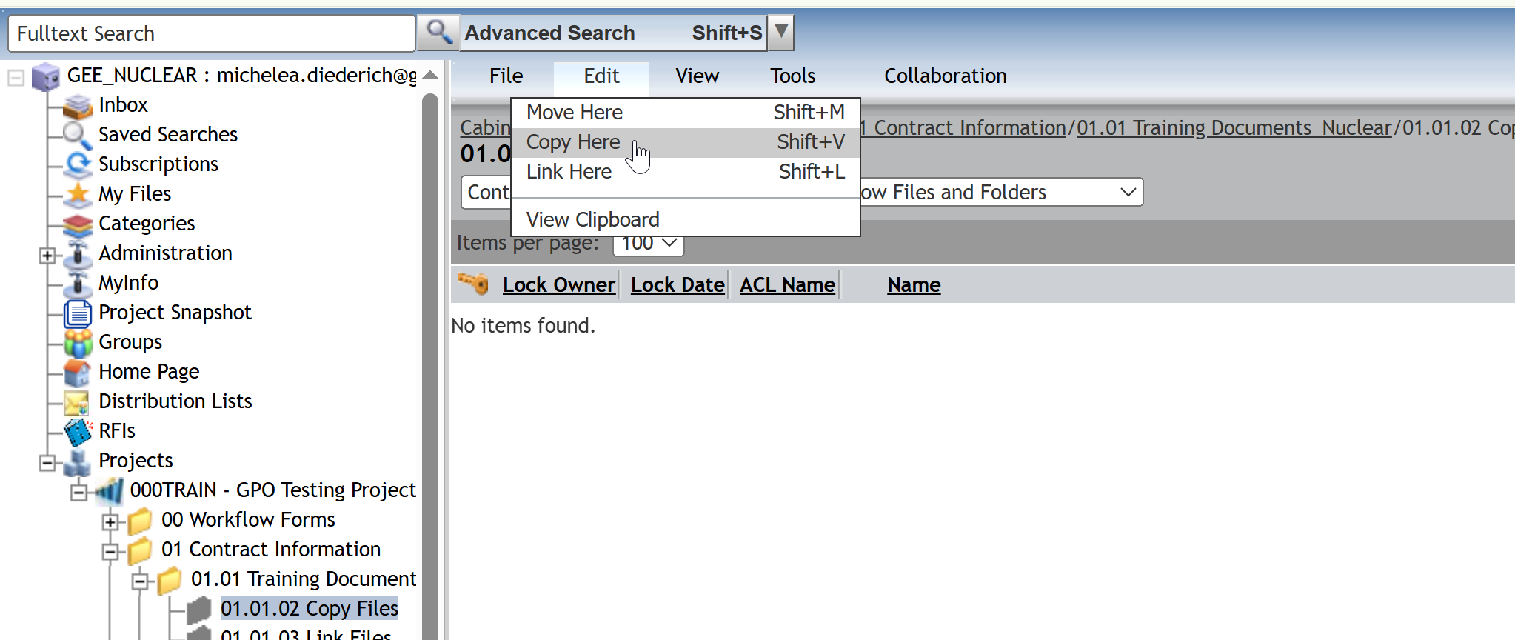
Copy a File
Navigate to the folder where the file(s) is to be copied to. Click Edit > Copy Here.

Slide 4
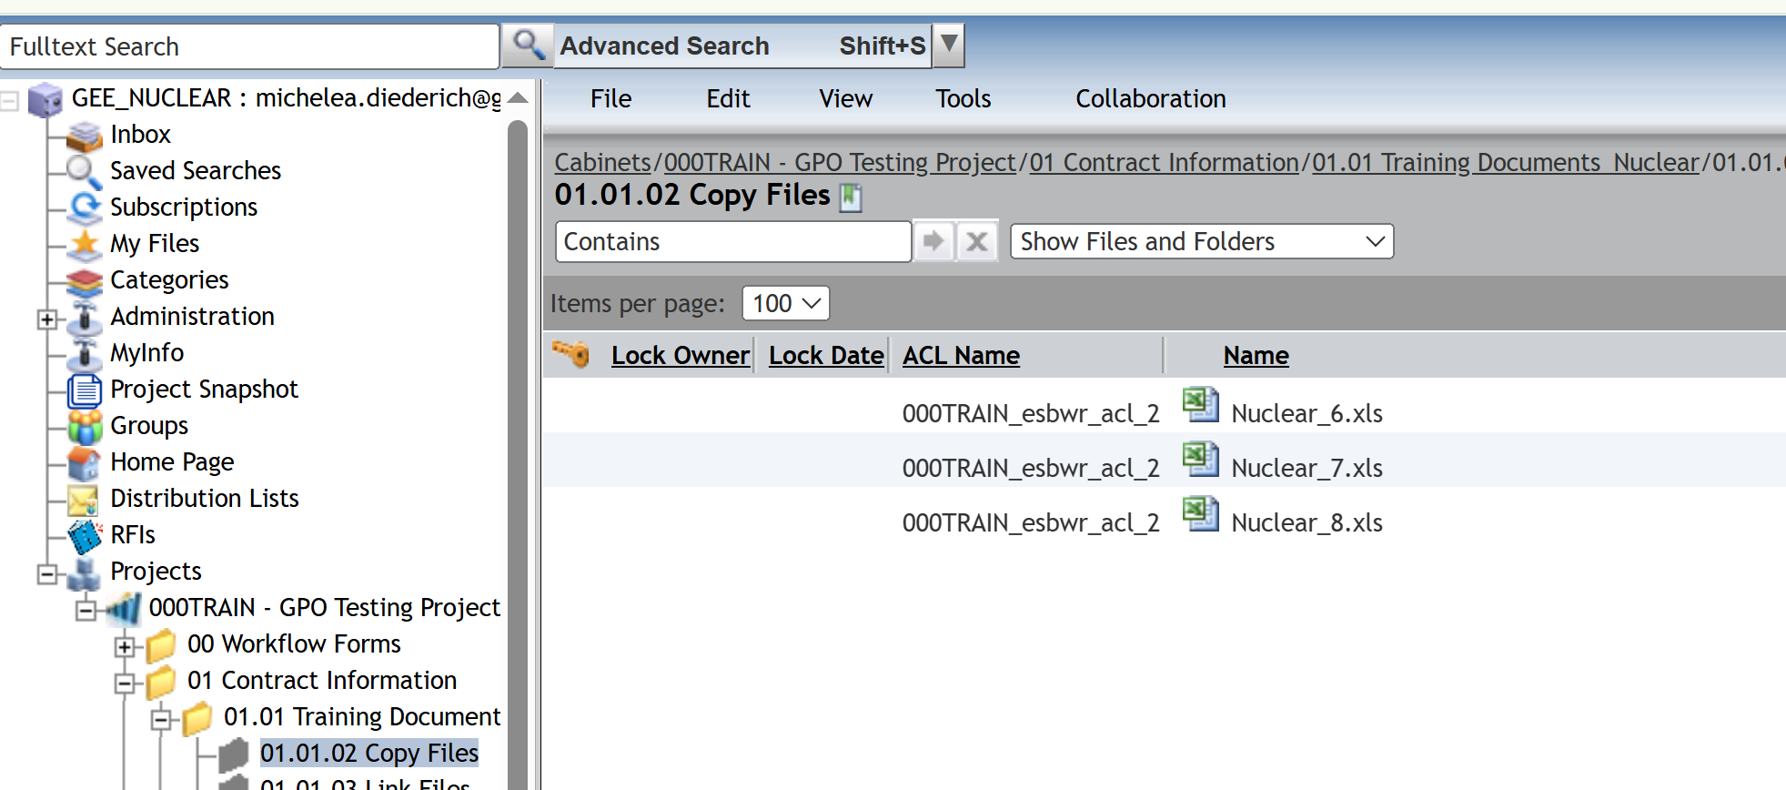
Copy a File
The file(s) will now appear in the new location. Files will inherit the security of the new location and be consider a new and separate object.

Slide 5
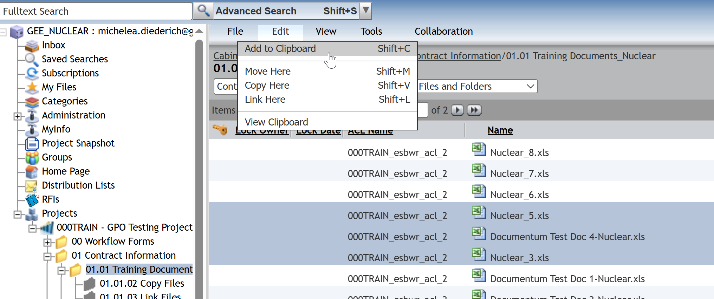
Link a File
Select file(s) to be linked and click Edit > Add to Clipboard.

Slide 6
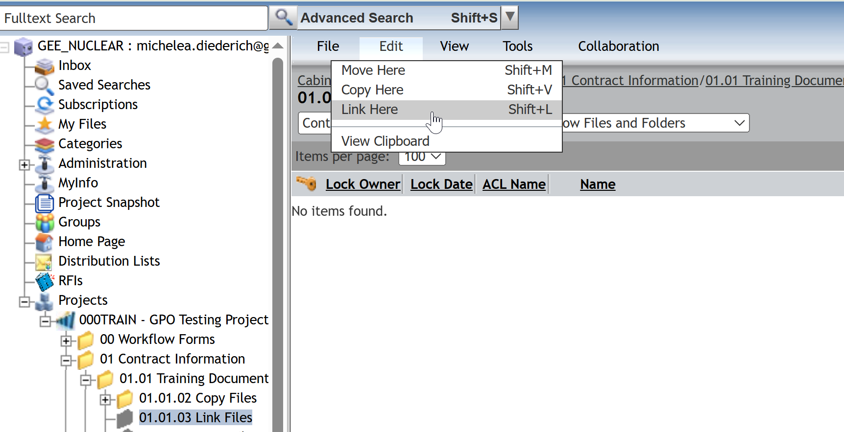
Link a File
Navigate to the folder where the file(s) is to be linked to. Click Edit > Link Here.

Slide 7
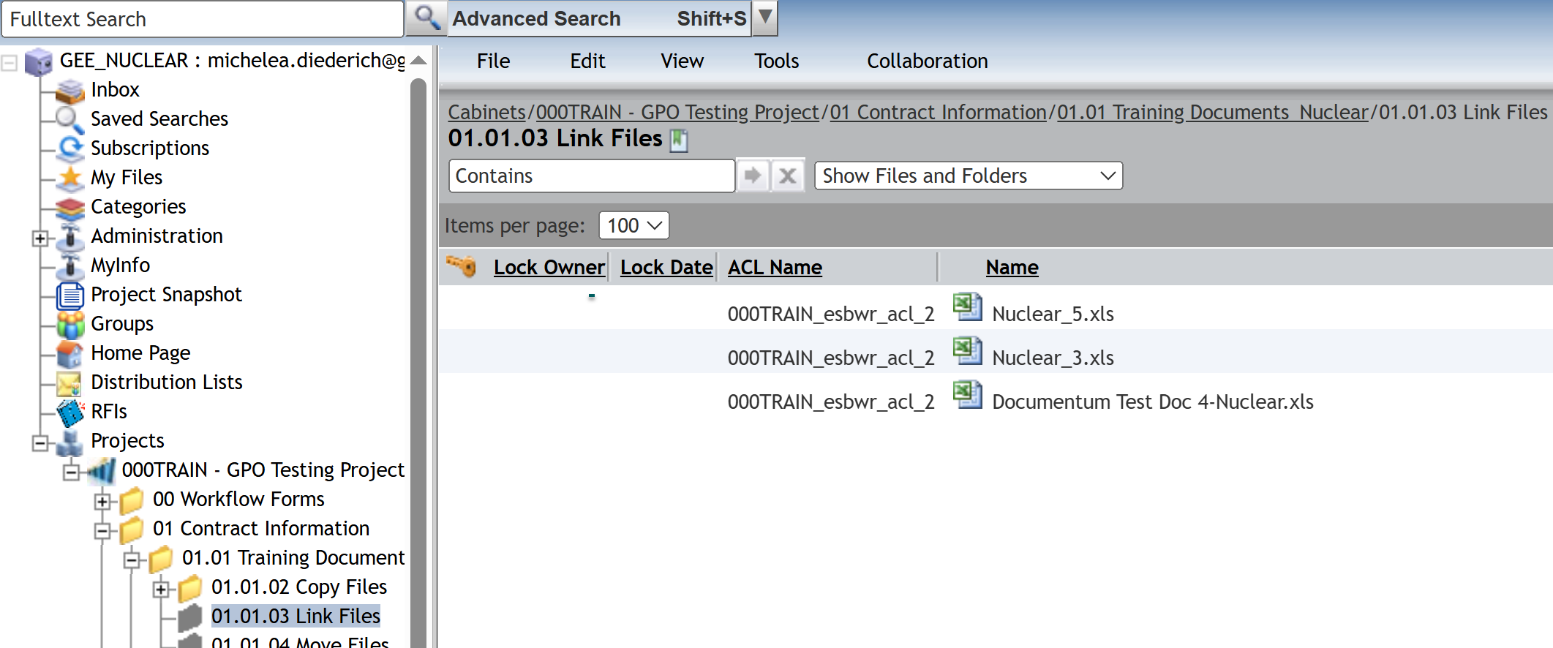
Link a File
The linked file(s) will now appear in the new location. File(s) will retain the security from the original location. Changes made to the file(s) will be reflected in both locations.

Slide 8
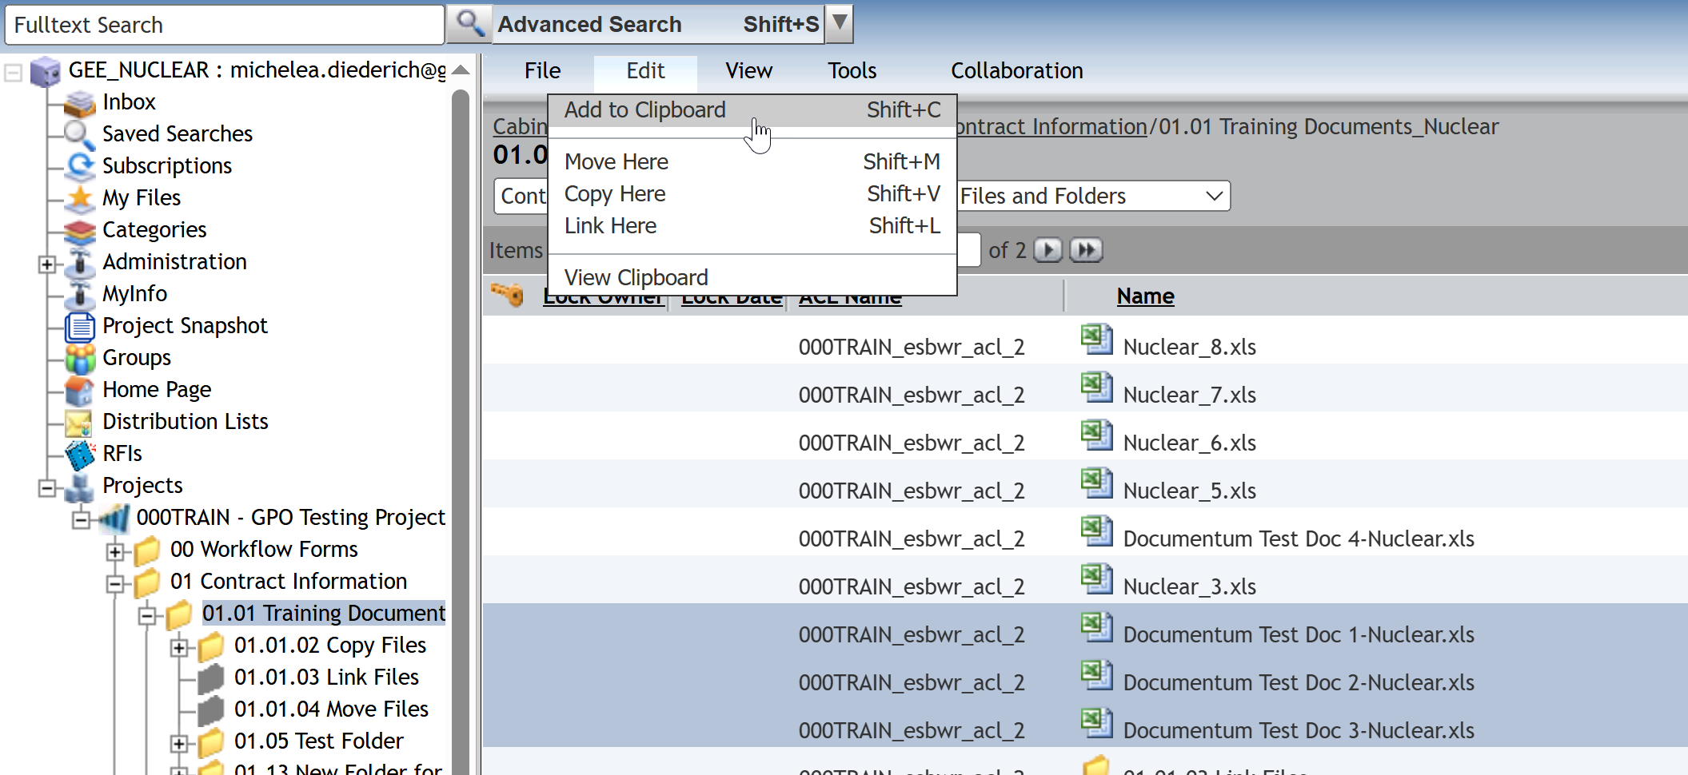
Move a File
Select file(s) to be moved and click Edit > Add to Clipboard.

Slide 9
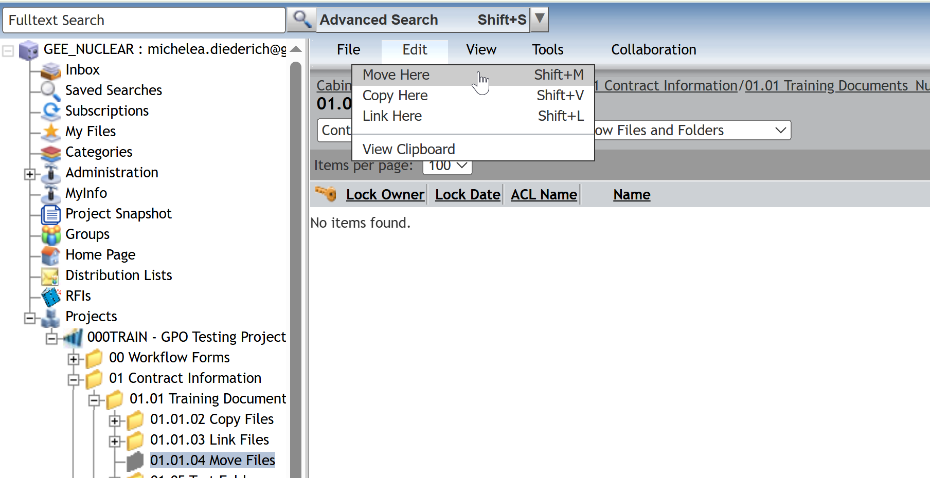
Move a File
Navigate to the folder where the file(s) is to be moved to. Click Edit > Move Here.

Slide 10
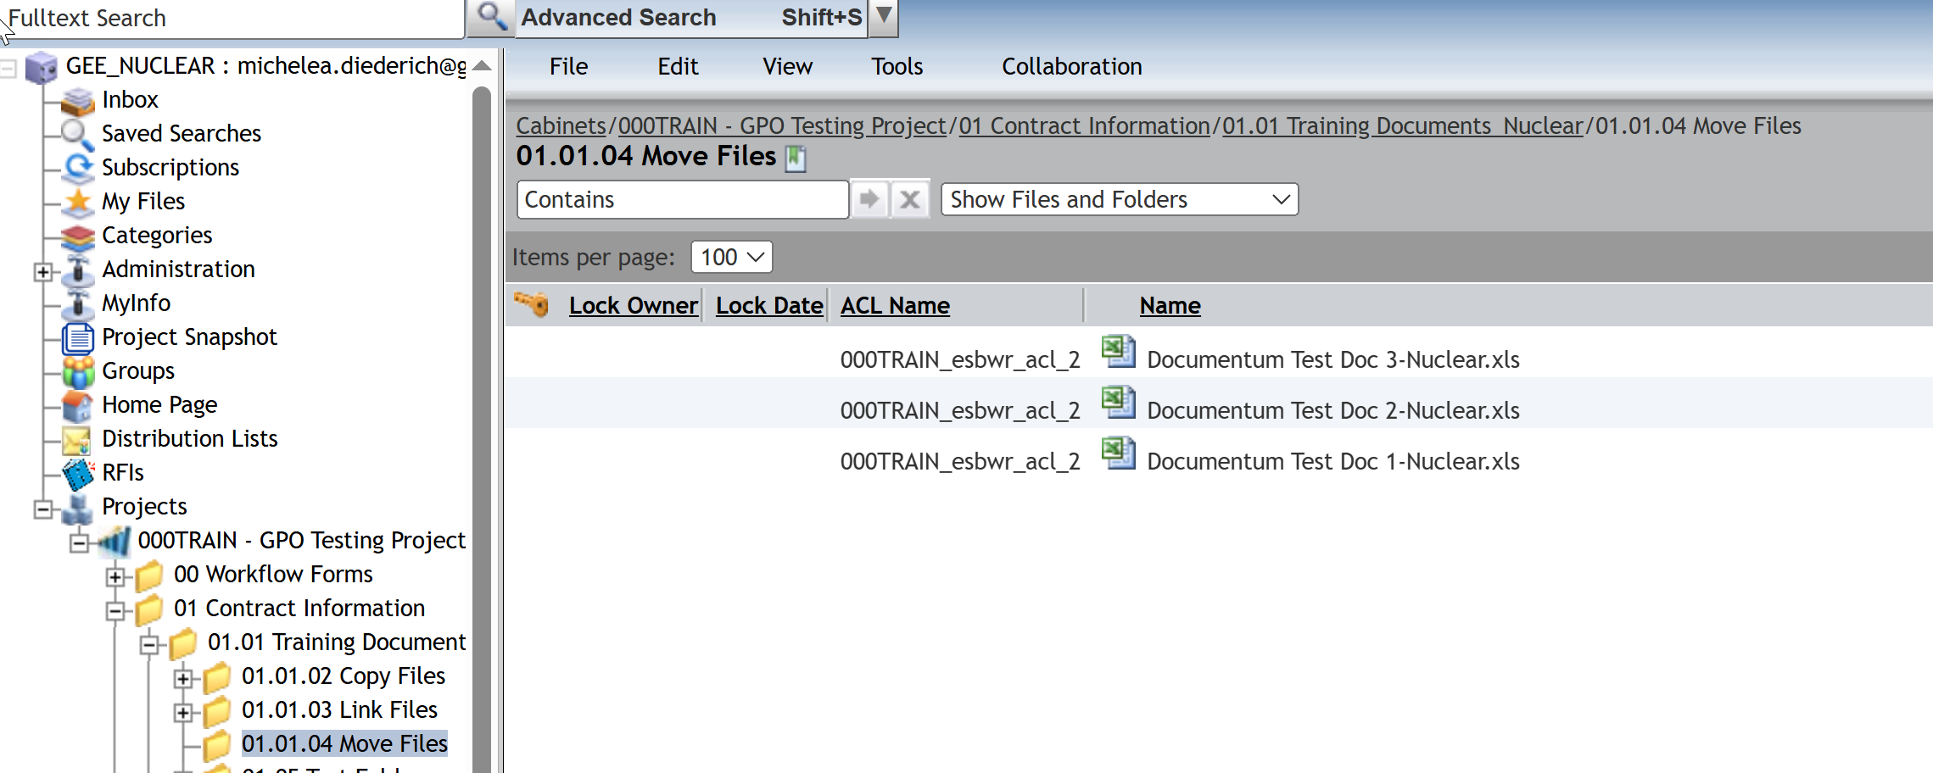
Move a File
The moved file(s) will now appear in the new location. File(s) will retain the security from the original location and will only reside in the new location.

Slide 11
Documentum Support
If you encounter any issues with Documentum, please send an email to: nucleardocumentumsupport@gevernova.com and include the following information:
Full Name
Email Address
SSO
Project Name
Screen Shot of any Errors

