Slide 1
Documentum training Bulk Import
Michele Diederich
July 2025

Slide 2
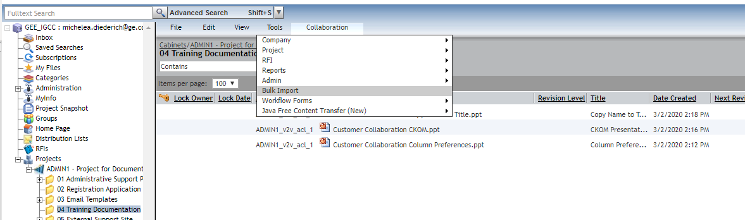
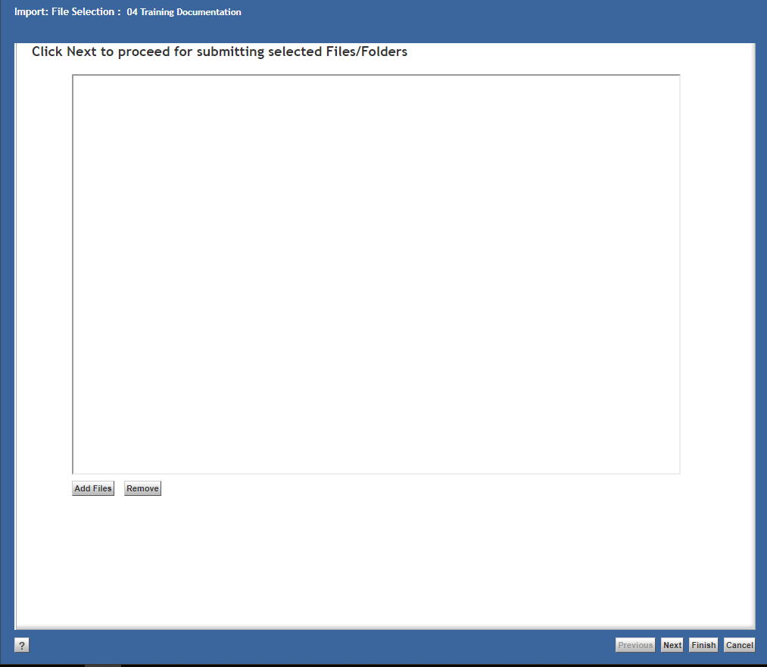
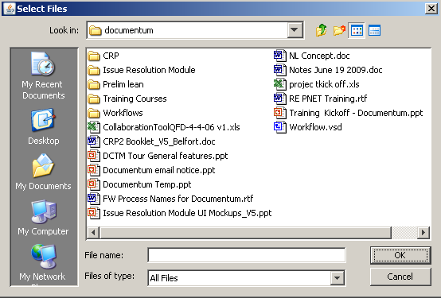
Bulk Import
To import files using Bulk Import, navigate to the folder where the files will be imported to. From the Collaboration menu, select Bulk Import. Click Add Files and select one or more files from your computer. Click OK.

Slide 3
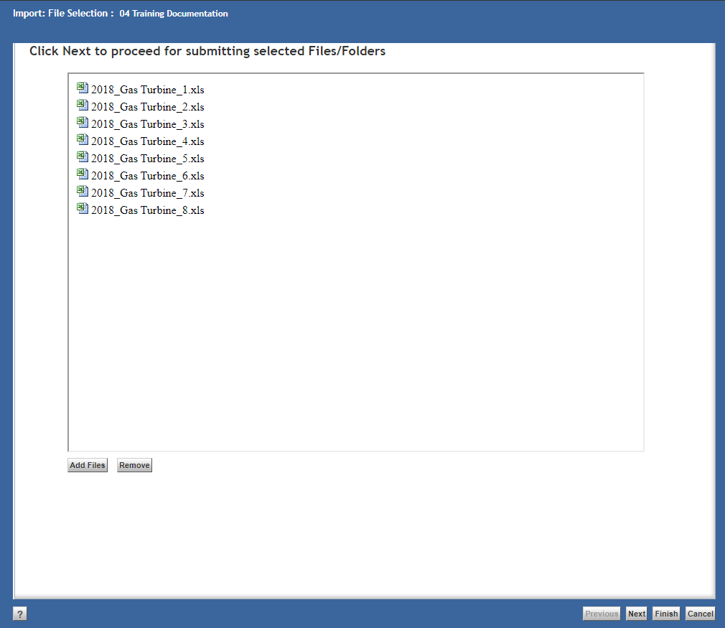
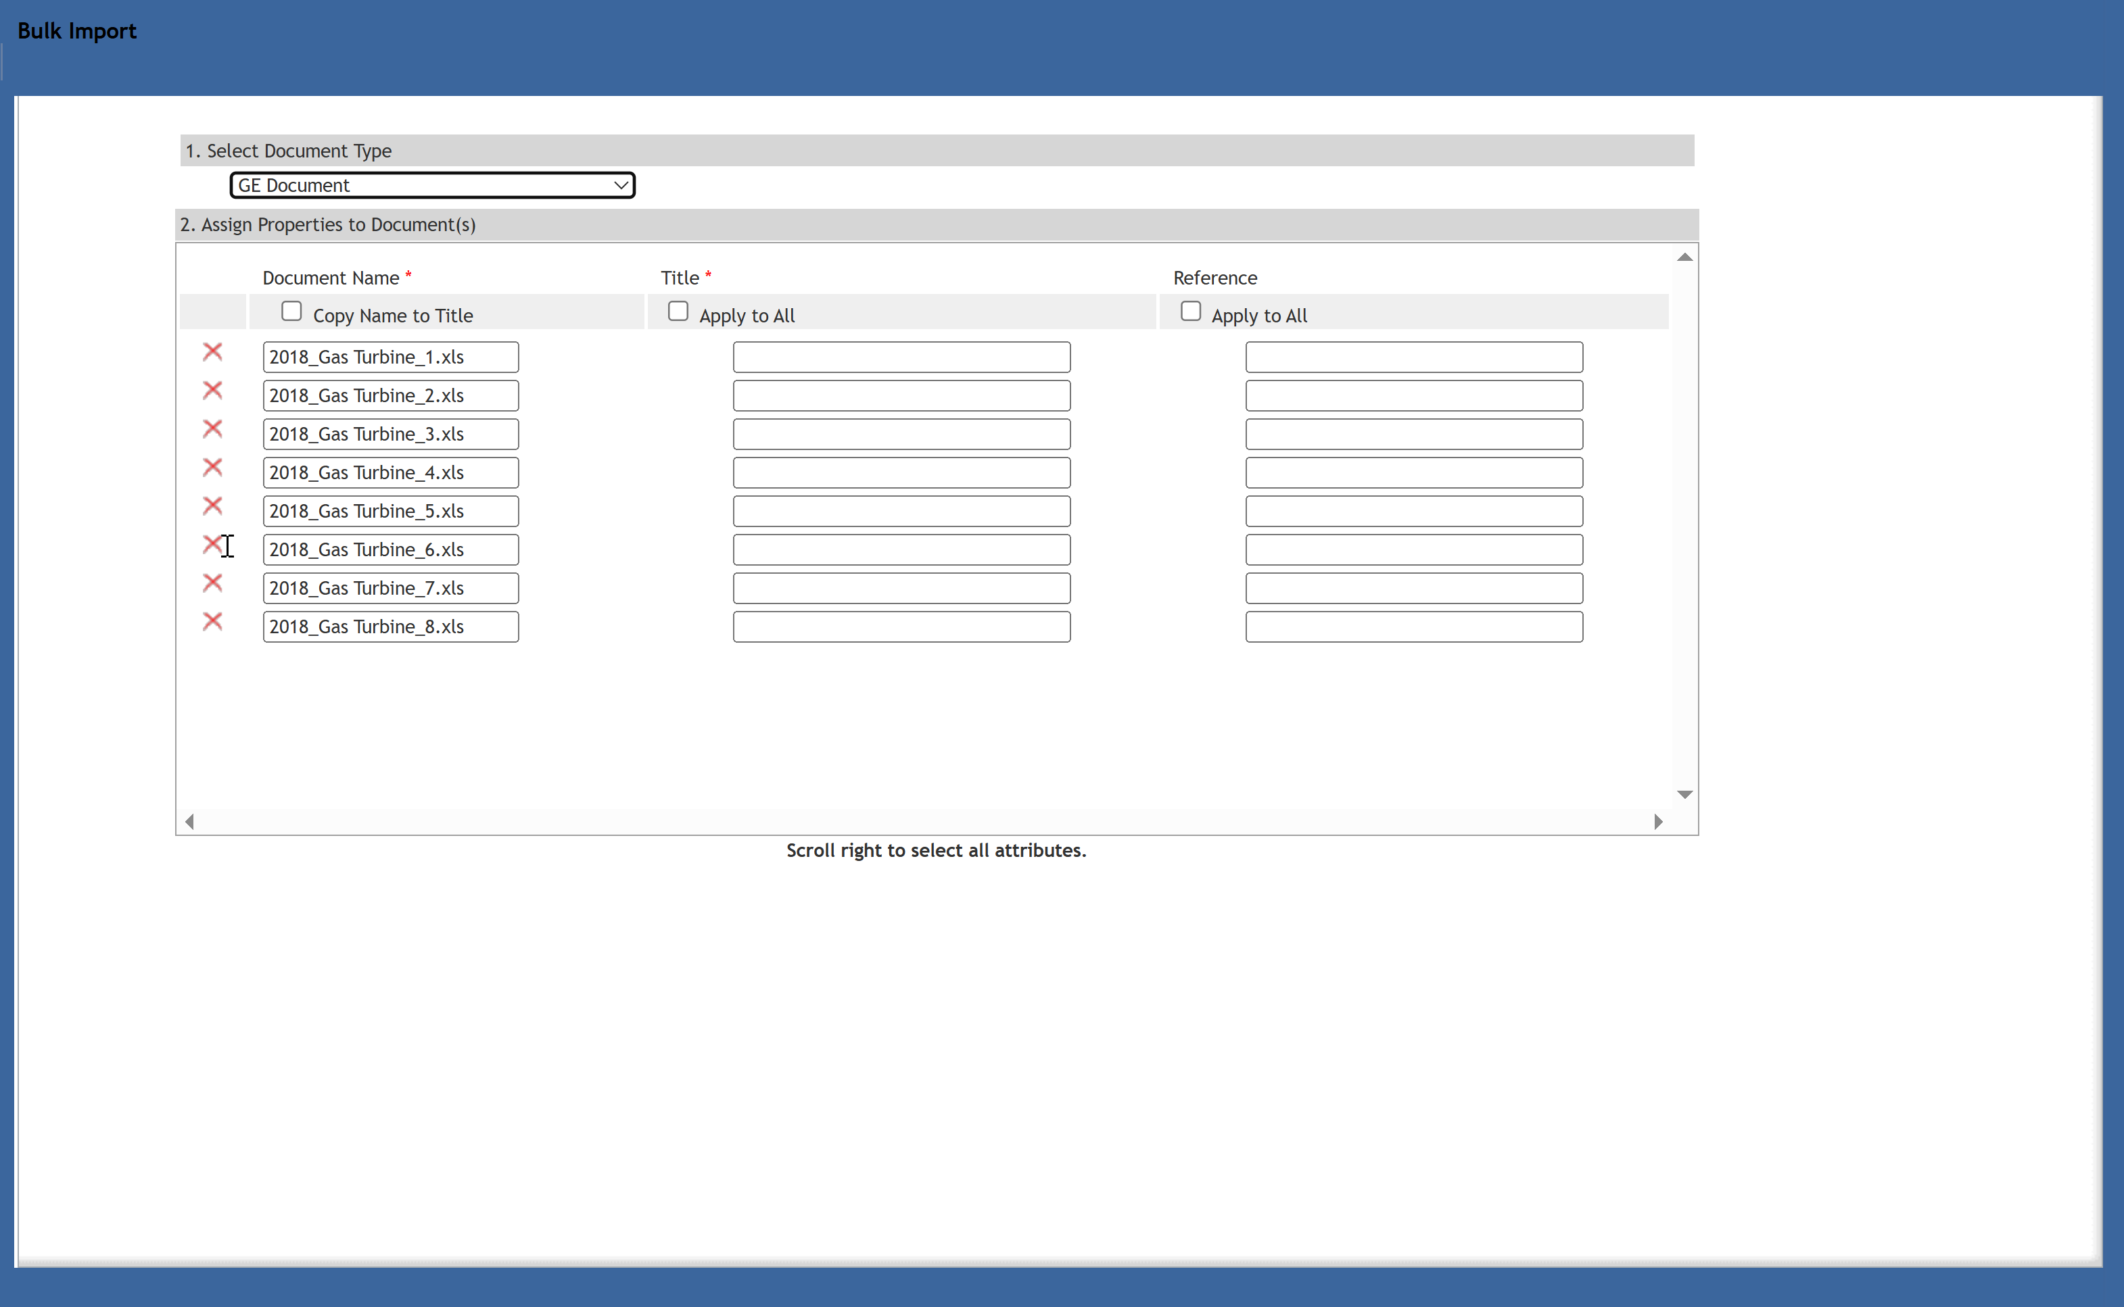
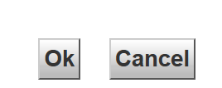
Bulk Import
Click Next to go the Bulk Import screen. Select Document Type from the drop-down box. Add required file properties (marked with a red asterisk) and click OK. You can complete each property separately or, if applicable, you can check the Apply to All box, and the top property listed will automatically populate to all files. To delete a file from the import, click the red X next to the file.

Slide 4
Documentum Support
If you encounter any issues with Documentum, please send an email to: nucleardocumentumsupport@gevernova.com and include the following information:
Full Name
Email Address
SSO
Project Name
Screen Shot of any Errors

