Slide 1
Documentum training Document Transmittal Form
Michele Diederich
March 2024

Slide 2
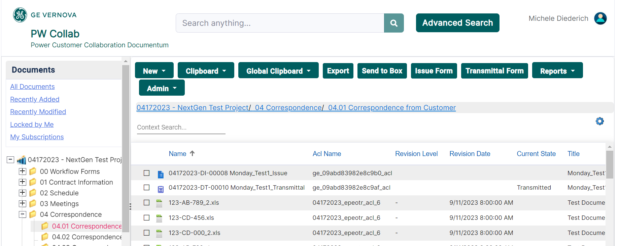
Create a Document Transmittal Form
Select the folder from the Navigation Tree where the form is to be created and click Transmittal Form in the tool bar.

Slide 3
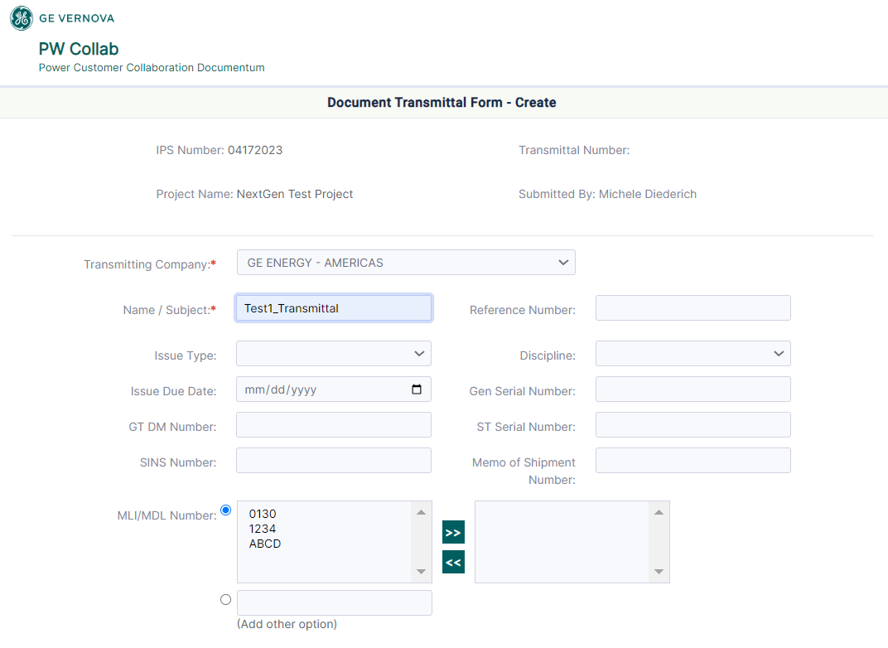
Create a Document Transmittal Form
Complete all required fields (marked with a red asterisk) and optional fields as needed for the specific business process.

Slide 4
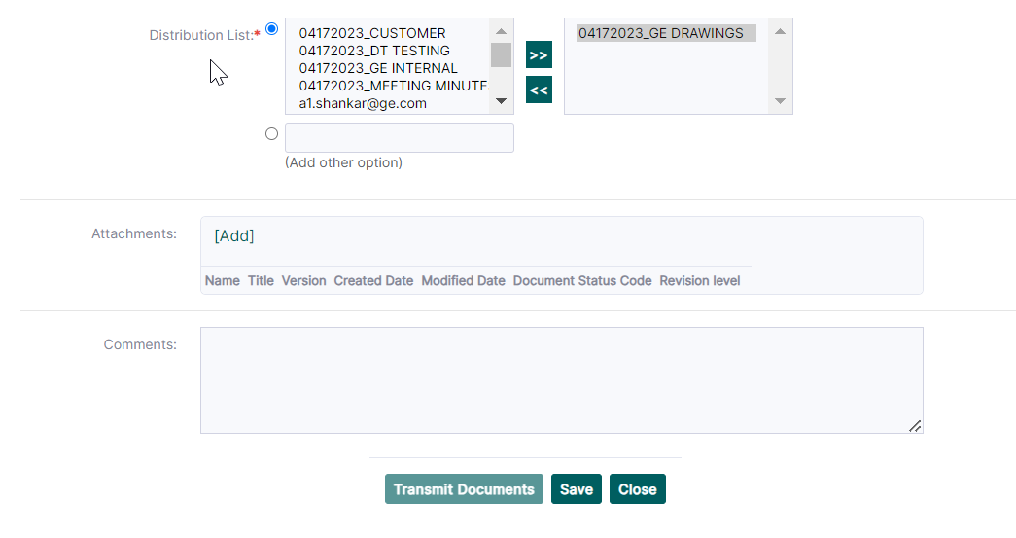
Create a Document Transmittal Form
Select individuals and Project Specific Distribution Lists from the Distribution List box who are to receive the Document Transmittal.

Slide 5
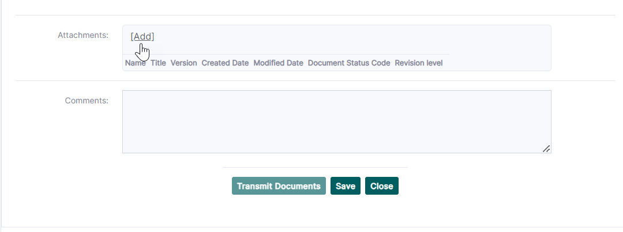
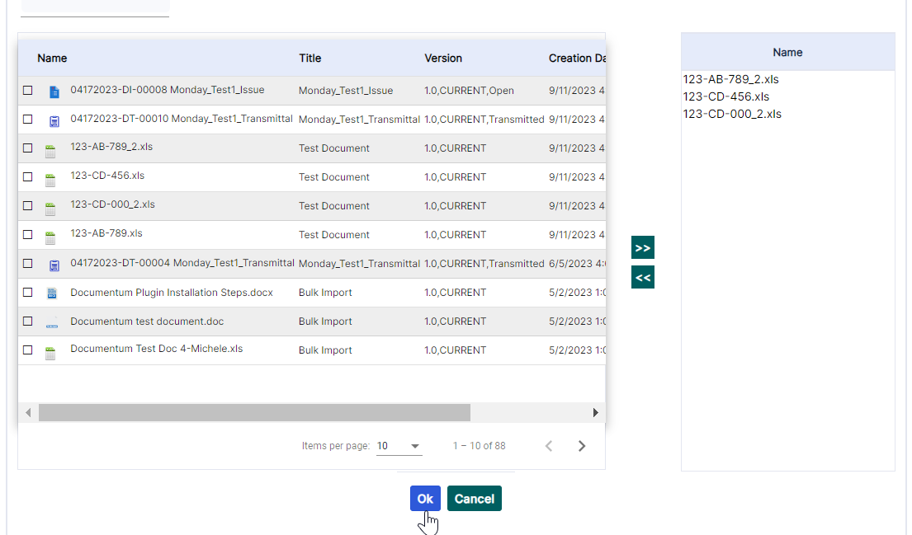
Create a Document Transmittal Form
Add attachments and comments as needed. Attachments must be imported to the project before the form is created.

Slide 6
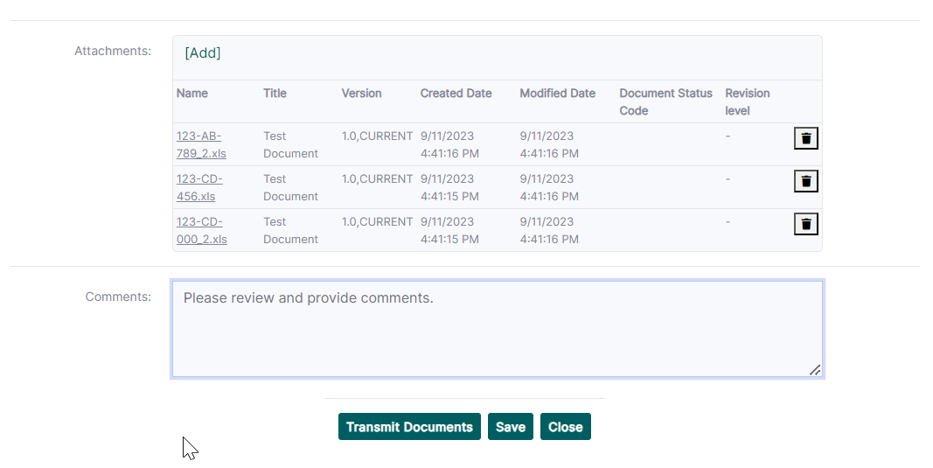
Create a Document Transmittal Form
Transmit Documents: Creates the form and sends an email notification.
Save: Saves form as a draft to be completed at another time - drafts are in the folder where the form was created and in the Document Transmittal Forms folder located under 00 Workflow Forms. To modify/complete a saved form, right click and choose Edit. Make the changes as needed and then click Transmit Documents.
Close - Cancels the form without saving.

Slide 7
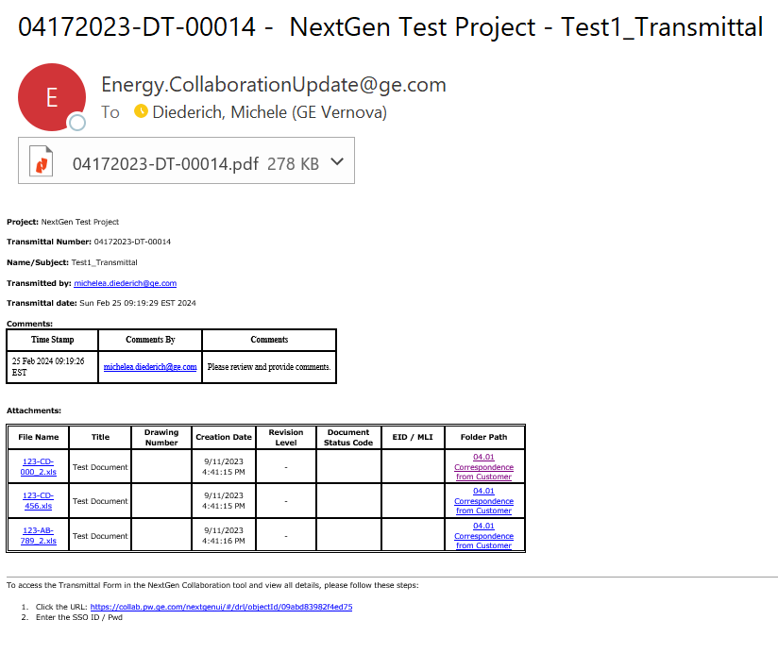
Document Transmittal Form Email
An email will be sent to those selected for distribution. From this email users will be able to use the links to view the form and any attachments.

Slide 8
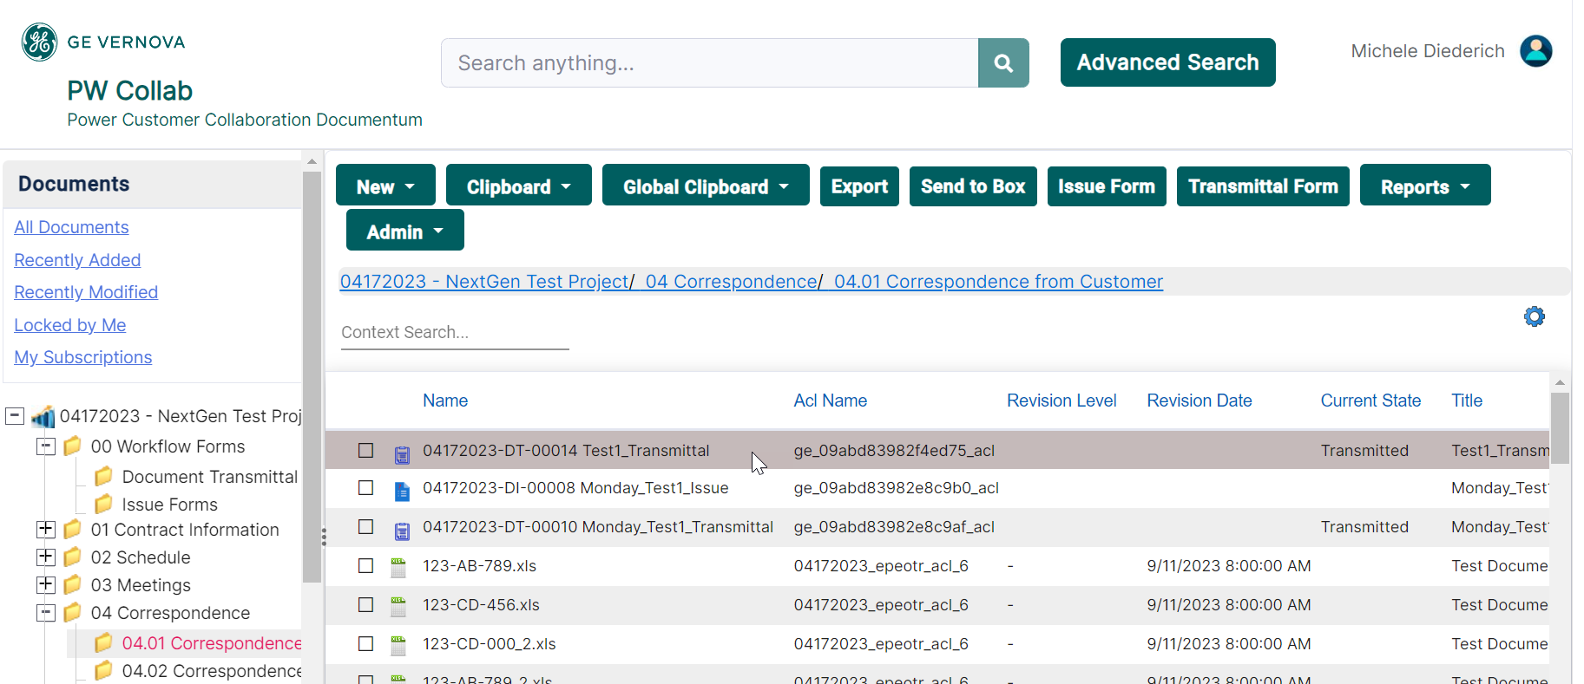
View a Document Transmittal Form
Navigate to the project where the form was created and select the folder it was created in or access the form in the Document Transmittal Forms folder located under 00 Workflow Forms. Double click on the form to view.

Slide 9
Documentum Support
If you encounter any issues with Documentum, please send an email to: ebusinesstechsupport@ps.ge.com and include the following information:
Full Name
Email Address
SSO
Project Name
Screen Shot of any Errors

