Slide 1
Energy Customer Collaboration Documentum:
View Relationships
Batch Export Documents

Slide 2
Module Objectives:
View Form Relationships
Batch Export Documents

Slide 3
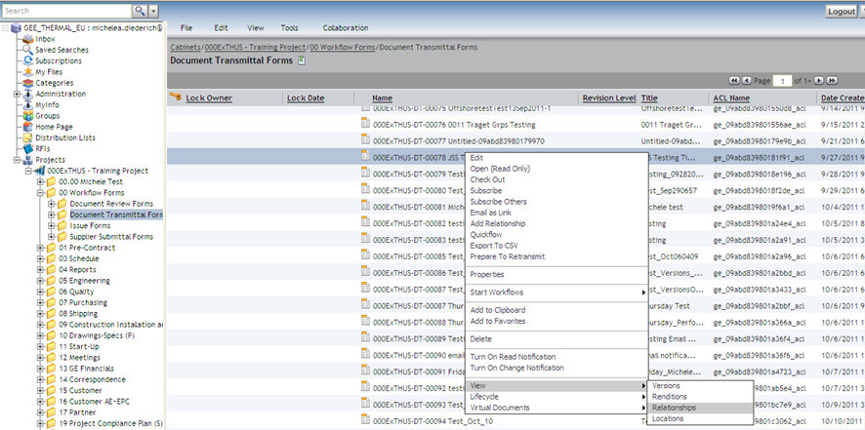
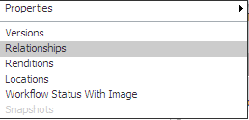
Form Relationships
2.
1.
Select any form (Document Transmittal, Issue Form or RFI) within the 00 Workflow Forms folder or the folder it was created in and either:
Right Click, “View” and then “Relationships” (DT’s) or
Click on “View” and then “Relationships” (Issue Form’s & RFI’s)

Slide 4
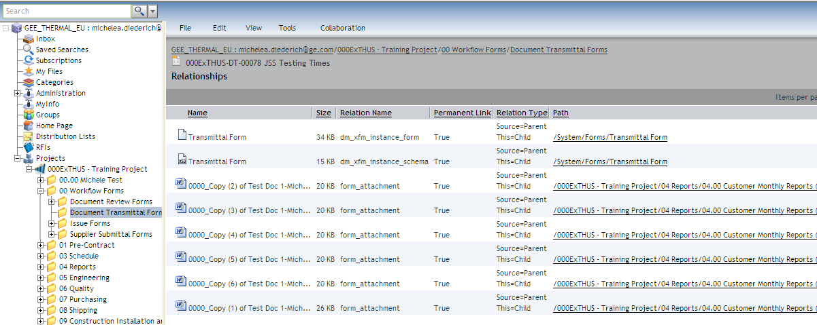
Form Relationships
Relationships list all files linked (attached) to the selected form.

Slide 5
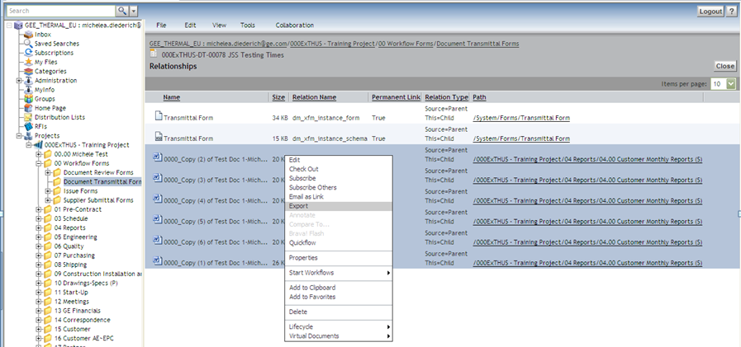
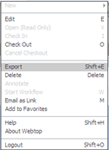
Form Relationships
2.
1.
All files can be exported at once. Highlight all files and either
Right Click, “Export” or
Click on “File” and then “Export”

Slide 6
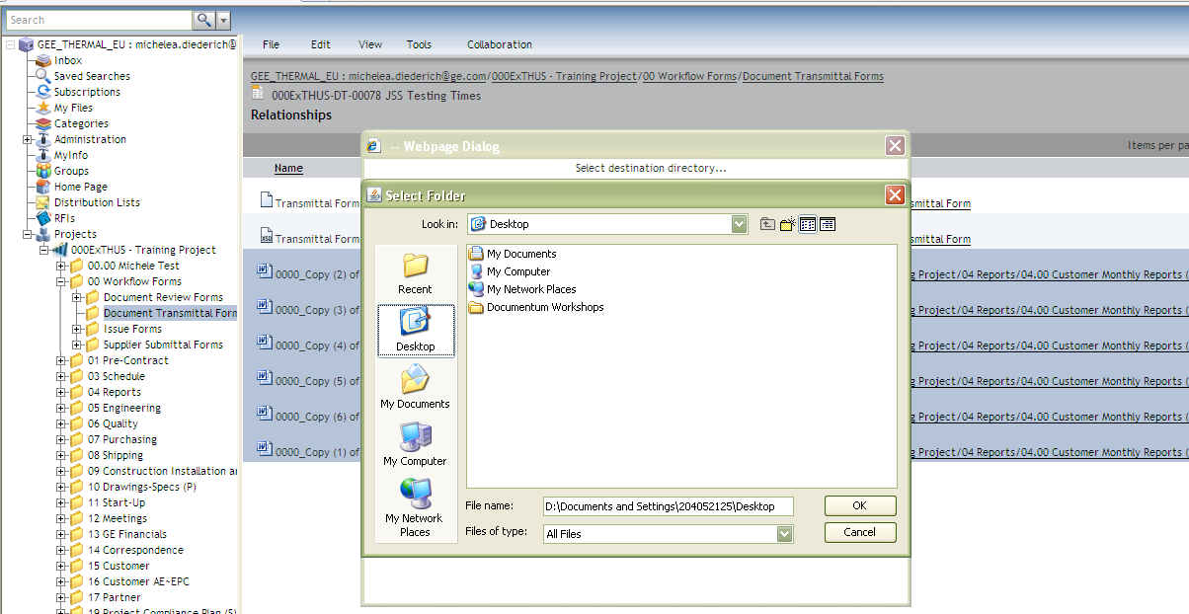
Form Relationships
Navigate to desired location to save files and click “OK”.

