Slide 1
Documentum training
CREATE A NEW FOLDER
Michele Diederich
March 2024

Slide 2
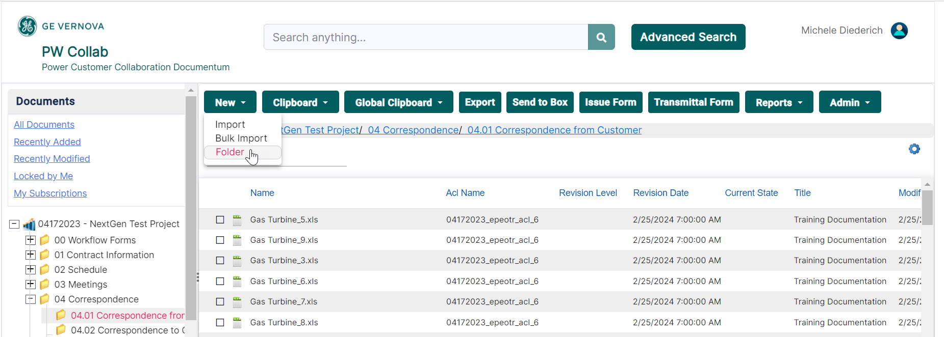
Create a New Folder
  Select the folder in the Navigation Tree where the new folder is to be created. Click New > Folder.

Slide 3
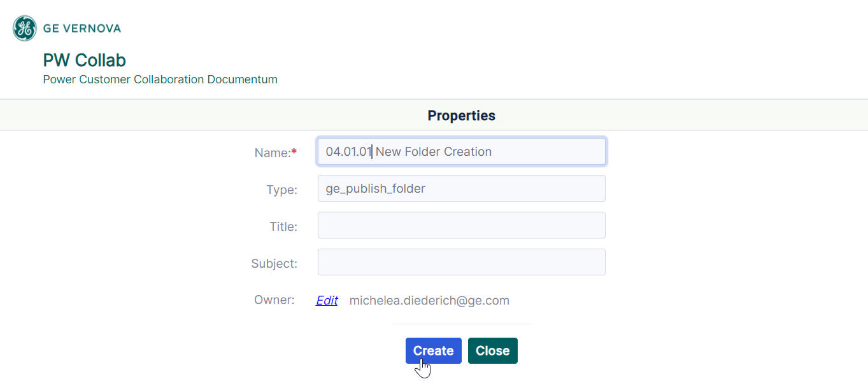
Create a New Folder
  Enter the folder Name and other properties as needed and click Create. Commas, slashes, quotation marks and apostrophes should not be used in the Name.

Slide 4
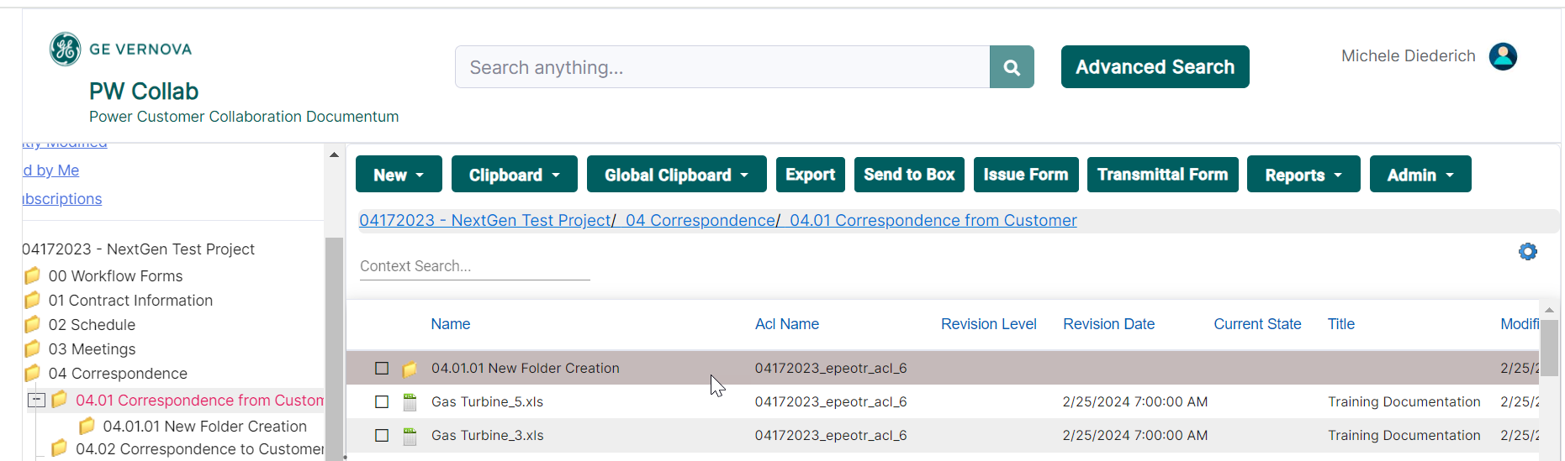
Create a New Folder
  The new folder is created and ready for use. The folder will inherit the security of the parent folder.

Slide 5
Documentum Support
  If you encounter any issues with Documentum, please send an email to: ebusinesstechsupport@ps.ge.com and include the following information:
      Full Name
      Email Address
      SSO
      Project Name
      Screen Shot of any Errors

