Slide 1
Documentum training
Copy, Link and move Files
Michele Diederich
March 2024

Slide 2
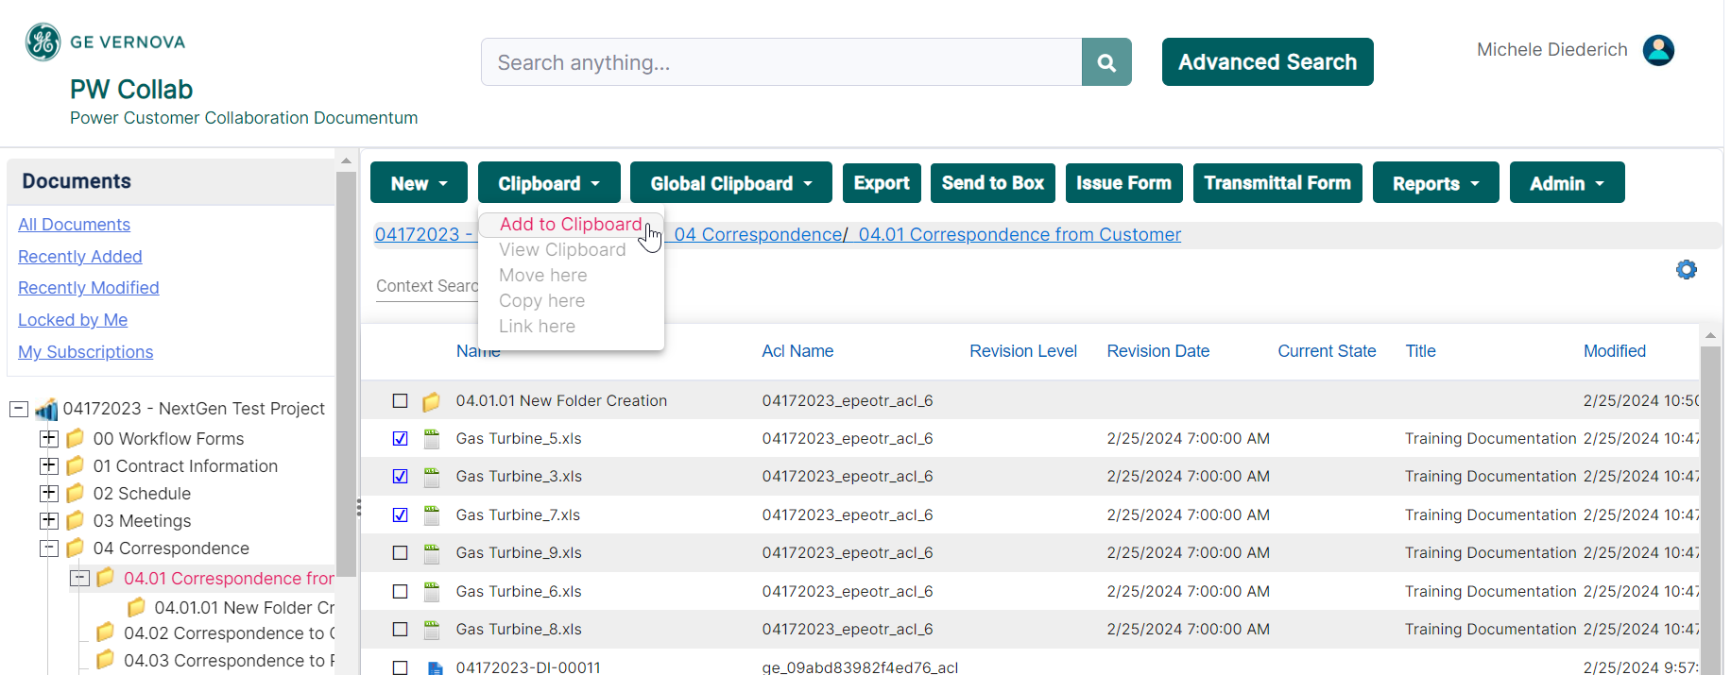
Copy a File
  Select file(s) to be copied and click Clipboard > Add to Clipboard.

Slide 3
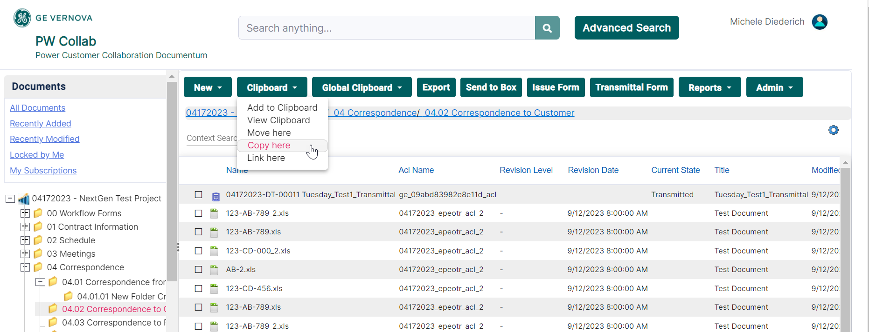
Copy a File
  Navigate to and select the folder where the file(s) is to be copied to. Click Clipboard > Copy Here.

Slide 4
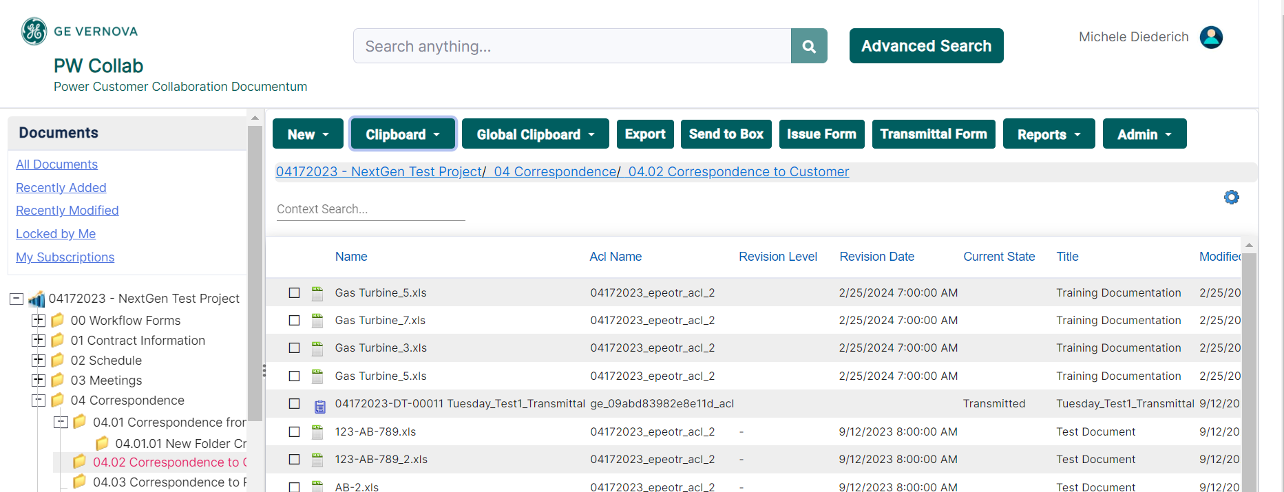
Copy a File
  The file(s) will now appear in the new location. Files will inherit the security of the new location and be consider a new and separate object.

Slide 5
Link a File
  Select file(s) to be linked and click Clipboard > Add to Clipboard.

Slide 6
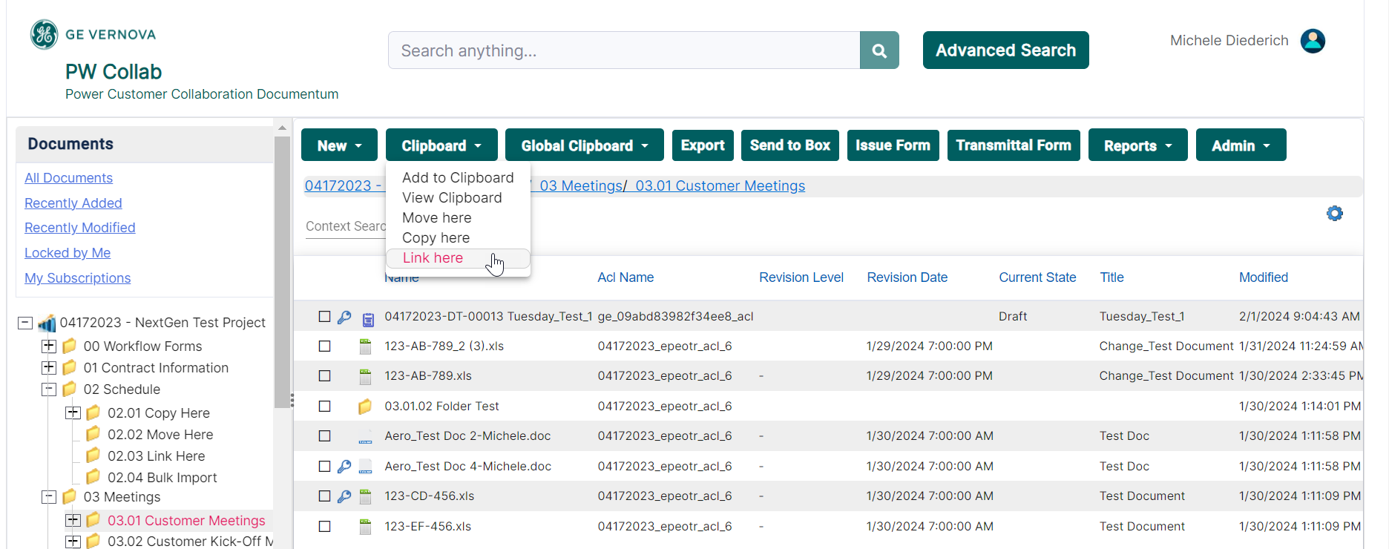
Link a File
  Navigate to and select the folder where the file(s) is to be linked to. Click Clipboard > Link Here.

Slide 7
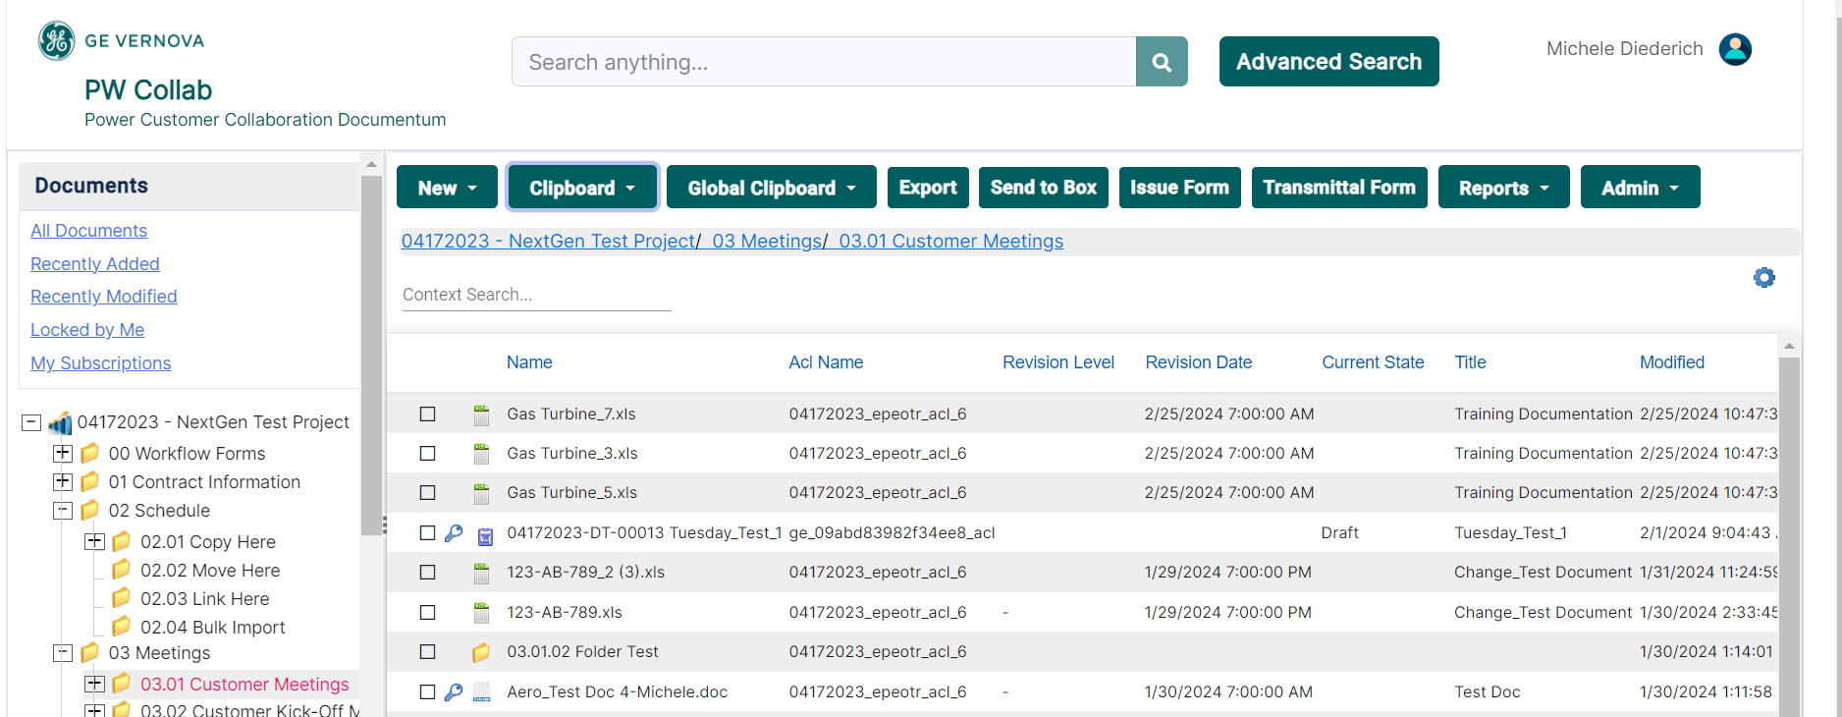
Link a File
  The linked file(s) will now appear in the new location. Files will retain the security from the original location. Changes made to the files will be reflected in both locations.

Slide 8
Move a File
  Select file(s) to be moved and click Clipboard > Add to Clipboard.

Slide 9
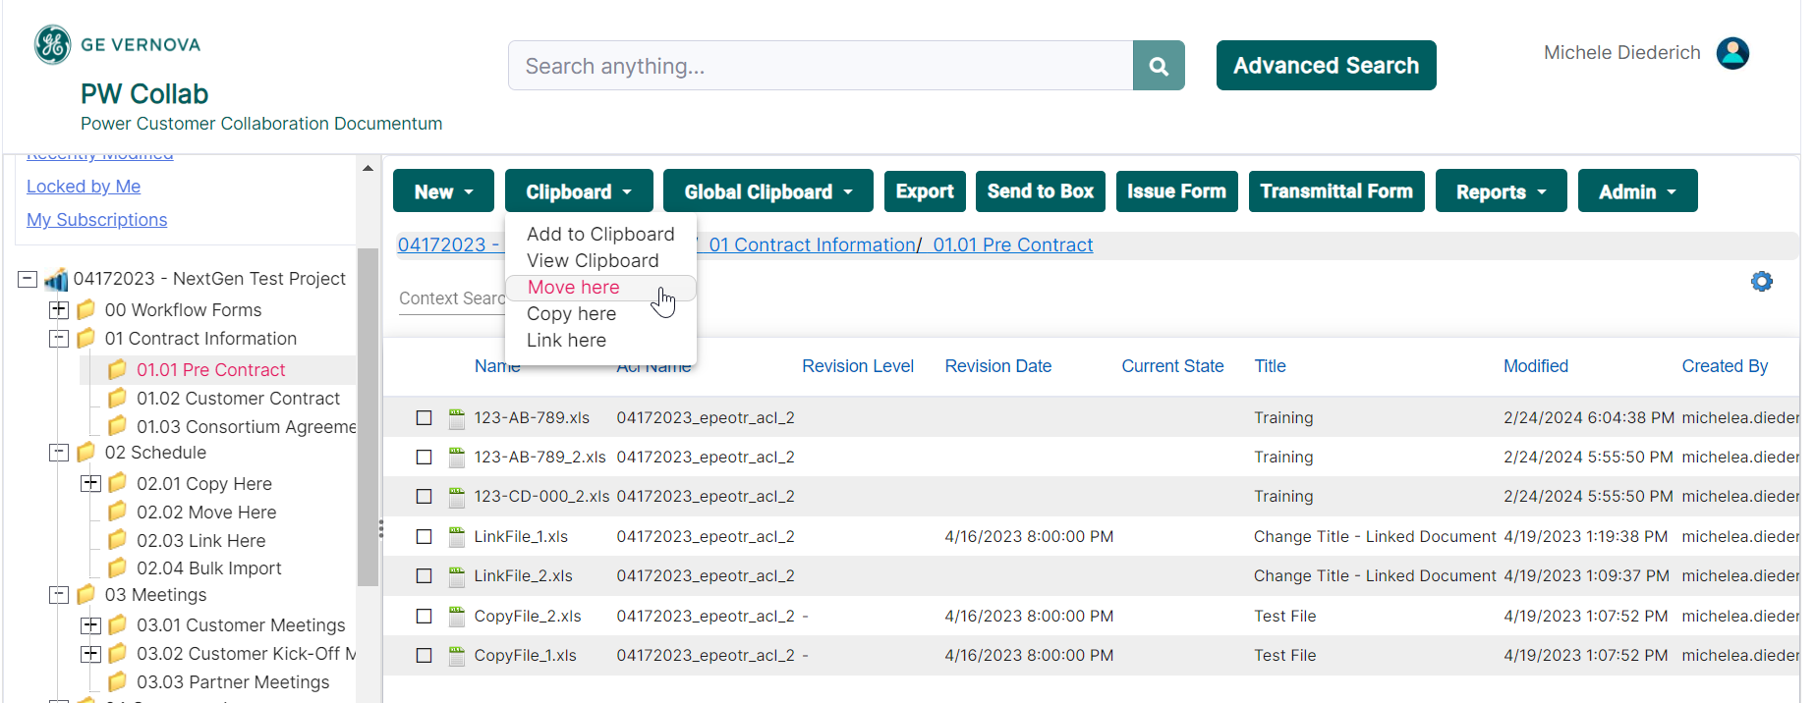
Move a File
  Navigate to and select the folder where the file(s) is to be moved to. Click Clipboard > Move Here.

Slide 10
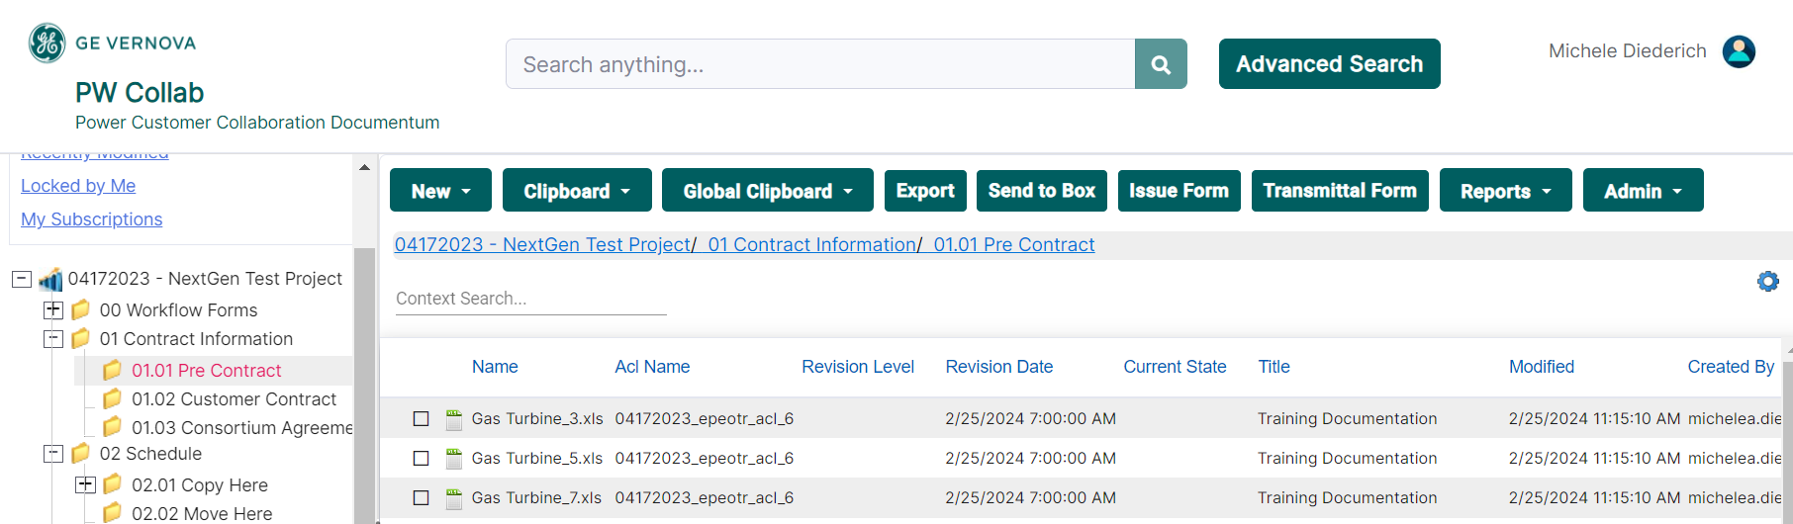
Move a File
  The moved file(s) will now appear in the new location. Files will retain the security from the original location and will only reside in the new location.

Slide 11
Documentum Support
  If you encounter any issues with Documentum, please send an email to: ebusinesstechsupport@ps.ge.com and include the following information:
      Full Name
      Email Address
      SSO
      Project Name
      Screen Shot of any Errors

