Slide 1
Documentum training
Customizing Column Preferences
Michele Diederich
March 2024

Slide 2
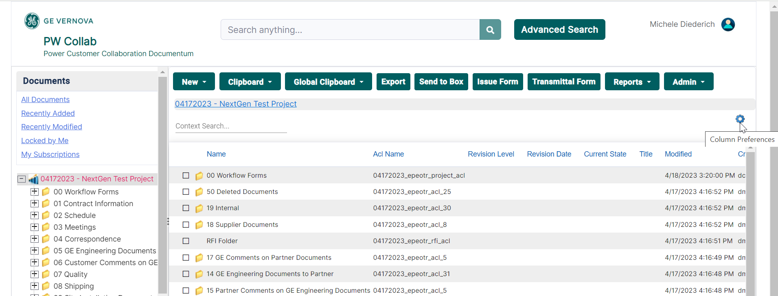
Customize Column Preferences
  Click the Preferences button to open the Preferences window.

Slide 3
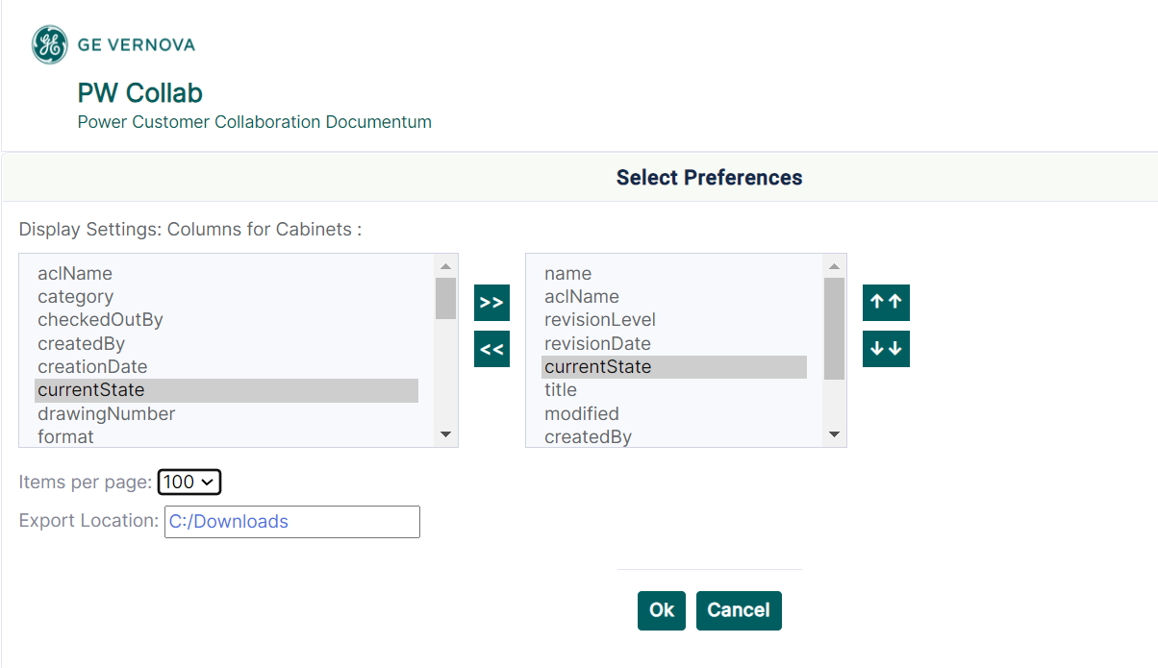
Customize Column Preferences
  In the Preferences window, select the attributes and use the center arrows to display or remove each item. Columns can be reordered using the right-side arrows. Click OK to save changes

Slide 4
Documentum Support
  If you encounter any issues with Documentum, please send an email to: ebusinesstechsupport@ps.ge.com and include the following information:
      Full Name
      Email Address
      SSO
      Project Name
      Screen Shot of any Errors

