Slide 1
Documentum training CKOM Overview
Michele Diederich
March 2024

Slide 2
What is Power Customer Collaboration Documentum?
A secure environment for GE and external companies to exchange all project documents and communications.
The tool has an export control repository, non-export control repository and integrated workflow capabilities to ensure secure collaboration regarding documents, requests and other project related deliverables.
Documentum is suitable for collaborative execution during all project phases: development, inquiry, contract, design, construction, commissioning, operation and warranty.

Slide 3
Benefits of Power Customer Collaboration Documentum:
Provides a secure repository for all project documents.
Provides a secure environment for communication & workflows between GE, customers and suppliers worldwide.
Extends Project Management best practices to GE Global Community.
Increases access to project information, driving consistency, improving time to completion and reducing risk.
Access to all project documents available through user security groups.

Slide 4
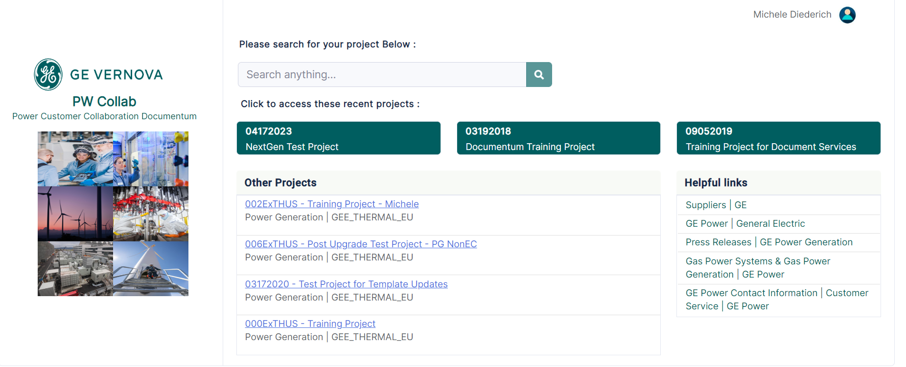
Streamlined Access to Projects
One link to access all projects and a Search field for ease in finding projects.

Slide 5
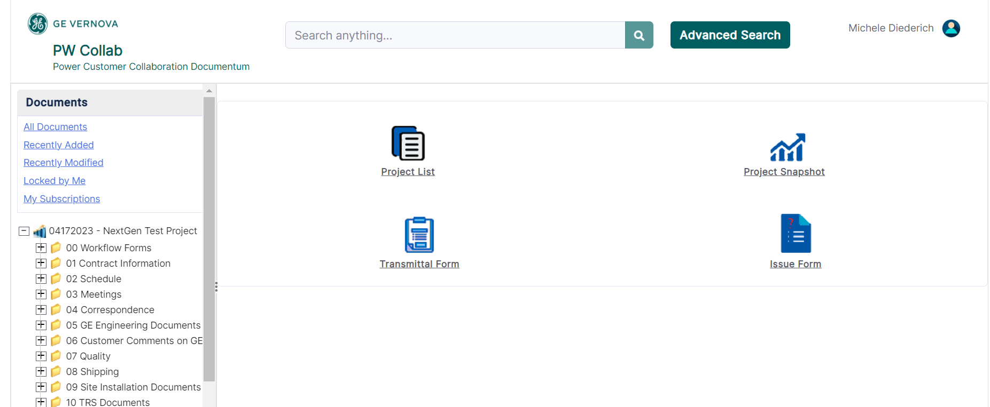
Navigation Tree
The navigation tree provides quick access to Documents, Subscriptions and project folders.

Slide 6
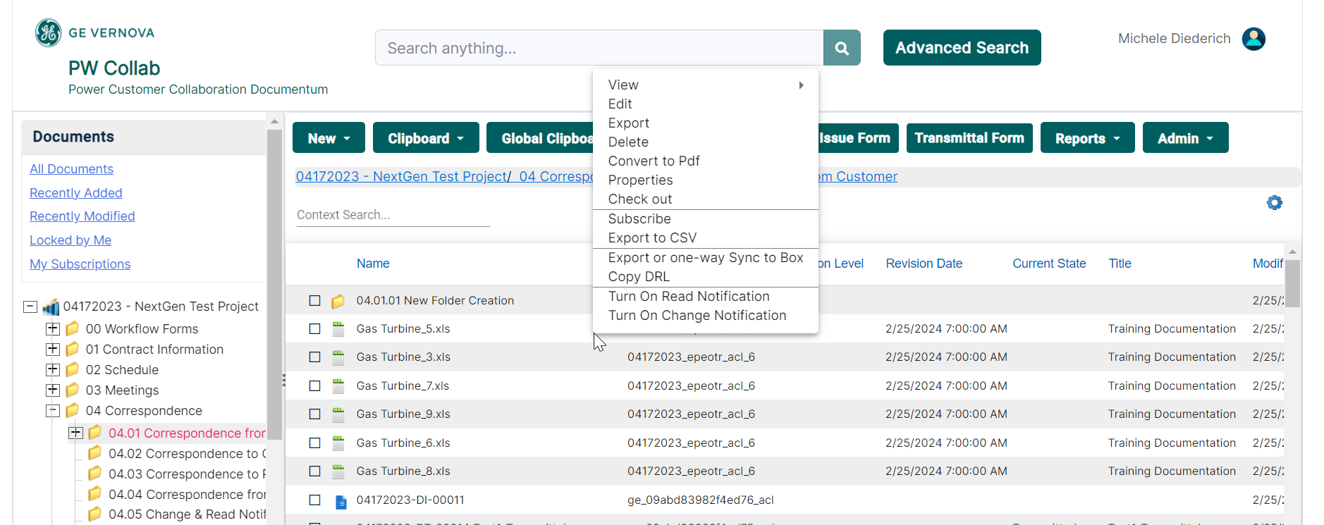
Right-Click Menu
Right-click an item to access all available functionality that can be performed.

Slide 7
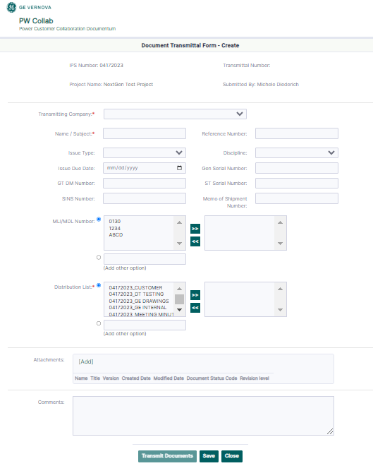
Document Transmittal Form
Document Transmittal Forms are a method to transmit documents between project team members.

Slide 8
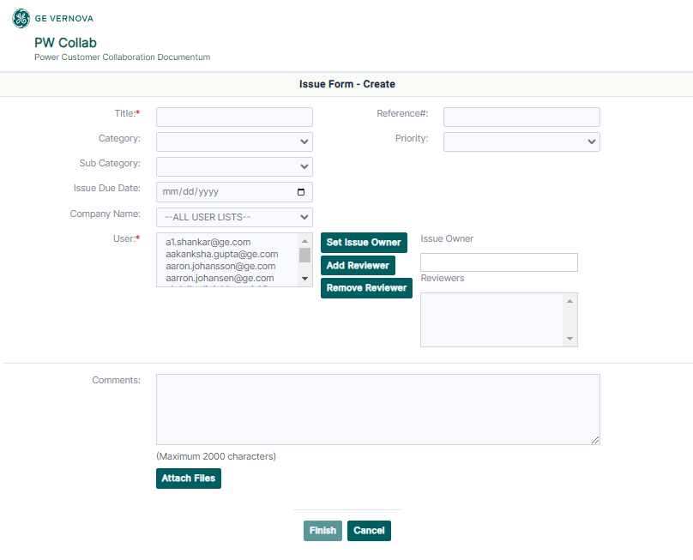
Issue Form
Issue Forms are another method to transmit documents between project team members.

Slide 9
Documentum Support
If you encounter any issues with Documentum, please send an email to: ebusinesstechsupport@ps.ge.com and include the following information:
Full Name
Email Address
SSO
Project Name
Screen Shot of any Errors

