Slide 1
Documentum training Bulk import
Michele Diederich
March 2024

Slide 2
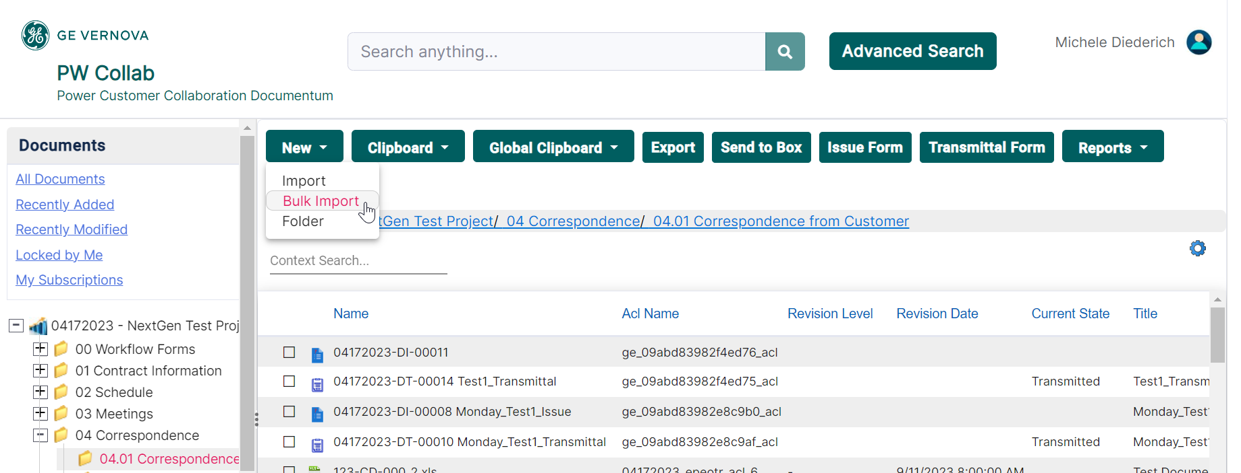
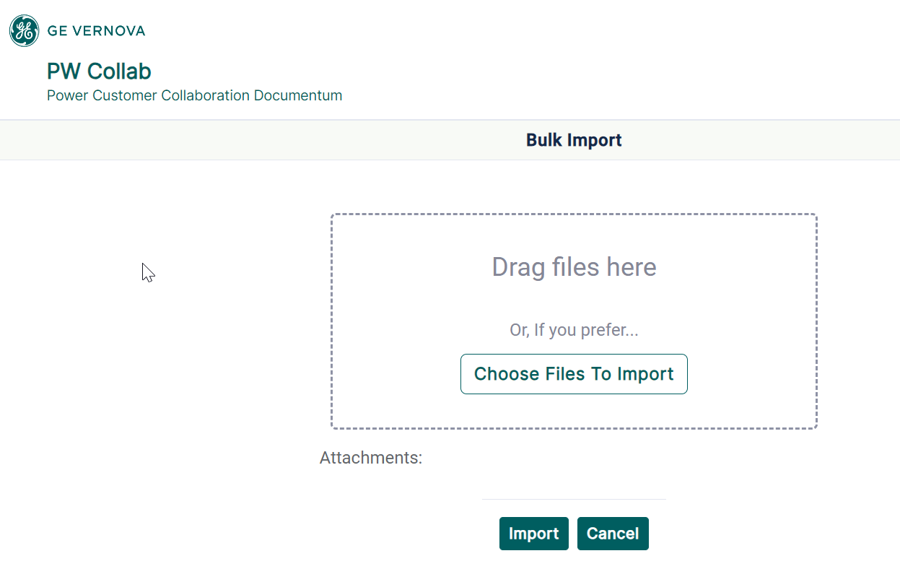
Using Bulk Import
Select the folder where the files are to be imported to. Click New > Bulk Import. Choose the files to be imported (or drag and drop).

Slide 3
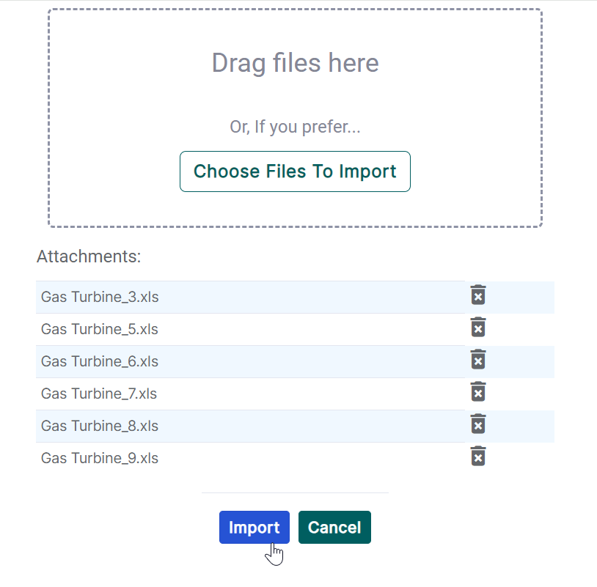
Using Bulk Import
After choosing files click Import.

Slide 4
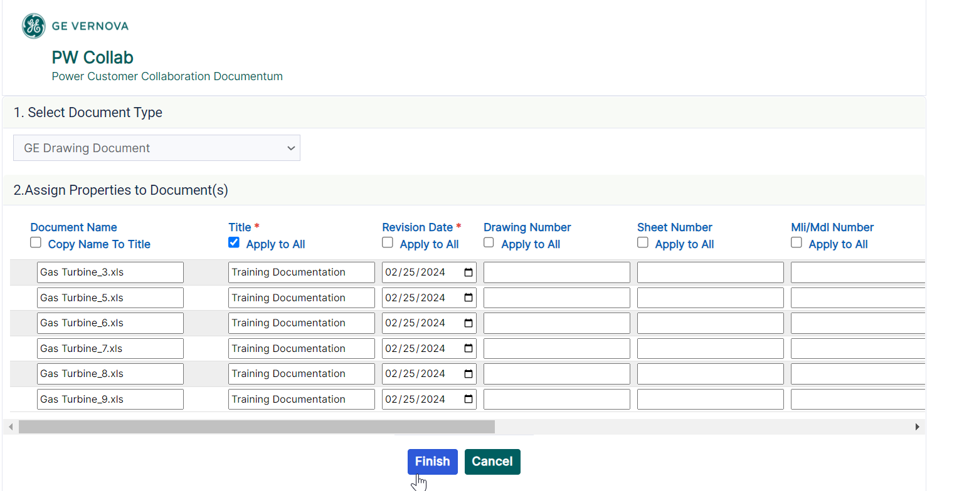
Using Bulk Import
Select the Document Type (GE Document or GE Drawing Document). Add properties for each file individually or use Copy Name to Title or Apply to All. Click Finish to import the files. All required fields are marked with a red asterisk.

Slide 5
Documentum Support
If you encounter any issues with Documentum, please send an email to: ebusinesstechsupport@ps.ge.com and include the following information:
Full Name
Email Address
SSO
Project Name
Screen Shot of any Errors

